Slide 1
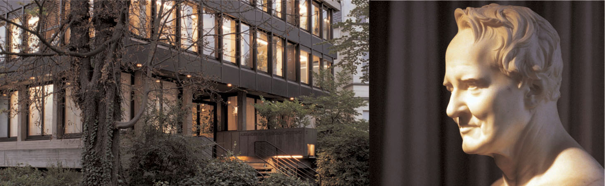
The
Alexander von Humboldt Foundation
Connecting academic excellence worldwide
Knowledge transfer and cooperation at the highest level
Presented by
Andrea Alberti, University of Bonn
Notes:
1
The Alexander von Humboldt Foundation sponsors academic cooperation between top-flight foreign and German academics.

Slide 2

The Humboldt Foundation's areas of work
    sponsorship of international academics as a part of foreign cultural and educational policy
    strengthening cutting-edge research through internationalisation
    impetus for the research location Germany by promoting individuals
    advancing development through academic cooperation
Notes:
2
2
The Alexander von Humboldt Foundation is active in various fields:
- it supports international academics as part of foreign cultural and educational policy
- it strengthens cutting-edge research through internationalisation
- it enables individuals, who provide an impetus for the research location Germany, to spend time researching there
- it promotes development by sponsoring cooperation with researchers from emerging and developing countries

Slide 3

Principles of the Foundation
    sole selection criterion: academic excellence
    no quotas for countries or disciplines
    free choice of research topic and of academic host/collaborative partner in Germany
    sponsorship of people, not projects
Notes:
3
3
The Alexander von Humboldt Foundation promotes outstanding researchers from Germany and abroad with its programmes. Sponsorship decisions are based on the applicant’s achievements and qualifications to date. There are no quotas, neither for countries nor disciplines. The Foundation believes that even in the times of increasing team work the ability of the individual is the crucial factor for academic success. This is why it sponsors people not projects. Those chosen on this basis should be given as much freedom as possible to carry out their research projects. This includes allowing Humboldtians to choose their host institutions themselves and to conduct independent research without any stipulations from the Foundation.

Slide 4

Key Sponsorship Programmes
Flexible sponsorship programmes for cutting-edge researchers at all
stages of their careers
  for postdoctoral researchers
  (doctorates completed less than 4 years ago)
    Research Fellowships; 6 to 24 months; €2,650 per month
    Feodor Lynen Research Fellowships; 6 to 24 months abroad
  for junior research group leaders
  (doctorates completed less than 6 years ago)
    Sofja Kovalevskaja Award; up to €1.65 million, to establish their own junior research group in Germany
Notes:
The Alexander von Humboldt Foundation offers flexible sponsorship programmes for cutting-edge researchers at all stages of their careers.
Postdoctoral researchers from abroad who are just embarking on their academic careers and who completed their doctorates less than four years ago, may apply for extended periods of research (6-24 months) in Germany. Applicants are responsible for choosing their own research project and host in Germany.
For postdoctoral researchers from Germany, the Foundation offers the opportunity to carry out long-term research projects at institutes outside Germany. One of the hosts must be a academic previously sponsored by the Foundation.
Successful top-rank junior researchers from abroad, who have completed their doctorate with distinction in the last six years, are eligible to apply for the Sofja Kovalevskaja Award. Award winners may spend five years building up working groups and working on a high-profile, innovative research project of their own choice at a German research institution they have selected themselves. The award is valued at €1.65 million.

Slide 5

Key Sponsorship Programmes
  for experienced researchers with an own, clearly defined academic profile
    Humboldt Research Fellowships
    (doctorates completed less than 12 years ago)
    6 to 18 months; €3,150 per month
    Friedrich Wilhelm Bessel Research Award
    (doctorates completed less than 18 years ago)
    up to €45,000 ; research stay in Germany; nomination
Notes:
Research Fellowships for experienced researchers are the tool with which the Alexander von Humboldt Foundation enables highly-qualified scientists and scholars from abroad, who completed their doctorates less than twelve years ago, to spend extended periods of research (6-18 months; may be divided up into a maximum of three blocks) in Germany. Candidates are expected to have their own, clearly defined academic profile. This means they should usually be working at least at the level of Assistant Professor or Junior Research Group Leader or be able to document independent research work over a number of years.
The Alexander von Humboldt Foundation awards Friedrich Wilhelm Bessel Research Awards to internationally renowned academics from abroad, who have completed their doctorate within the last 18 years, in recognition of the outstanding academic performance of these excellent researchers. The award winners are also invited to undertake research projects of their own choice in Germany, in cooperation with colleagues from their own discplines, for a period of approx. 6-12 months (can be divided up into shorter periods of time). The award is valued at €45,000. Nomination; self-nomination is not possible.

Slide 6
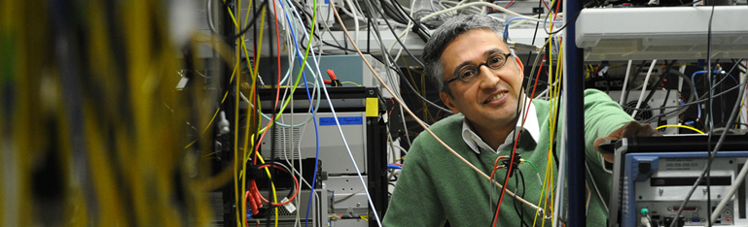
Key Sponsorship Programmes
  for internationally recognised cutting-edge researchers
    Humboldt Research Award
    €60,000; research stay in Germany; nomination
    Alexander von Humboldt Professorship; 3.5 - 5 million euros for a period of 5 years, for the long-term recruitment of established cutting-edge researchers from abroad; nominations by German universities
Notes:
With the Humboldt Research Awards and the Georg Forster Research Awards, the Alexander von Humboldt Foundation honours internationally eminent academics from abroad or from developing countries respectively in recognition of their entire academic record to date. The award winners are also invited to undertake research projects of their own choice in Germany, in cooperation with colleagues from their disciplines, for a period of approx. 6-12 months (can be divided up into shorter periods of time).
The Award is valued at €60,000. To support the collaboration, the Humboldt Foundation may grant additional funding of up to €25,000 to Georg Forster Research Award winners, particularly for participating in scientific conferences, additional material resources, e.g., specialist literature and scientific equipment for the nominee’s own institute, as well as for involving junior researchers. Nomination; self-nomination is not possible.
Academics of all disciplines from abroad, who are internationally recognised as leaders in their field and who are expected to contribute to enhancing Germany's sustained international competitiveness as a research location in consequence of the award, are eligible to be nominated for an Alexander von Humboldt Professorship.
The Alexander von Humboldt Professorship, which is being financed by the Federal Ministry of Education and Research through the International Research Fund for Germany, enables award winners to carry out long-term and ground-breaking research at universities and research institutions in Germany. The award amount, totalling 5 million euros for academics in experimental disciplines and 3.5 million euros for researchers in theoretical disciplines, is being made available for a period of five years.
Nominations may be made by German universities; non-university research institutions may also submit nominations jointly with a German university.

Slide 7
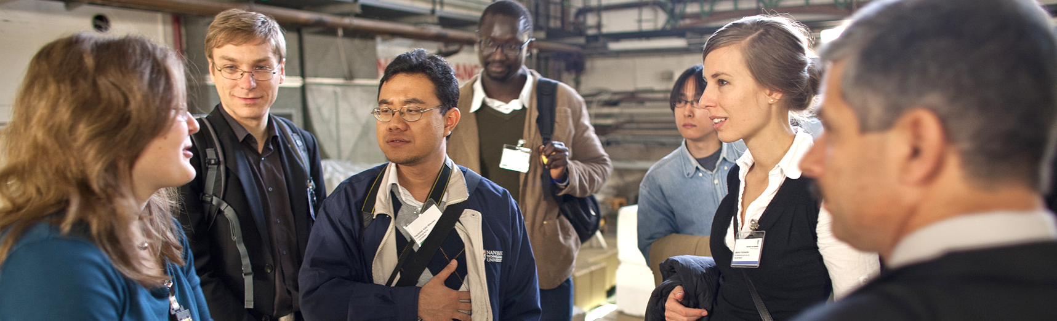
Alumni sponsorship and international networking
    more than 29,000 Humboldtians in over 140 countries:
    “Once a Humboldtian – always a Humboldtian“
    alumni sponsorship and international networking through e.g.
      further research stays
      Research Group Linkage Programme
      Humboldt Colloquia and Kollegs
      Humboldt Alumni Associations
      Humboldt Alumni Award
Notes:
7
7
“Once a Humboldtian – always a Humboldtian" – from the very beginning this was the hallmark of the Alexander von Humboldt Foundation. Humboldt sponsorship is enduring: the Foundation is a lifetime partner, maintaining the connections on a long-term basis through its alumni sponsorship programmes. As a result, an active knowledge network of more than 28,000 Humboldtians has been laid across the whole academic world – embracing over 140 states. The alumni sponsorship measures provide flexible support for the individual life paths and development of Humboldtians. Moreover, the Foundation encourages its alumni to undertake their own initiatives and collaborations across disciplinary and national borders.
Amongst other things, networking sponsorship caters for further research stays to Germany. This gives fellows a chance to revitalise relationships to specialist colleagues and their institutes or make contacts with new partners, continue joint projects already underway, or build new collaborations.
The Research Group Linkage Programme allows Humboldtians to apply for sponsorship in order to cooperate over a period of three years with a researcher working at a German institute and additional cooperation partners in other countries.
The Alexander von Humboldt Foundation regularly organises colloquia abroad to which it invites research fellows and research award winners living in the host country or region, as well as Feodor Lynen fellows working there.
Since 2002, the Alexander von Humboldt Foundation has provided financial support for Humboldt Alumni Associations as well as for individual Humboldtians to organise regional and specialist conferences. These Humboldt Kollegs have become one of the most popular instruments for strengthening regional and specialist networks. Apart from networking, the Kollegs serve to awaken the interest of young academics in the Foundation’s programmes and in Germany as a location for research.
The Alexander von Humboldt Foundation’s Humboldt Alumni Awards for innovative networking initiatives are granted to fellows and award winners abroad. Each award is valued at up to €25,000. Four awards are granted annually, including one that is earmarked to sponsor initiatives promoting networking between female academics. The awards are designed to support projects not covered by the Foundation's existing sponsorship and alumni programmes and to promote academic and cultural relations between Germany and the Humboldt alumni's own countries as well as to strengthen their collaboration in the respective regions. The Humboldt Alumni Award earmarked for networking between female academics targets initiatives which promote and strengthen the long-term career paths of female researchers and their collaborative partners within the respective networks whilst taking account of their professional and family obligations. It also seeks to encourage more female researchers to participate in the Foundation’s sponsorship programmes.

Slide 8
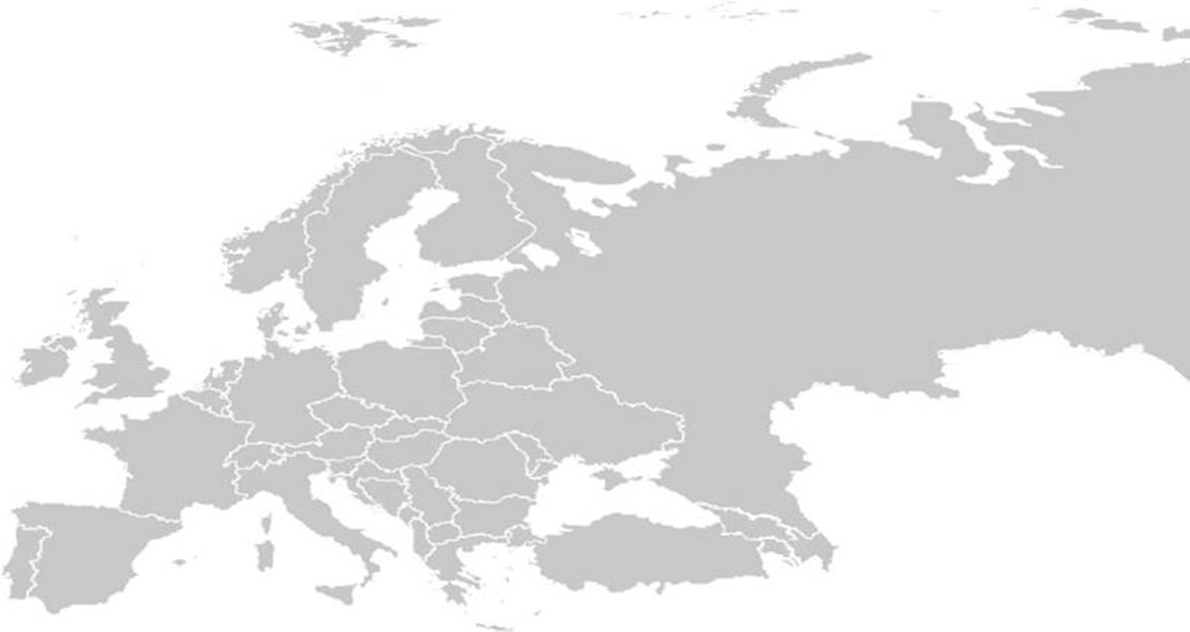
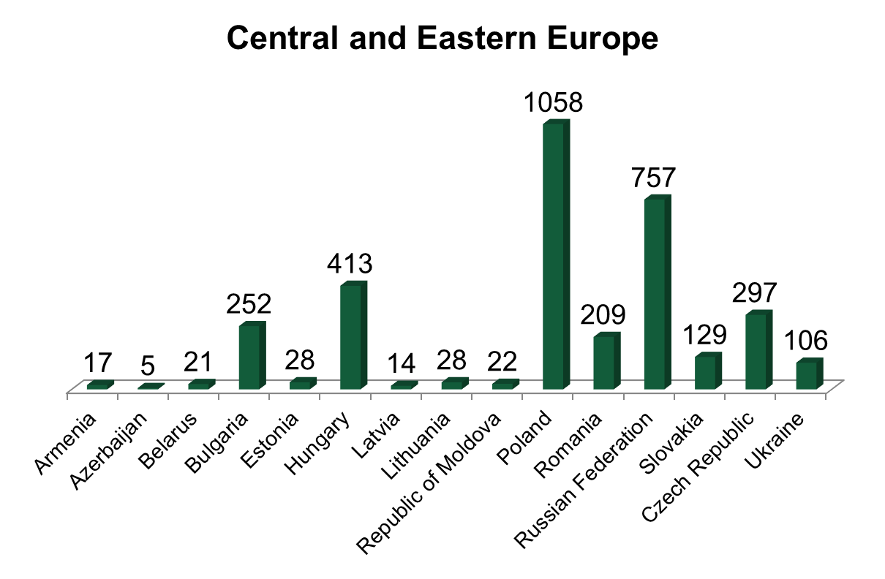
Humboldt Network in
Central and Eastern Europe
Notes:
There are currently 14,637 Humboldt Research Fellows and Awardees as well as Feodor Lynen Research Fellows in Europe.
The alumni networks in Central and Eastern Europe have a total of 3,356 Humboldtians.
In Germany the Humboldt Network has 5,410 members.
Source: Annual Report 2017

Slide 9
Key sponsorship programmes at a glance
 | Academics from abroad | Academics from Germany
Postdoctoral researchers (up to 4 years after completion of doctorate) | Humboldt Research Fellowship Georg Forster Research Fellowship | Feodor Lynen Research Fellowship
Junior research group leaders (up to 6 years after completion of doctorate) | Sofja Kovalevskaja Award
Experienced researchers (up to 12 years after completion of doctorate) | Humboldt Research Fellowship Georg Forster Research Fellowship | Feodor Lynen Research Fellowship
(up to 18 years after completion of doctorate) | Friedrich Wilhelm Bessel Research Award
Internationally renowned academics | Humboldt Research Award Georg Forster Research Award Anneliese Maier Research Award Max Planck-Humboldt Research Award Alexander von Humboldt Professorship
Notes:
9
9
The Alexander von Humboldt Foundation sponsors:
academics at different career stages, usually after completion of a doctorate
academics from abroad who wish to conduct research in Germany
academics from Germany who wish to conduct research abroad
(Gestaltungsvorschlag: Programme, die für das spezifische Publikum nicht interessant/relevant sind, können in grauer Schriftfarbe dargestellt werden.)

Slide 10





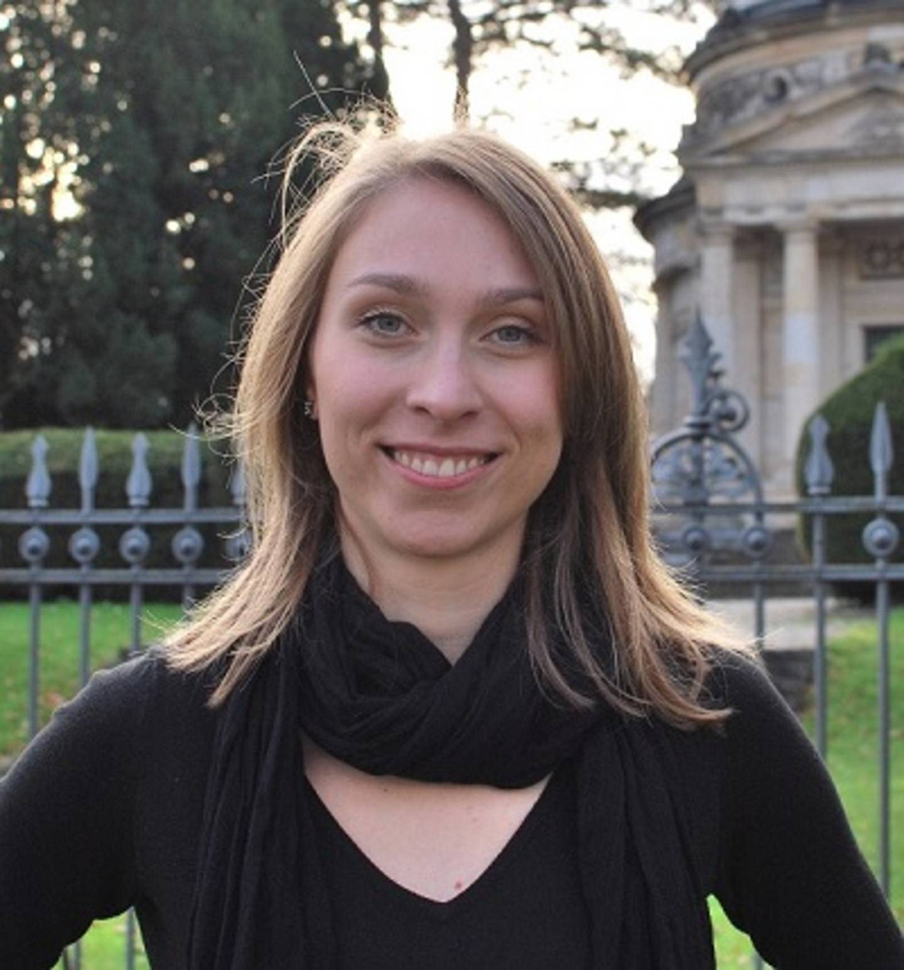
Contact and Information
www.humboldt-foundation.de
info@avh.de
+49 228 833-0
@AvHStiftung
www.youtube.com/AvHStiftung
Contact person for
Central and Eastern Europe
Rebecca Großmann
Rebecca.Grossmann@avh.de
Notes:
If you have any questions about the Humboldt Foundation’s work or would like to obtain
information on applications please contact info@avh.de directly.
Rebecca Großmann email + Foto

