Slide 1
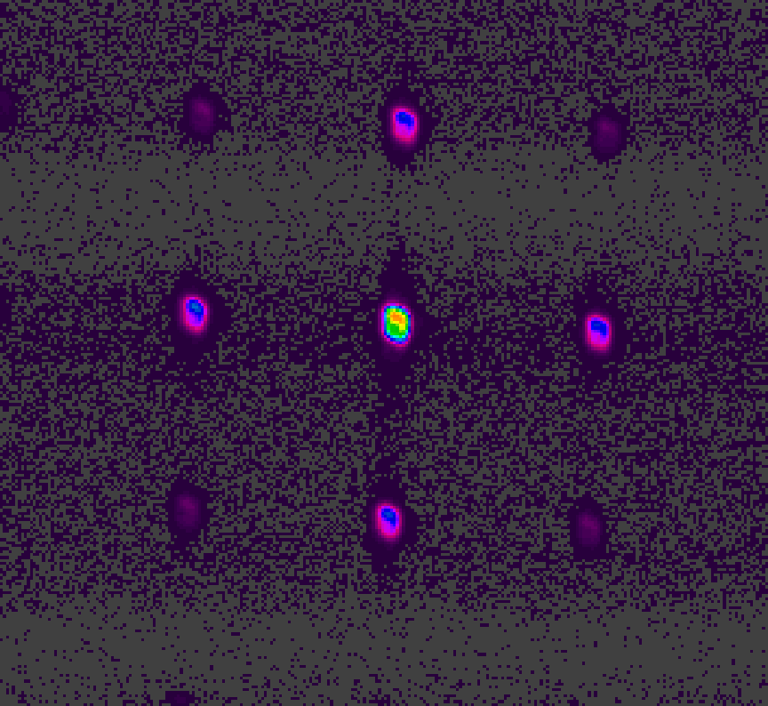
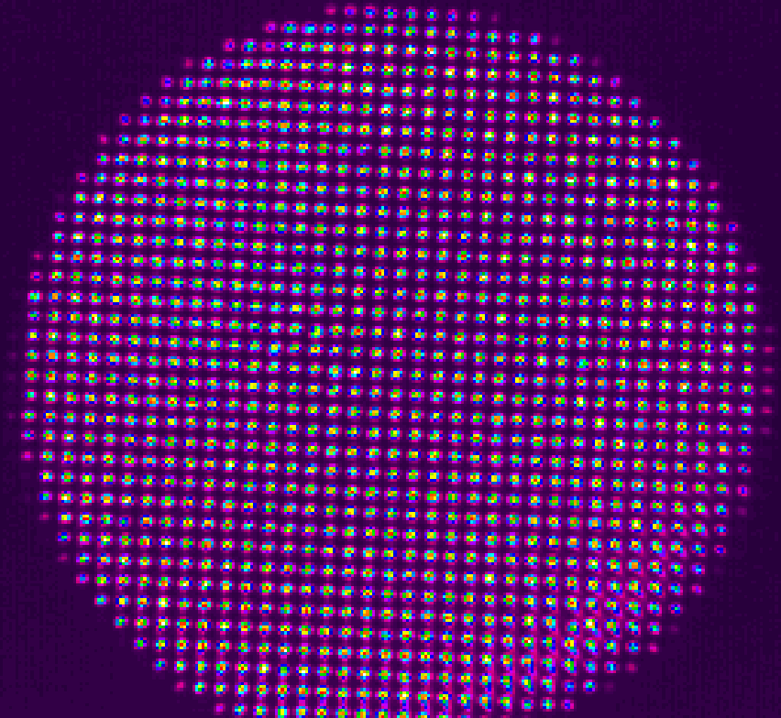
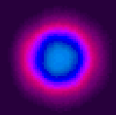
Solving hard computational problems with coupled lasers
?
Nir Davidson
Ronen Chriki, Vishwa Pal, Chene Tradonsky, Gilad Barach, Micha Nixon, Eitan Ronen, Moti Fridman and Asher Friesem
Weizmann Institute of Science
Far-Field
no coupling
Far-Field
with coupling
1500 lasers

Slide 2
Solving hard computational problems with coupled lasers
?
Nir Davidson
Ronen Chriki, Vishwa Pal, Chene Tradonsky, Gilad Barach, Micha Nixon, Eitan Ronen, Moti Fridman and Asher Friesem
Weizmann Institute of Science
(I also present a poster on cold atoms tomorrow)

Slide 3

Coherent computing: basic principle
Value
Value
$$e^{−N}{}$$
Parameter
Parameter
“Easy”
“Hard”

Slide 4
Coherent computing: basic principle
Physical System
Simulated
annealing
Energy
Value
Physical
Parameter
A. Marandi et al, Nature Photon. 8, 937 (2014)
Notes:
SIMULATED ANNEALING!!!

Slide 5
Coherent computing: basic principle
Physical System
Simulated
annealing
Energy
Value
Physical
Parameter
Laser System
Loss
gain = loss
gain < loss
Laser Phase
A. Marandi et al, Nature Photon. 8, 937 (2014)

Slide 6
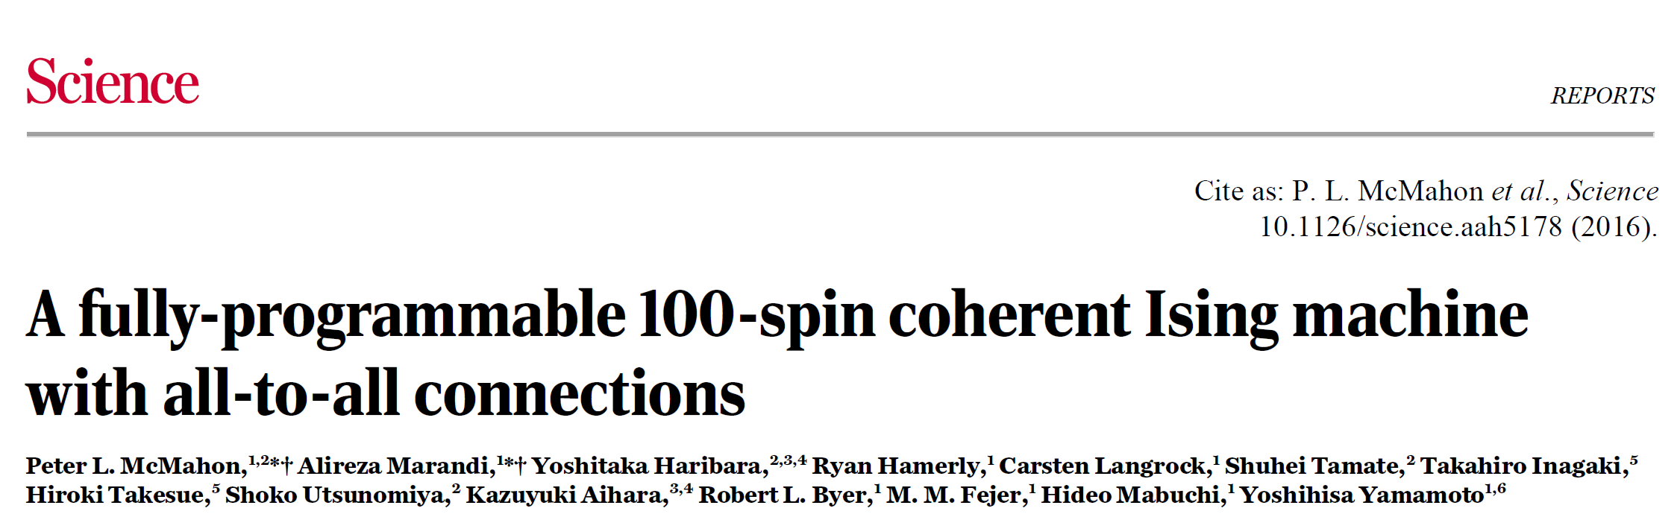


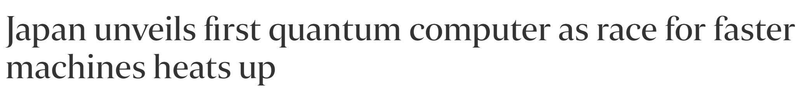
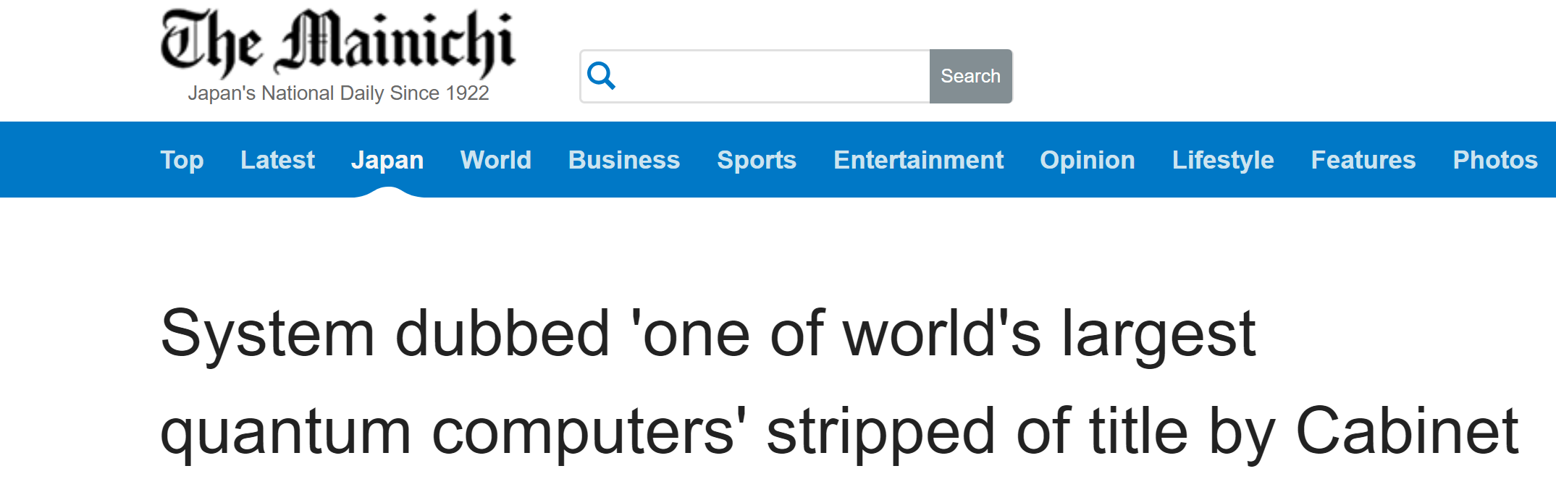


Slide 7
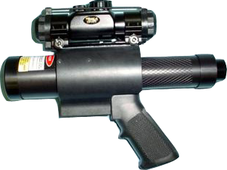
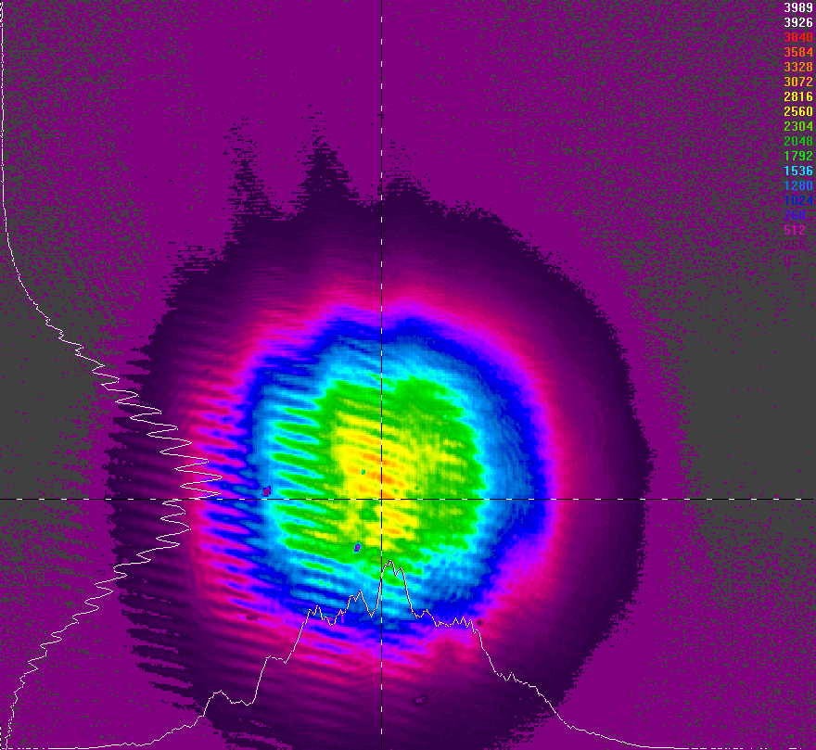
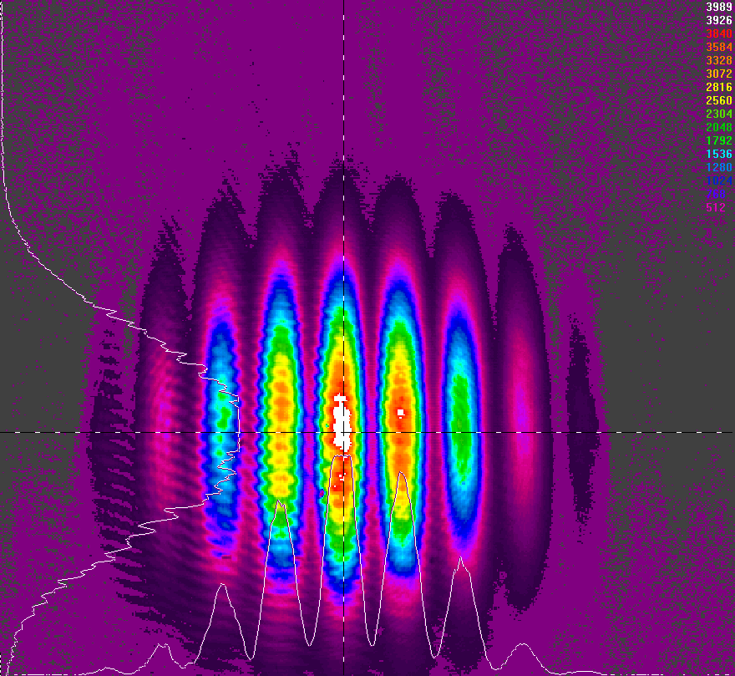
What is phase locking ?
Coupling

Slide 8
Diffractive coupling
mirror
mirror
Far Field
Nd-Yag
GAIN
Lens
Mask
Short range coupling
Dissipative coupling: minimizes losses

Slide 9

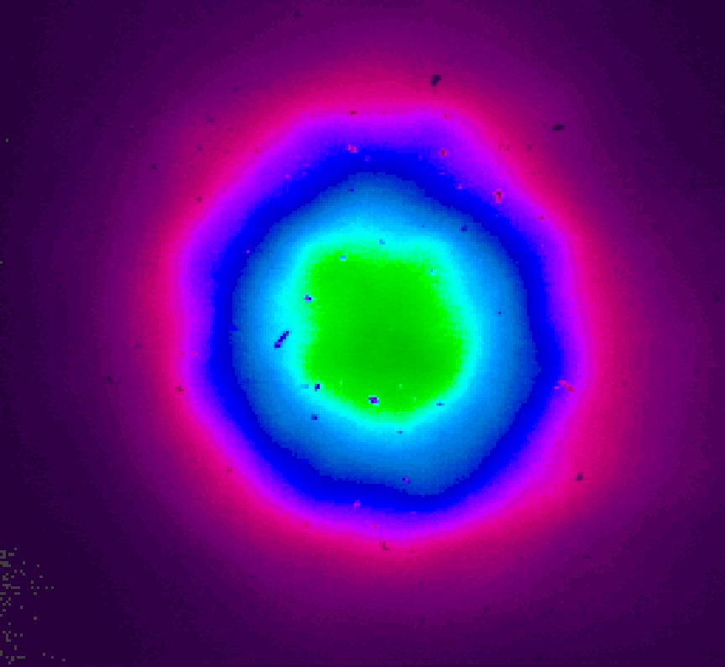
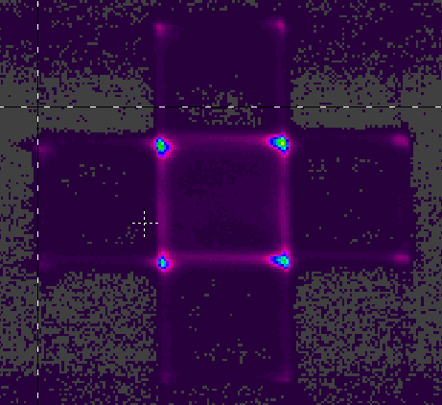
Degenerate cavity: square array
Output coupler
Lens
Lens
Mirror
GAIN
No coupling
Negative coupling
Far
Field
M. Nixon et. al., PRL 106, 223901 (2011); PRL 108, 214101 (2012)

Slide 10
Degenerate cavity: square array
Output coupler
Lens
Lens
Mirror
GAIN
No coupling
Negative coupling
Positive coupling
Far
Field
M. Nixon et. al., PRL 106, 223901 (2011); PRL 108, 214101 (2012)

Slide 11
Lasers
Spins
0
π
0
π
π
0
π
0
0
π
0
π
π
0
π
0
Kuramoto Model
Classical XY model
M. Nixon et. al., PRL 110, 184102 (2013)

Slide 12
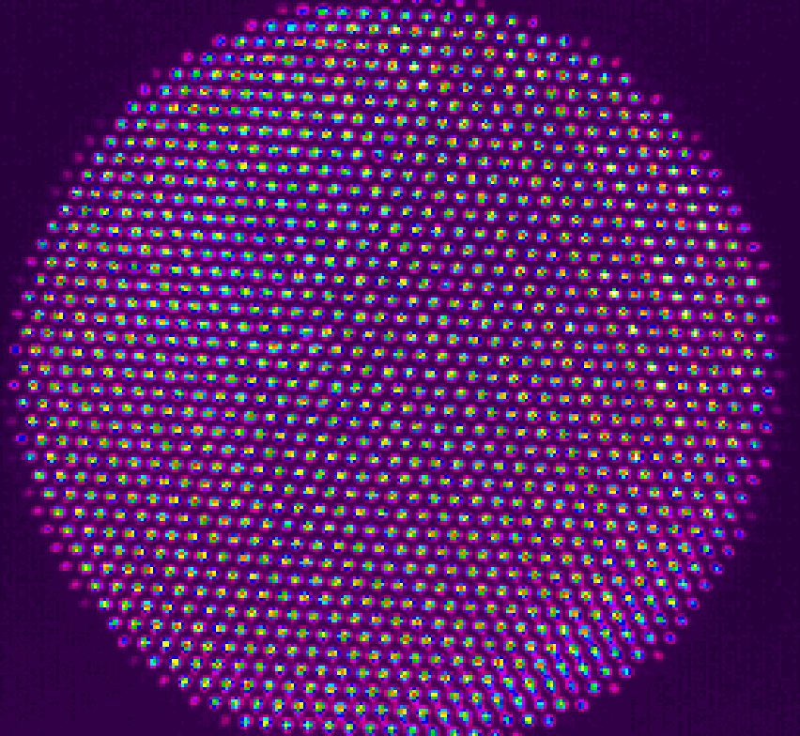
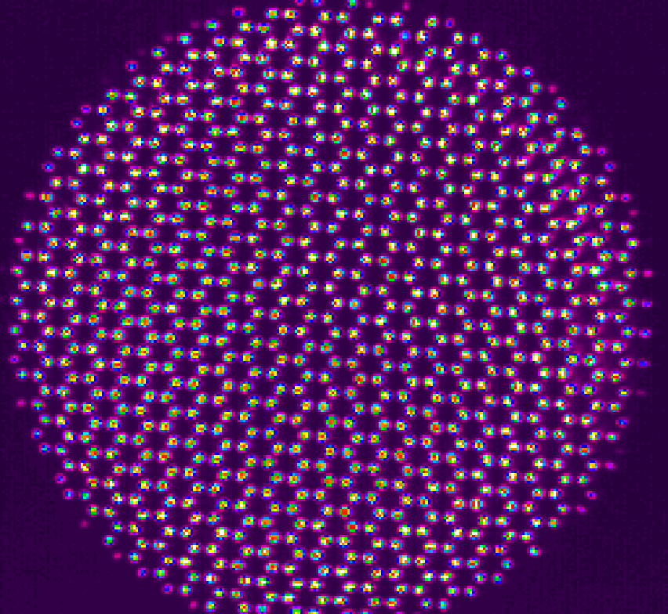
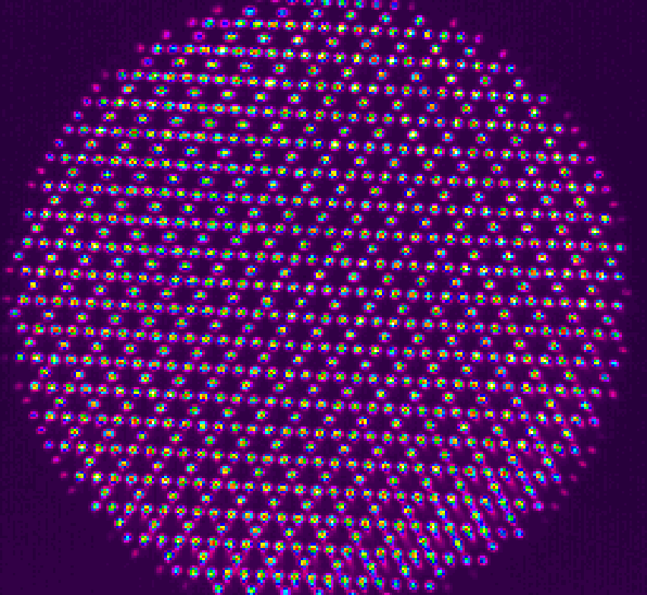
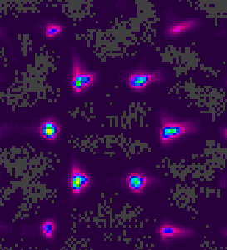
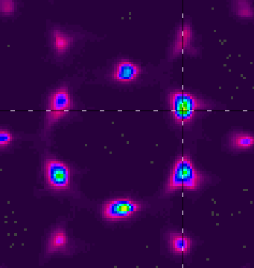
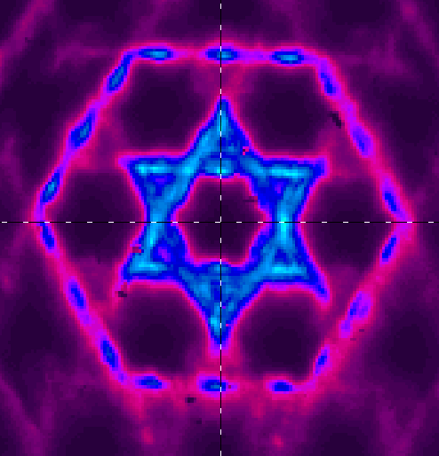
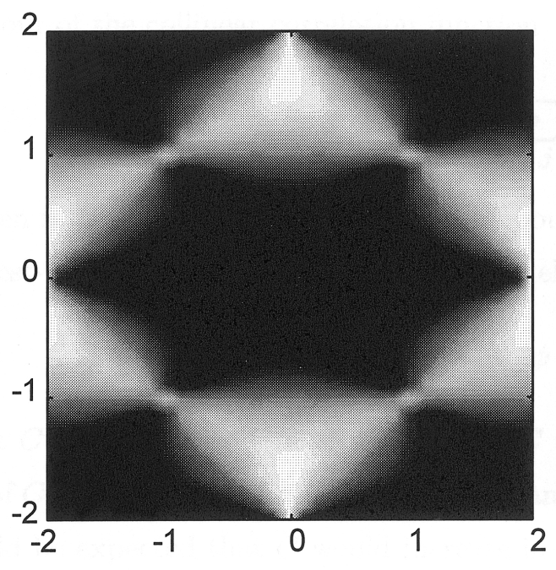
Large arrays (NN coupling)
Triangular
lattice
Hexagonal
lattice
Kagome
lattice
0
π
0
2π/3
+
-
2π/3
0
π
0
π
0
π
π
0
Near
Fields
Moessner and Chalker
PRB 58 12049 (1998)
Far
Fields
M. Nixon et. al., PRL 110, 184102 (2013); V. Pal unpublished

Slide 13
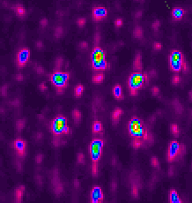
Large arrays (NN coupling)
Triangular
lattice
Hexagonal
lattice
Kagome
lattice
0
π
0
2π/3
+
-
2π/3
0
π
0
π
0
π
π
0
Near
Fields
NNN coupling
Far
Fields
M. Nixon et. al., PRL 110, 184102 (2013); V. Pal unpublished

Slide 14
Quasi crystals and random arrays
Near Field
Far Field
C. Tradensky et. al., unpublished

Slide 15
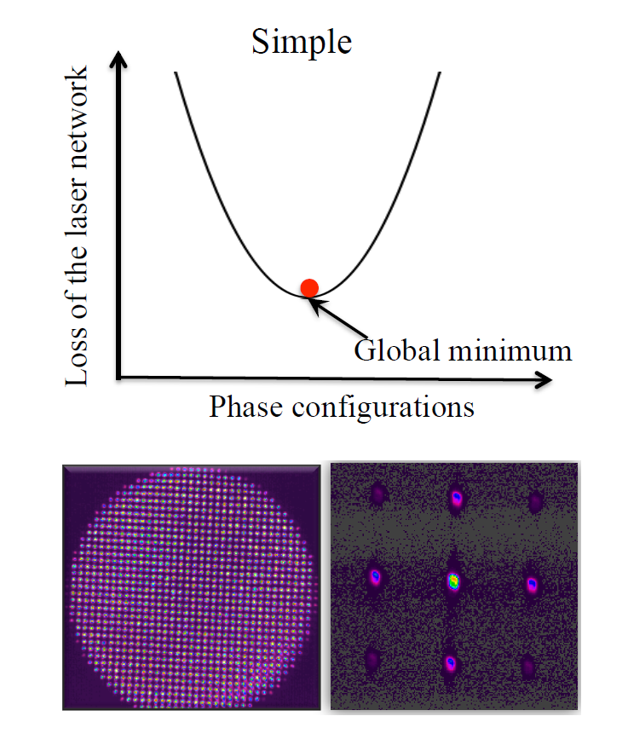
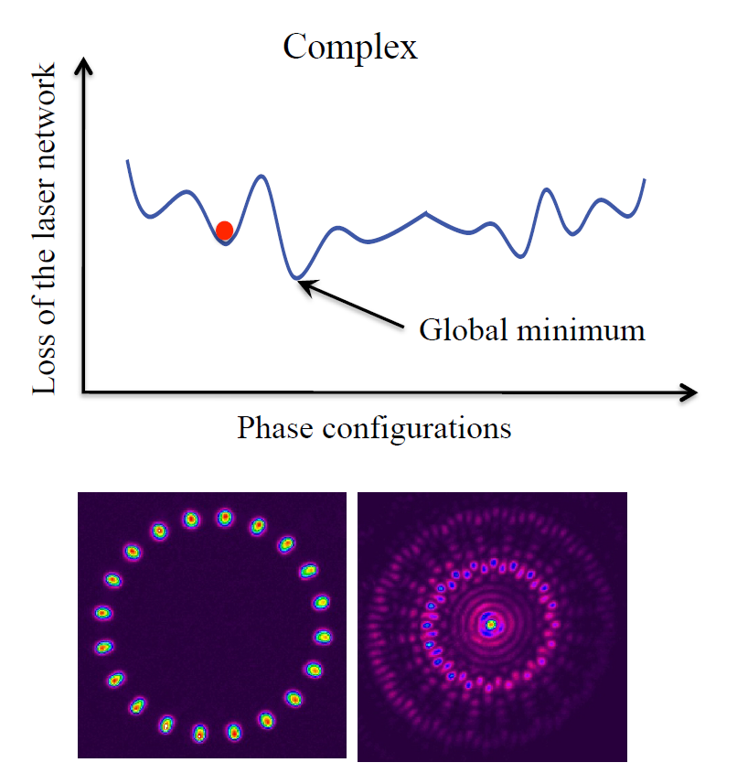
“Hard” problems have complex landscape
V. Pal et. al., PRL 119, 1013902 (2017)

Slide 16
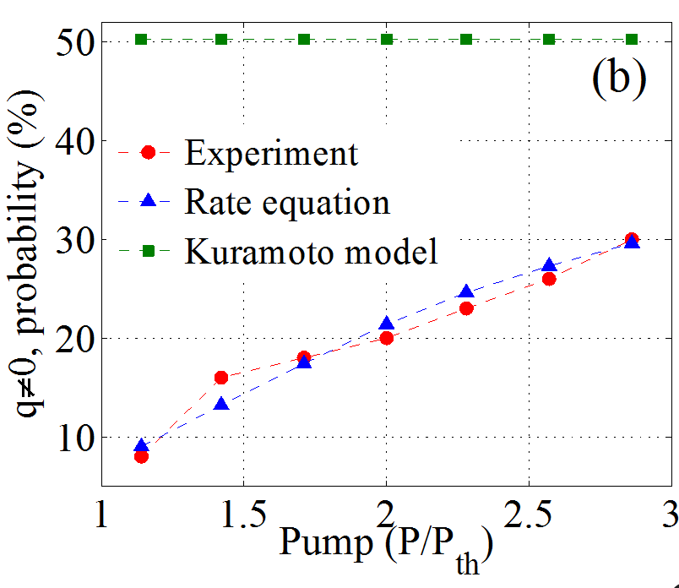

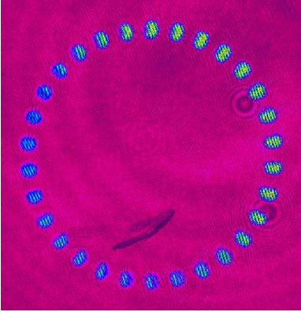
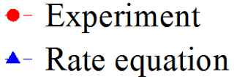
Avoid local minima
V. Pal et. al., PRL 119, 1013902 (2017)

Slide 17
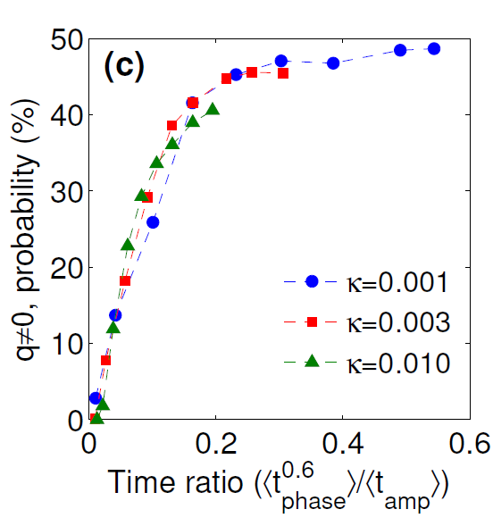
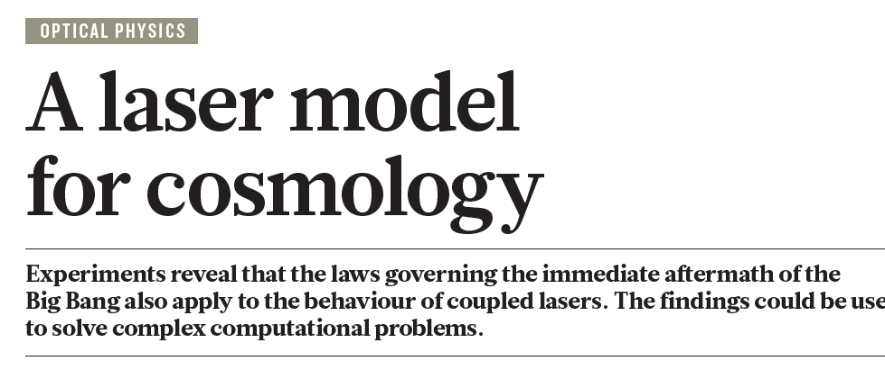

Kibble-Zurek mechanism
V. Pal et. al., PRL 119, 1013902 (2017)

Slide 18
Adding disorder
Spatial Light
Modulator
Lens
(f₂)
Lens
(f₁)
Mask
Mirror
GAIN
f₂
f₂
f₁
f₁
E. Ronen et. al.
unpublished

Slide 19
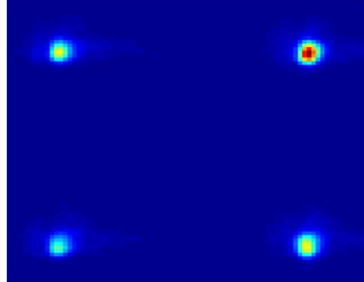
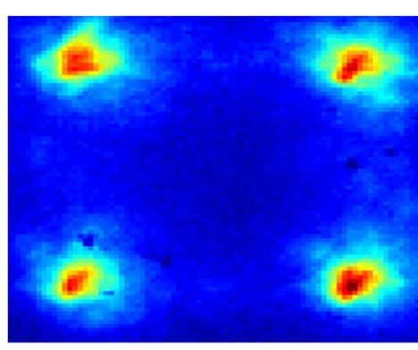
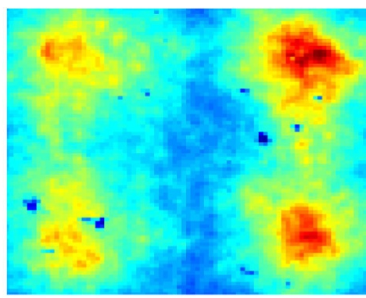
Adding disorder
Spatial Light
Modulator
Lens
(f₂)
Lens
(f₁)
Mask
Mirror
GAIN
f₂
f₂
f₁
f₁
Far Field
Far Field
Far Field
E. Ronen et. al.
unpublished

Slide 20
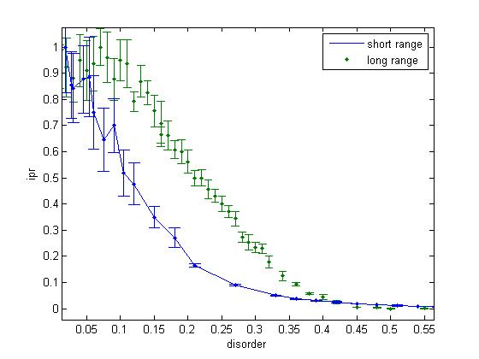
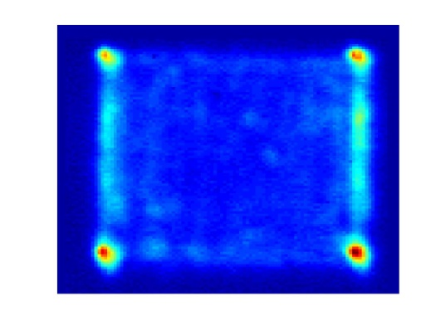
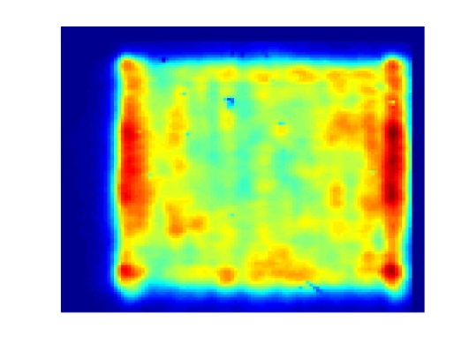
Long Vs. short range coupling
Coherence
E. Ronen et. al.
unpublished

Slide 21

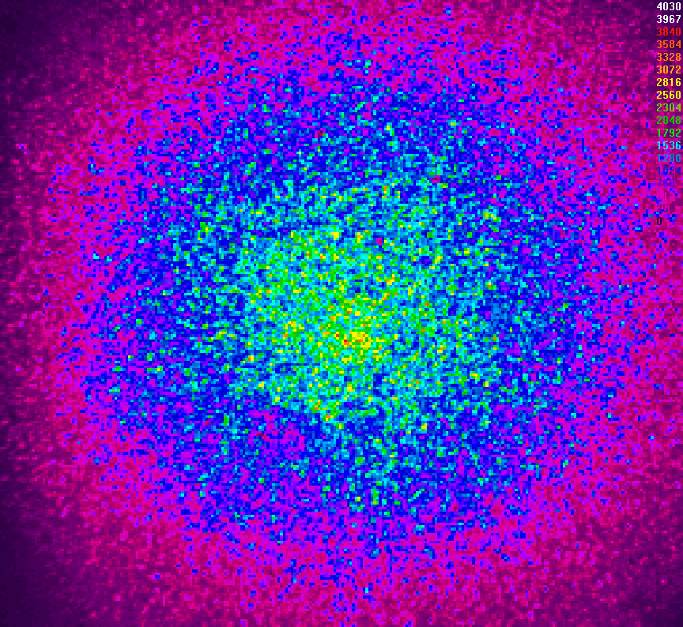
Lasing through a Diffuser
Output coupler
Lens
Pinhole
Mirror
GAIN
Lens
CCD
Diffuser
diffuser
M. Nixon et. al., Nature Photonics 7, 919 (2013)

Slide 22
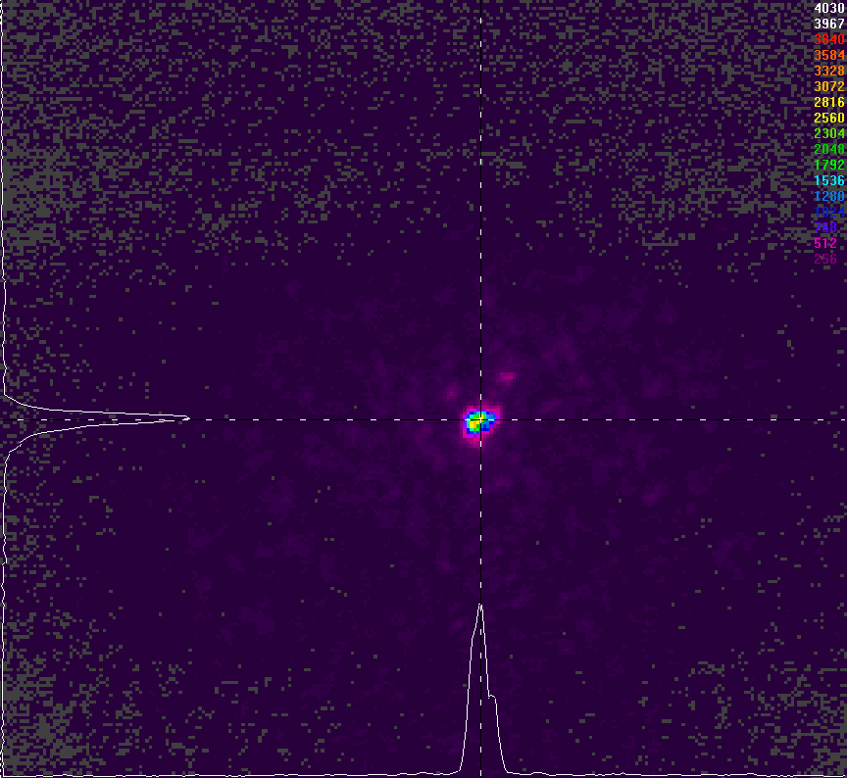
Lasing through a Diffuser
Output coupler
Lens
Pinhole
Lens
Mirror
GAIN
CCD
Diffuser
x 100 increase of peak
in < 500 nsec
diffuser
Pinhole + diffuser
M. Nixon et. al., Nature Photonics 7, 919 (2013)

Slide 23
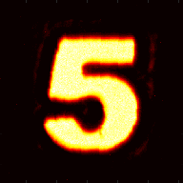
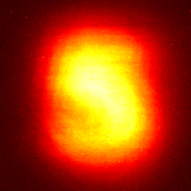
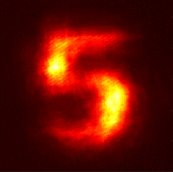
Imaging through a Diffuser
Lens
Lens
Output coupler
Diffuser
Gain
SLM
2f
2f
Diffuser outside the cavity
Diffuser inside the cavity
Object
R. Chriki et al, preliminary
Notes:
Loss level of less than 40%, even for such complicated structured images. Notice the images are a negative.

Slide 24
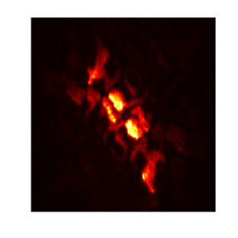
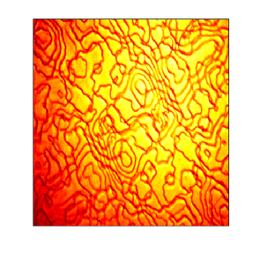
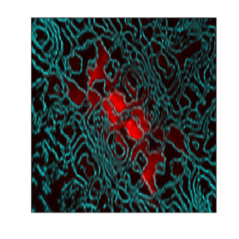
Imaging through a Diffuser
Lens
Lens
Output coupler
Diffuser
Gain
SLM
2f
2f
Plane of diffuser
Imaging of 0-π diffuser
Overlap
R. Chriki et al, preliminary
Notes:
Loss level of less than 40%, even for such complicated structured images. Notice the images are a negative.

Slide 25
Solution of the inverse phase problem
f₂
f₂
f₁
f₁’
Gain
SLM
Aperture
Output coupler
Lens f₂
Lens f₁
Calculated
Diffraction
Pattern
Reconstructed
Object
Object
In less than 100 nanoseconds
C. Tradensky et. al., submitted

Slide 26
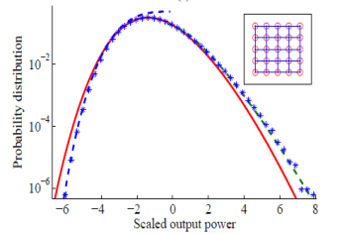
Summary
Phase lock >1000
Simulating XY spins
Extreme Value Statistic
Focusing through tissue
Inverse phase reconstruction

Slide 27
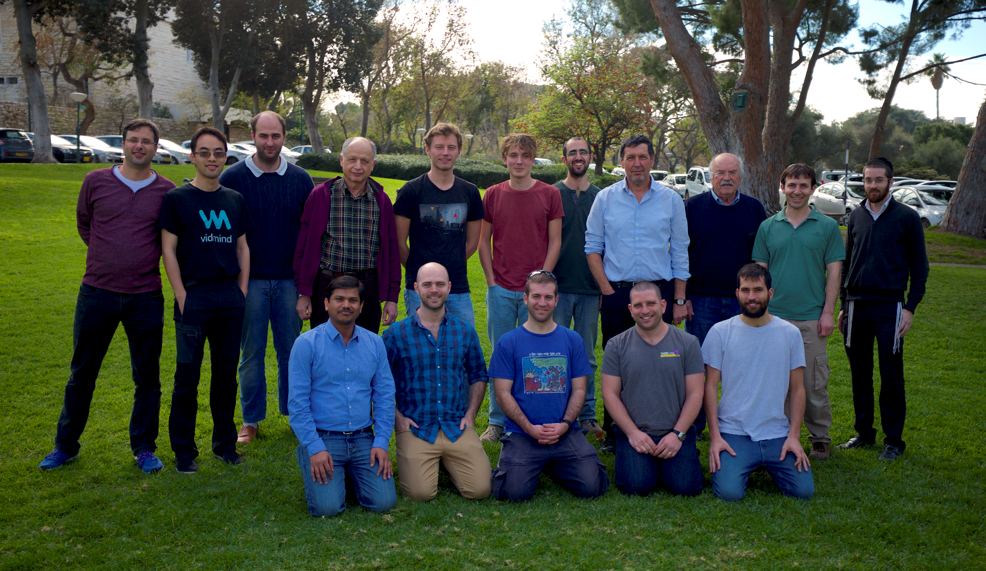

Slide 28
Additional results
Dynamics
External “fields” and noise (“temperature”)
Spin glasses
Time delayed coupling
High harmonic generation
1D systems
Small world and scale free networks
Chaos synchronization
Quantum effects

Slide 29
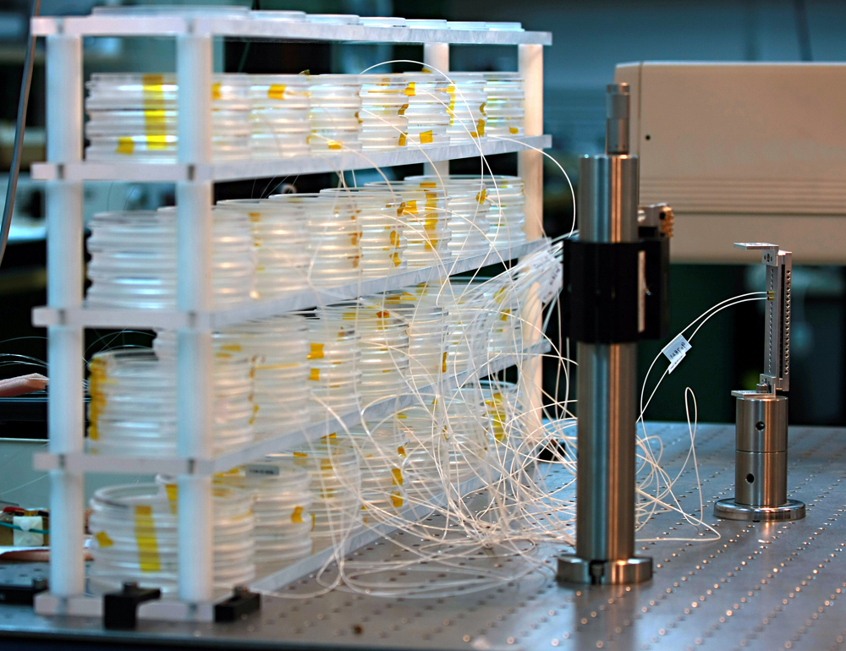
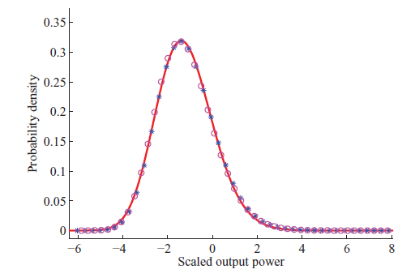
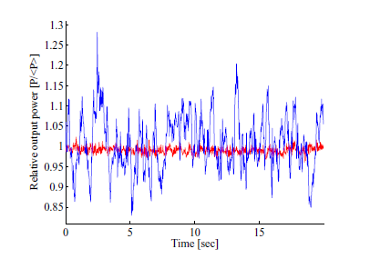
Extreme eigenvalue statistics of random matrices
Tracy
Widom
(1994)
M. Fridman et. al., PRE R85, 020101 (2012)
Notes:
29

Slide 30
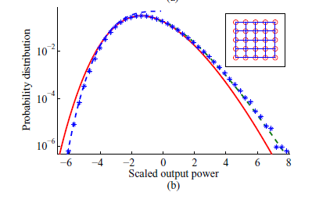
Extreme eigenvalue statistics of random matrices
Majumdar
Vergassola
(2009)
Vivo
Majumdar
Bohigas
(2007)
Tracy
Widom
(1994)
M. Fridman et. al., PRE R85, 020101 (2012)
Notes:
30

Slide 31

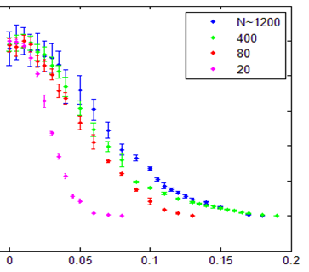
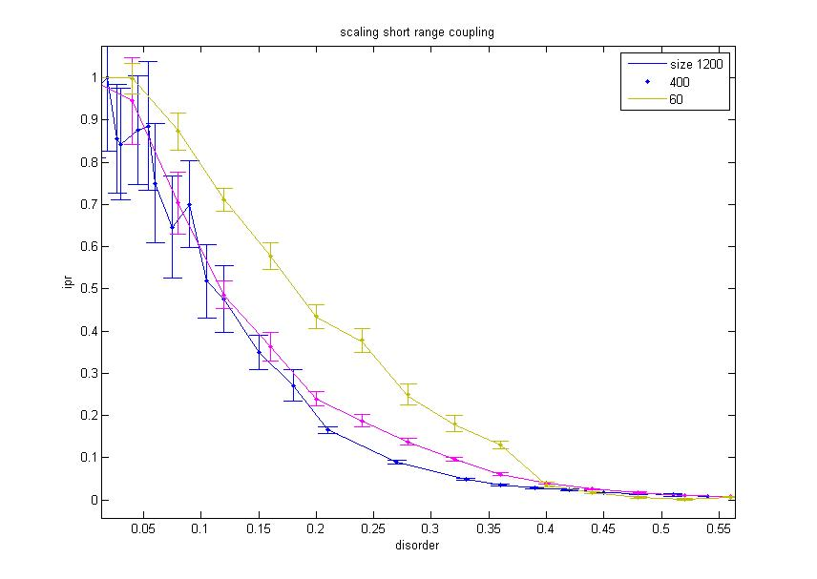
Long Vs. short range coupling scaling system size
Long
Short
1200 lasers
80 lasers
Coherence
Coherence
20 lasers
1200 lasers
Disorder
Disorder
E. Ronen et. al.
unpublished
Notes:
Scalbility of the array, needs numerics.

Slide 32
Long Vs. short range coupling
Coherence
E. Ronen et. al.
unpublished

Slide 33
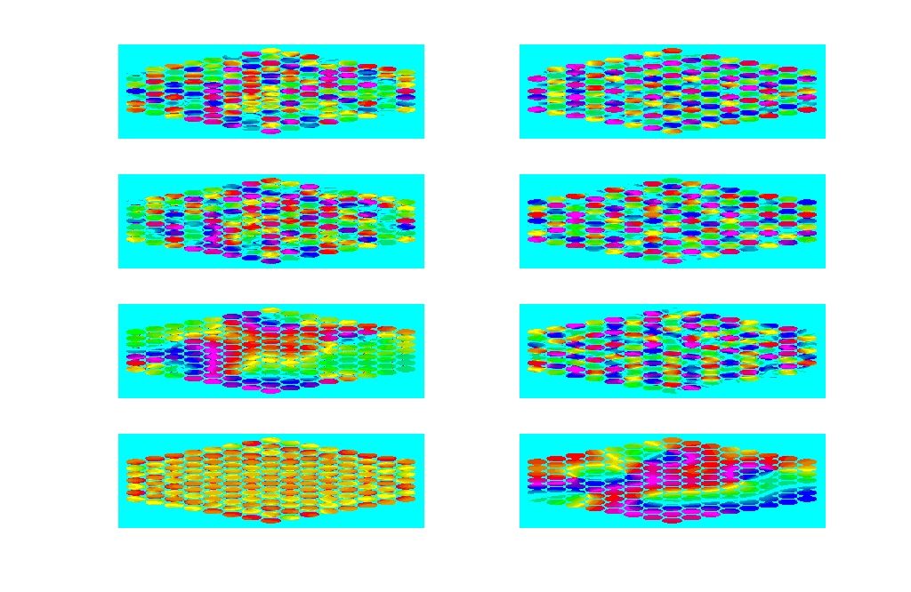
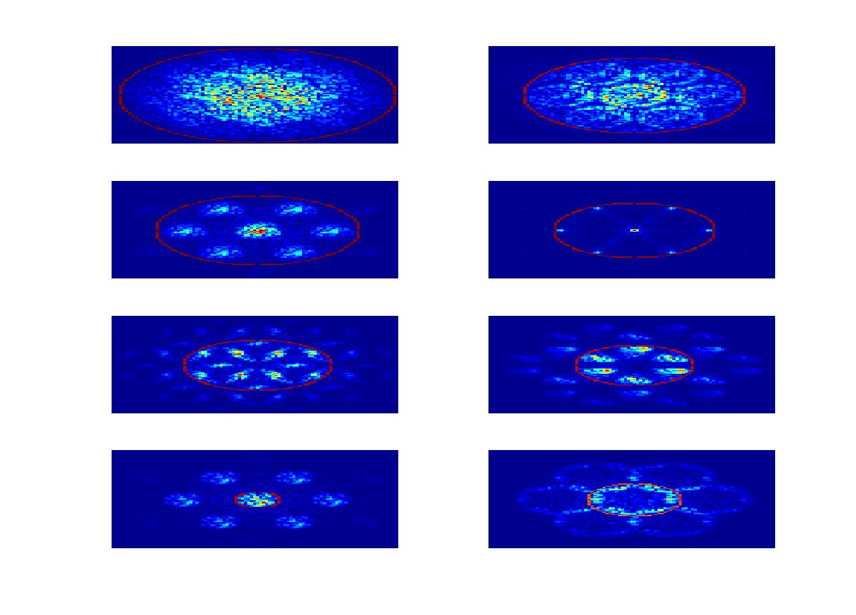





Calculated phase
distribution
Calculated
far field
Experimental far field
1.1 mm
0.9 mm
-π
0
π
0.8 mm
0.7 mm
Notes:
The laser tries to smear the lobes inside the pinhole in order to maximize the area that it fills inside the pinhole.
More narrow.

Slide 34
Solution of the inverse phase problem
Diffraction
Pattern
Reconstructed
Object
Object
C. Tradensky et. al., unpublished

Slide 35






Propagation Invariant Shaped Beams
z=0
z=1cm
z=2cm
z=0
z=1cm
z=2cm
*Experiment
R. Shriki et. al., unpublished

Slide 36


Avoid local minima: Kibble-Zurek mechanism
Amplitude
Phase
Amplitude
Phase
V. Pal et. al., PRL 119, 1013902 (2017)

Slide 37


Coupled laser on “small world networks”
R. Shriki et. al., unpublished

Slide 38


Digital Degenerate Cavity Laser
f₂
f₂
f₁
f₁’
Gain
SLM
Aperture
Rear Mirror
Lens f₂
Lens f₁
C. Tradensky et. al., unpublished

Slide 39
Phase locked lasers with internal structure.
C. Tradensky et. al., unpublished

Slide 40
Beyond Kuramoto: Intensity (chaos) synchronization
Uncoupled lasers
Coupled lasers
time
time
C. Tradensky et. al., unpublished

Slide 41














External Field for 1D
Near field spiral
Far field
E. Ronen et. al., unpublished

Slide 42



Is it a true “ground state”?
Experimental
Simulation
Г
Г
Κ
Ϻ
Κ
Ϻ
1
0.8
0.6
Intensity [normalized]
0.4
0.2
0
Г
Κ
Ϻ
Г
Wave vector
M. Nixon et. al., PRL 110, 184102 (2013)

Slide 43
No φ phase ordering !
3φ phase ordering

Slide 44



Second harmonics doubles the phase
C. Tradensky et. al., submitted

Slide 45


Lucas et. al. (77)

Slide 46
Time-delayed coupling
?
Coupling

Slide 47
Time-delayed coupling
?
Coupling

Slide 48
Time-delayed coupling
?
Coupling

Slide 49










Time-delayed coupling (even vs odd ring)
1
1
6
2
7
2
6
3
5
3
4
5
4
M. Nixon et. al., PRL 106, 223901 (2011); PRL 108, 214101 (2012)

Slide 50

Synchronizing large laser networks using number theory
GCD(
,
,
,…,
) = # of clusters
M. Nixon et. al., PRL 106, 223901 (2011); PRL 108, 214101 (2012)

