Slide 1
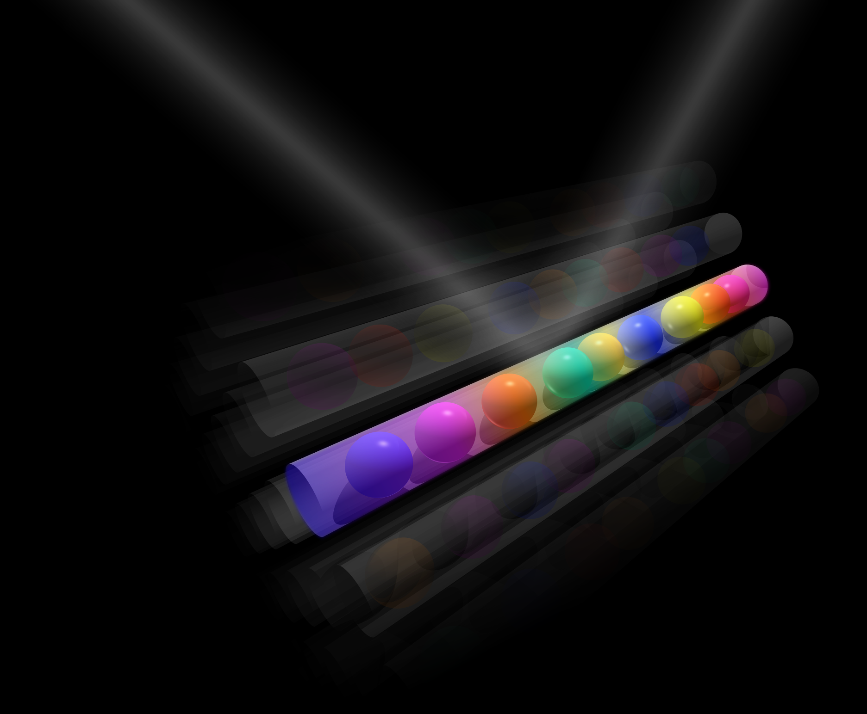


Synthetic quantum systems with multicomponent fermions
Humboldt Kolleg “Controlling quantum matter: From ultracold atoms to solids”
Vilnius, July 30th 2018
Leonardo Fallani
Department of Physics and Astronomy & LENS
University of Florence

Slide 2
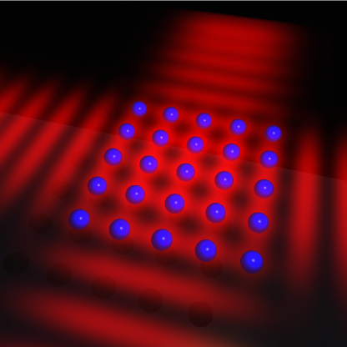
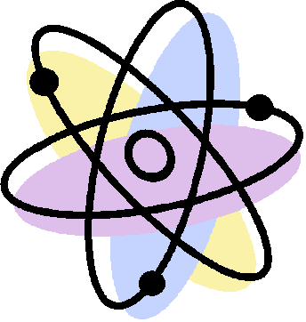
Introduction
Quantum engineering of synthetic quantum systems
"exact" implementations of models
new "extreme" states of matter

Slide 3
Ultracold two-electron fermions
Two internal degrees of freedom with long coherence times:
Nuclear spin
Electronic orbital
³P₀
5/2
3/2
1/2
-1/2
-3/2
-5/2
¹⁷³Yb
¹S₀
5/2
3/2
1/2
-1/2
-3/2
-5/2

Slide 4
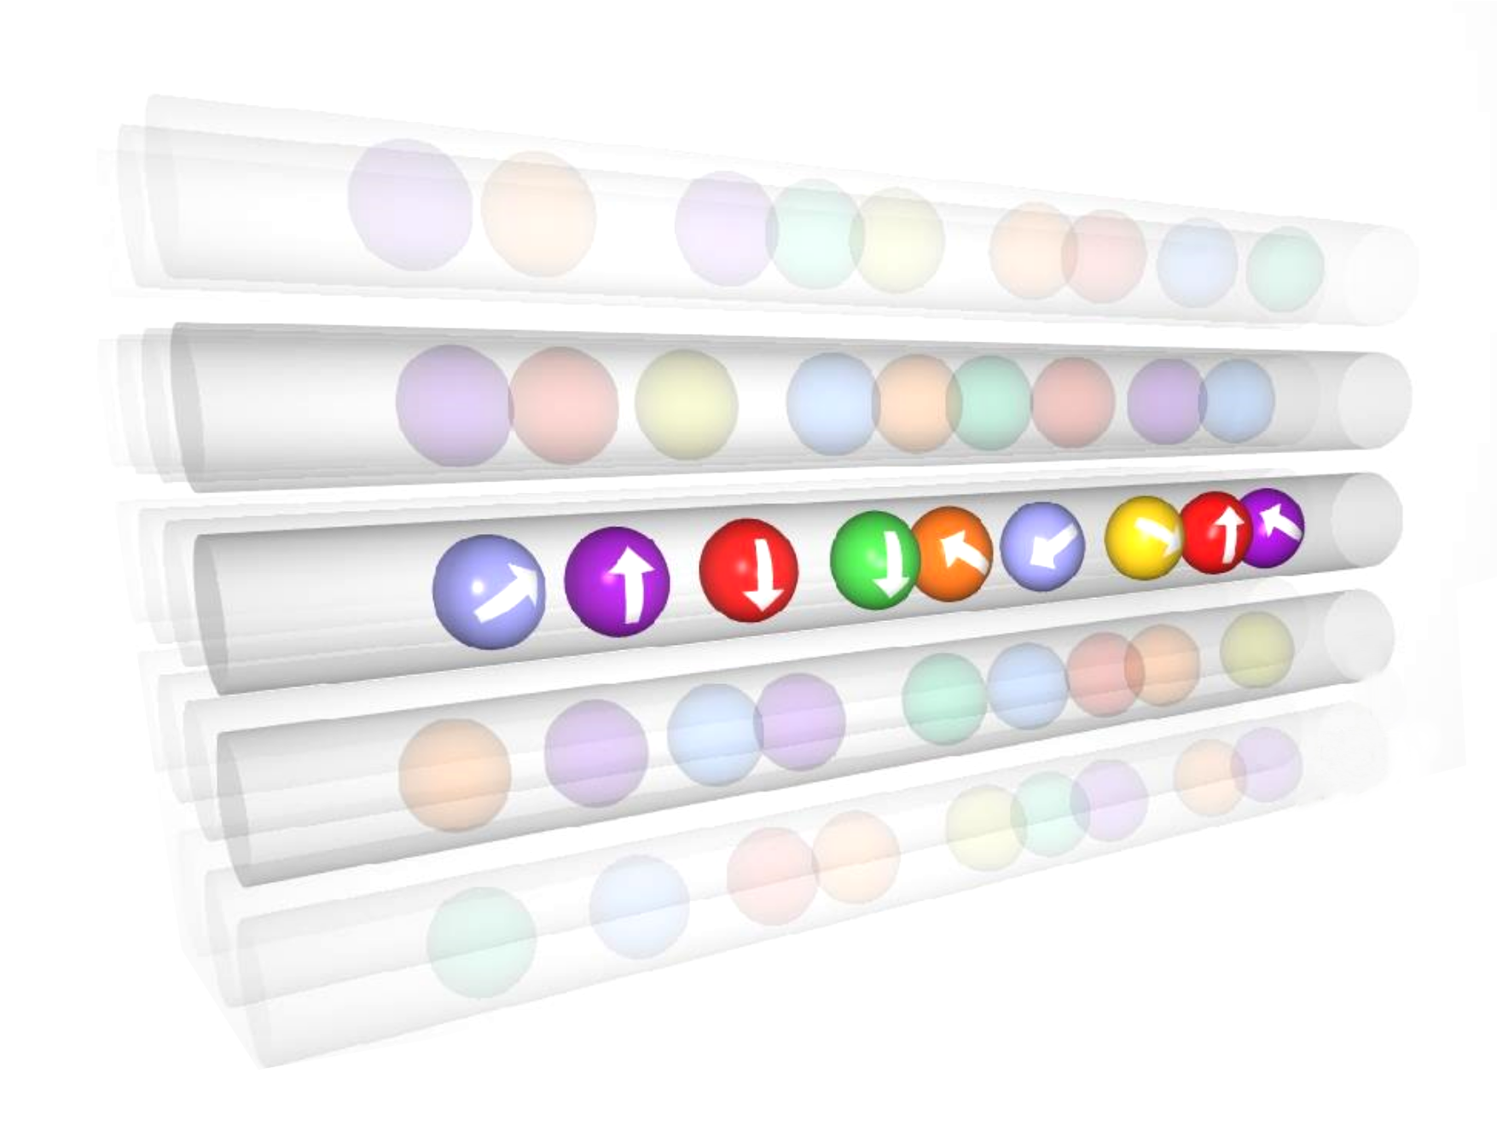
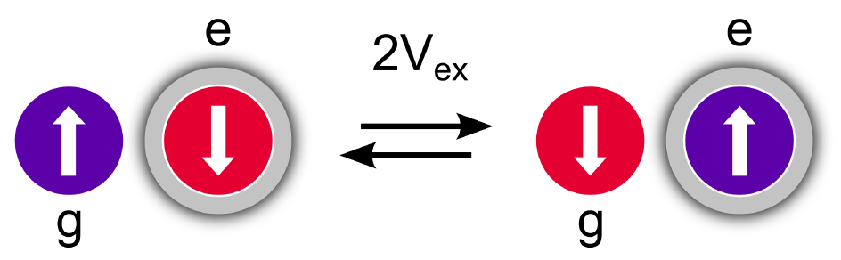
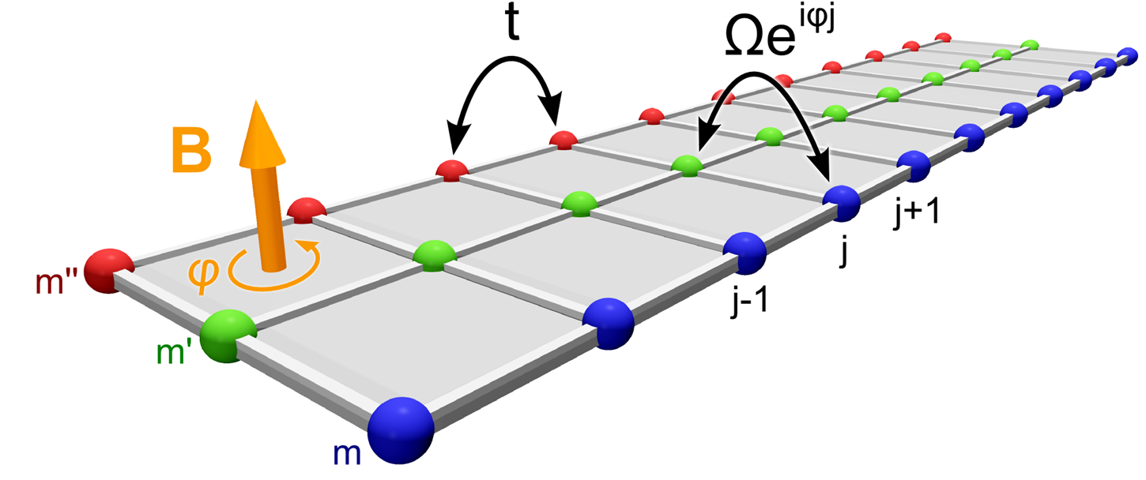
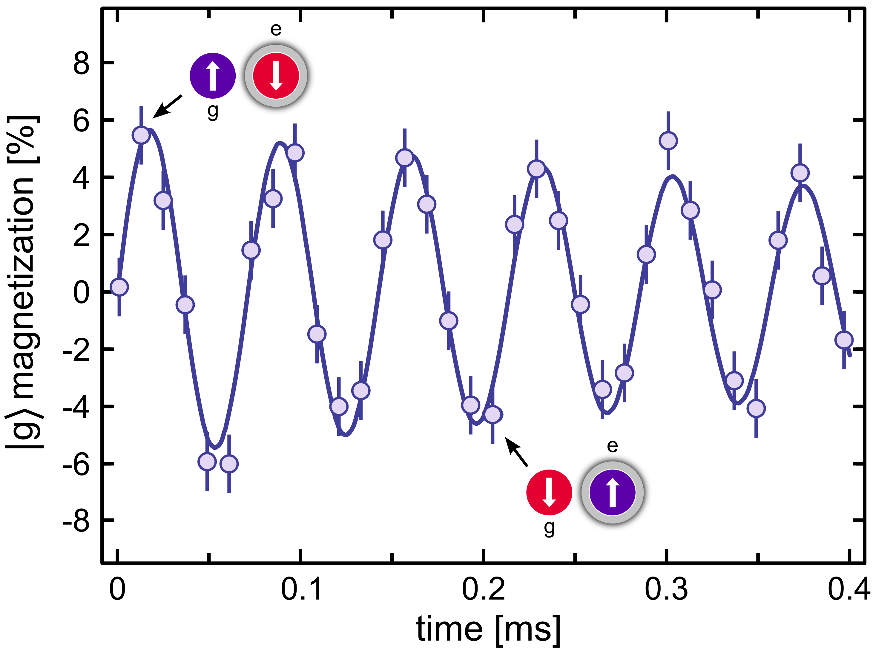
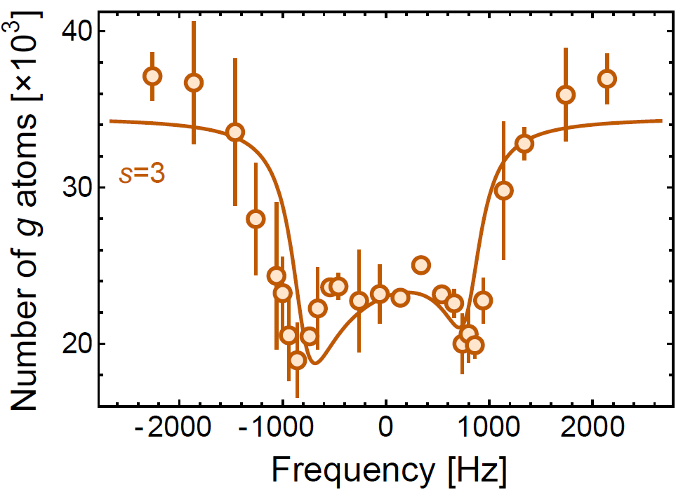
Experiments with multicomponent ¹⁷³Yb fermions
Two internal degrees of freedom with long coherence times:
Nuclear spin
Electronic orbital
Strongly interacting 1D SU(N) fermions
Two-orbital spin-exchange
G. Pagano et al., Nature Phys. 10, 198 (2014)
G. Cappellini et al., PRL 113, 120402 (2014)
Synthetic dimensions and edge states
Orbital Feshbach resonance
M. Mancini et al., Science 349, 1510 (2015)
G. Pagano et al., PRL 115, 265301 (2015)
Spin-orbit coupling and tunable flux ladders
L. F. Livi et al., PRL 117, 220401 (2016)

Slide 5
Nuclear spin:
quantum transport in synthetic dimensions
M. Mancini et al., Science 349, 1510 (2015)

Slide 6


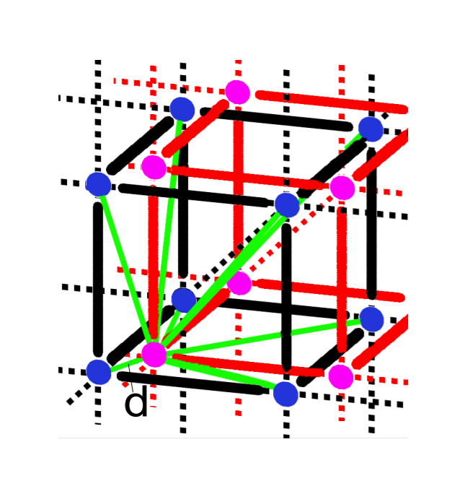
Augmented reality?

Slide 7
Simulating an "extra dimension"
¹S₀
5/2
3/2
1/2
-1/2
-3/2
-5/2

Slide 8
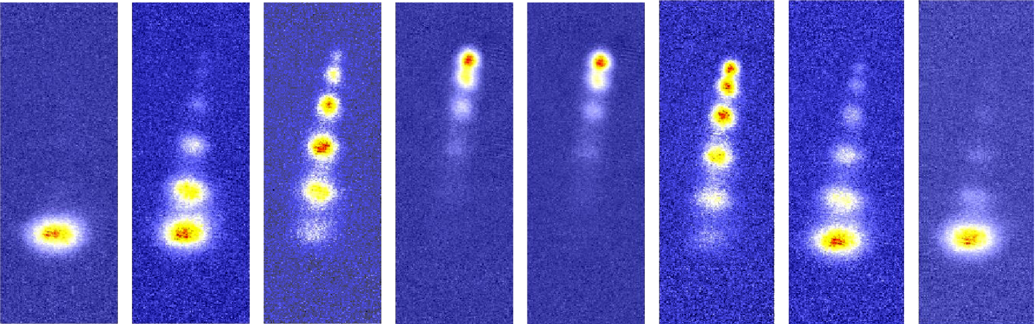
Simulating an "extra dimension"
Raman transitions coupling coherently different nuclear spin states:
∼ 6 GHz
³P₁
5/2
3/2
1/2
-1/2
-3/2
-5/2
σ⁺
π
σ⁺
π
σ⁺
π
σ⁺
π
σ⁺
π
time
γ ∼ 100 kHz
¹S₀
5/2
3/2
1/2
-1/2
-3/2
-5/2

Slide 9
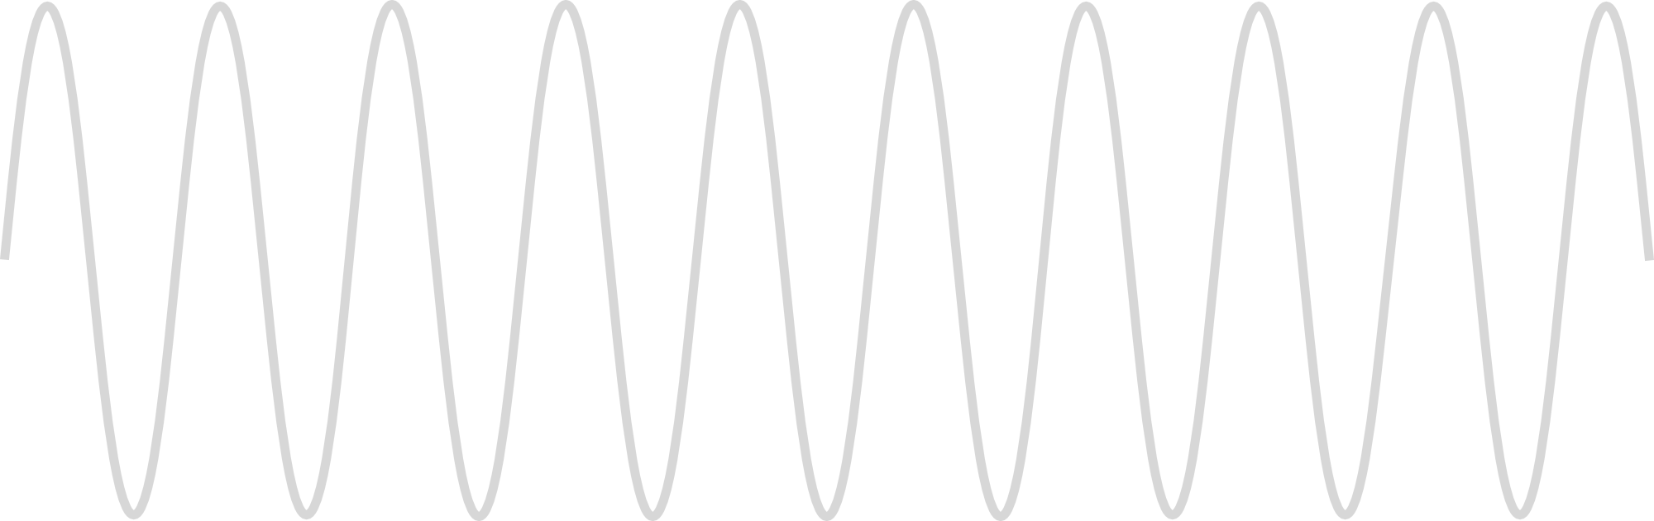
Simulating an "extra dimension"
Analogous to coherent tunnelling coupling in a lattice:
$$H={−t ∑}_{j }\left(c_{j}^{†}c_{j+1}^{}+h.c.\right)$$
$$H={−Ω ∑}_{m }\left(c_{m}^{†}c_{m+1}^{}+h.c.\right)$$
5/2
3/2
1/2
-1/2
-3/2
-5/2

Slide 10
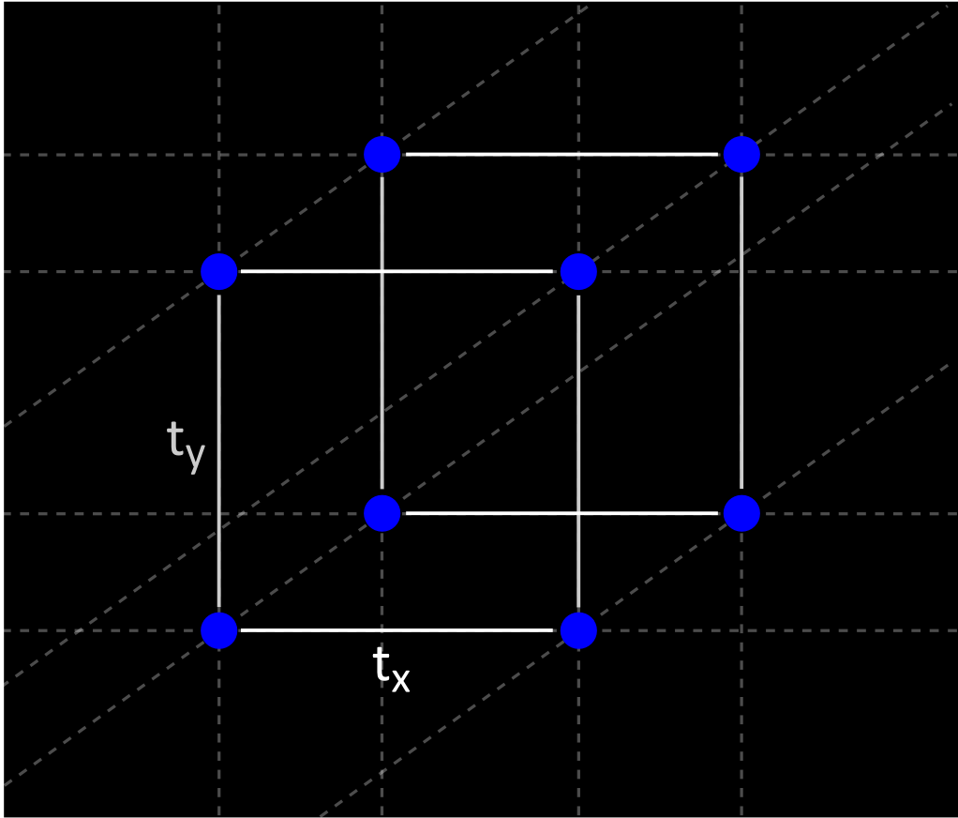
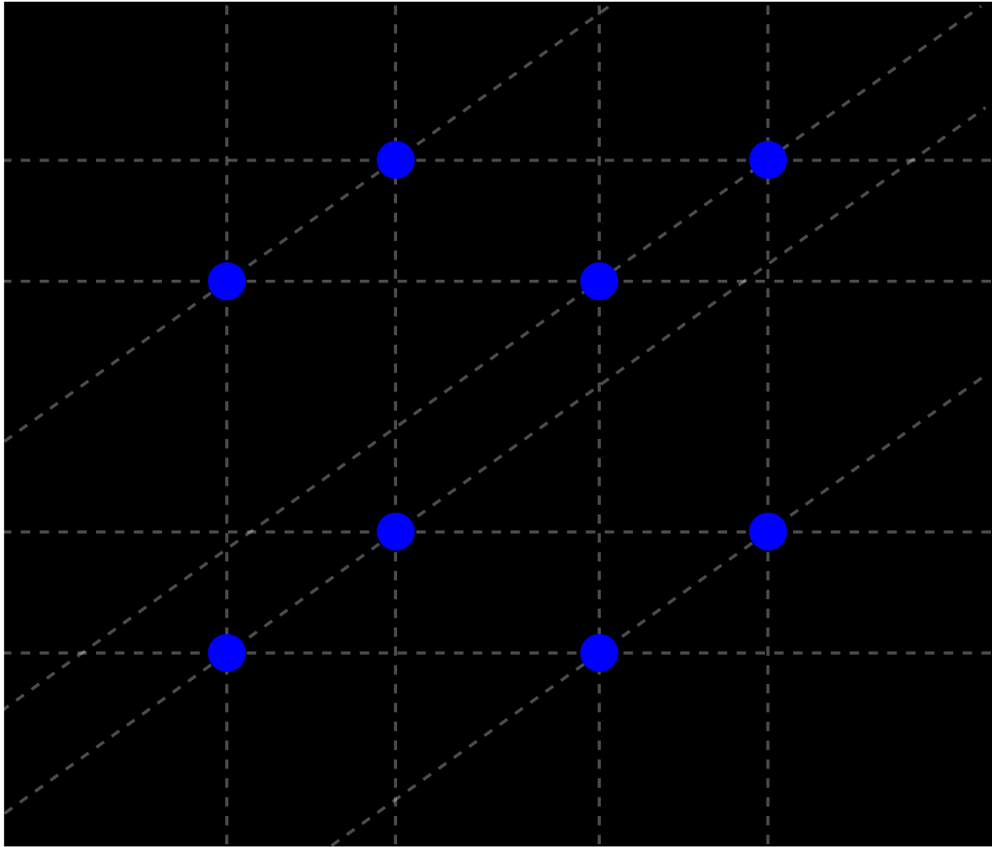
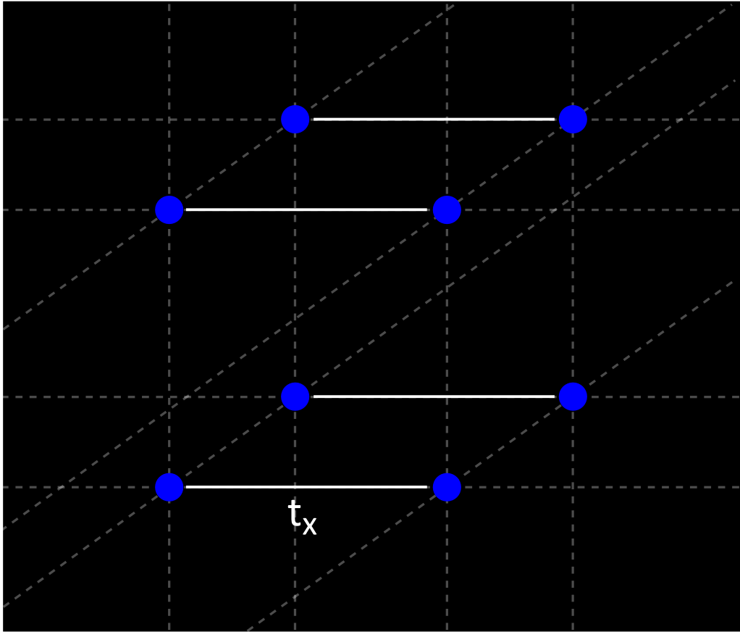
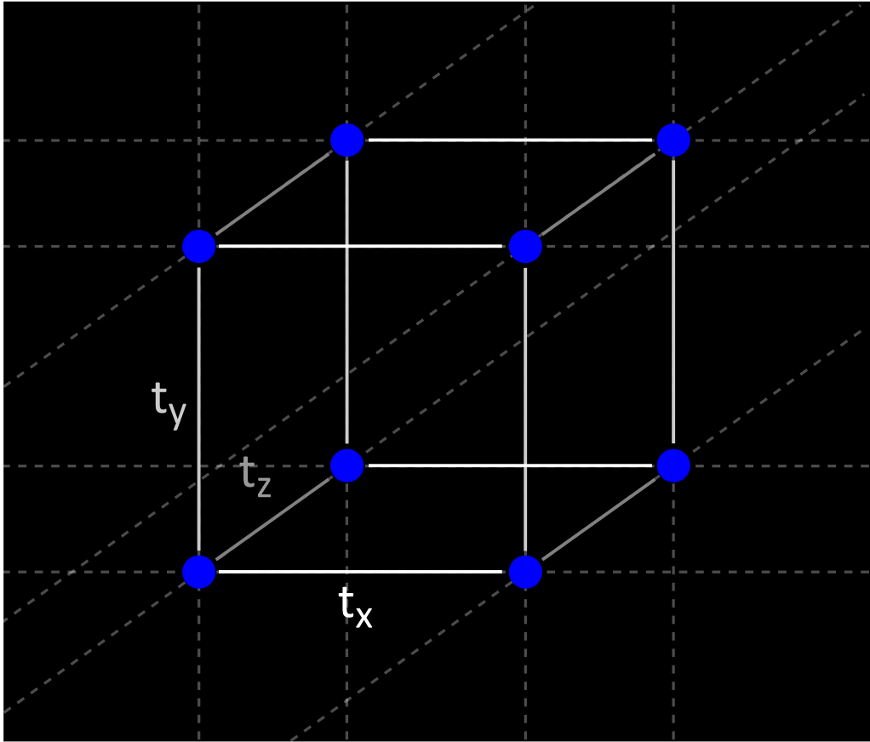
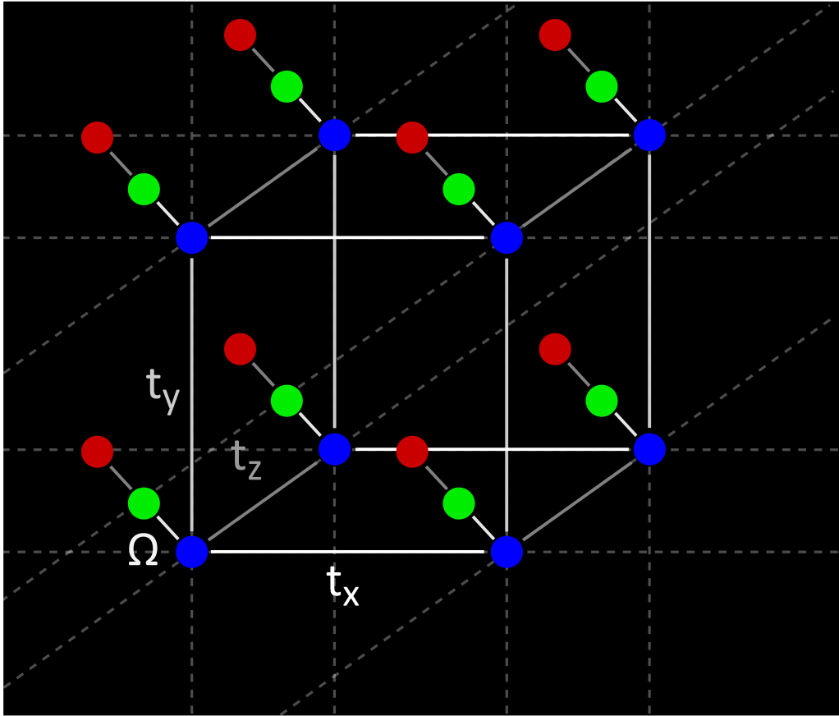
Simulating an "extra dimension"
Realization of a synthetic lattice dimension
Quantum simulation of 4D models:
O. Boada et al., PRL 108, 133001 (2012)

Slide 11
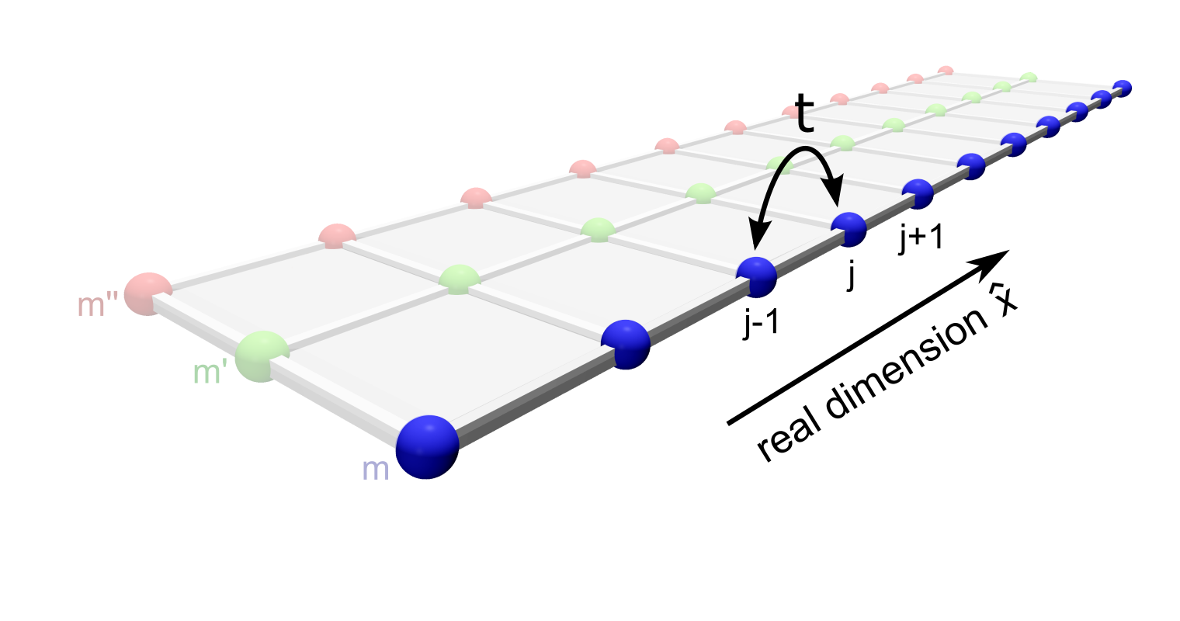
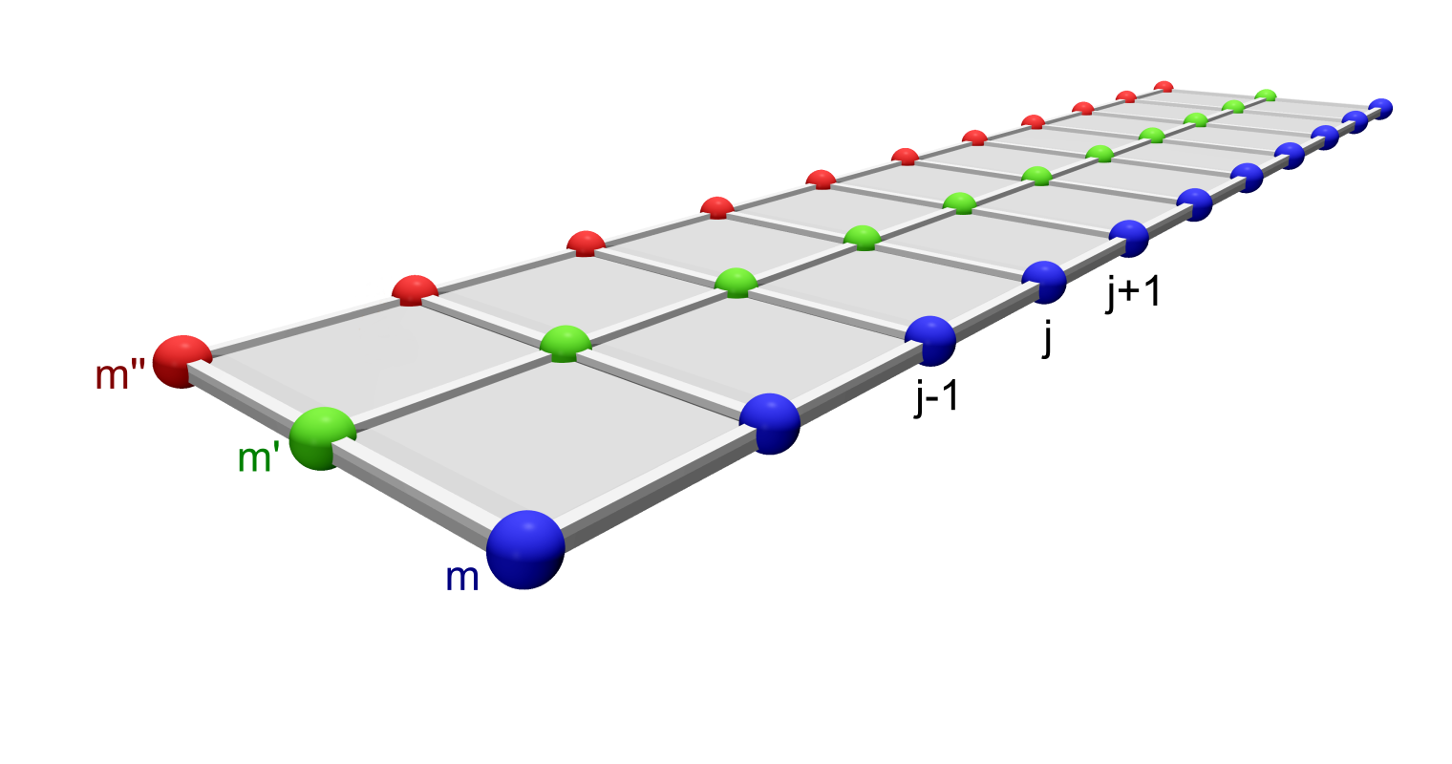
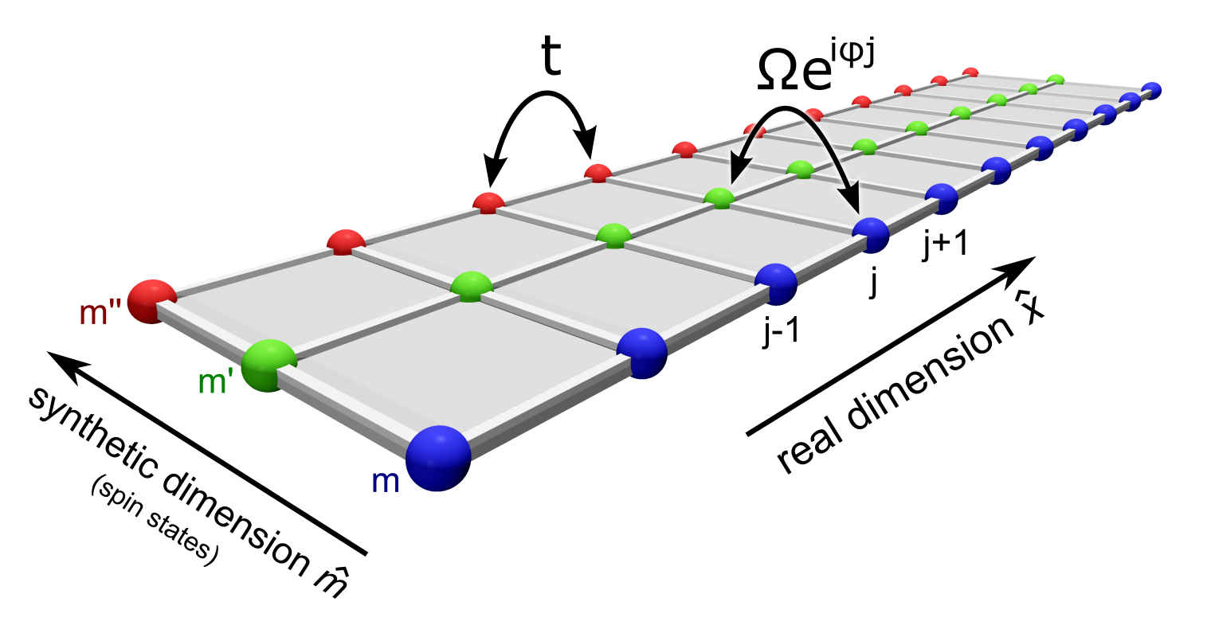
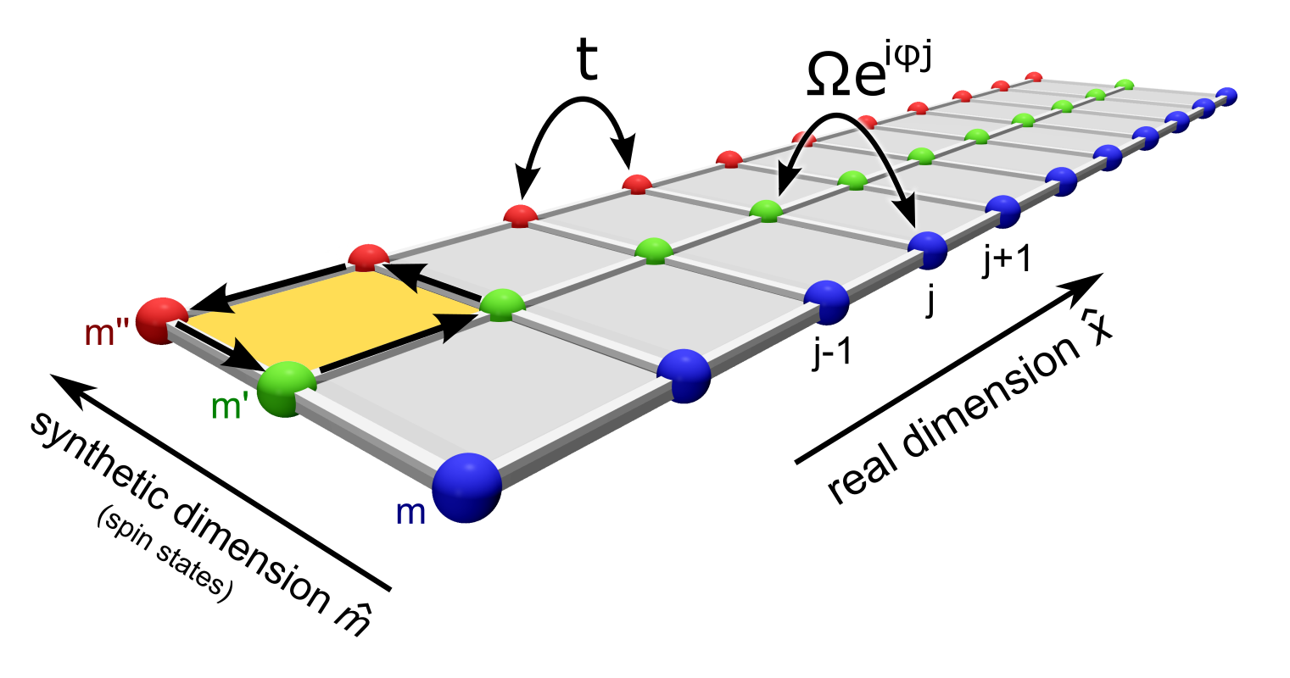
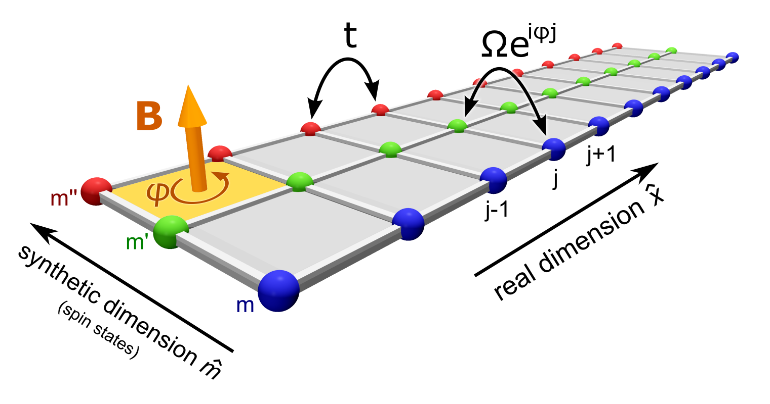
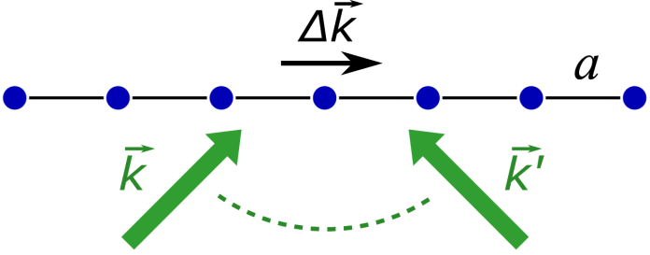

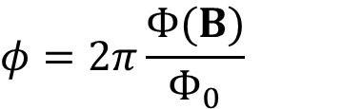


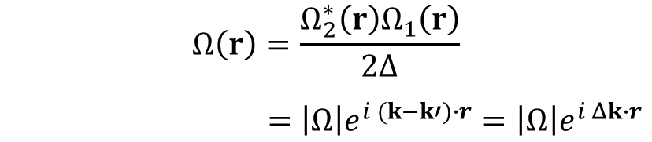

A synthetic flux ladder
$$E_{1}=E_{0}e^{ik∙r}$$
Aharonov-Bohm phase imprinted by lasers:
B
$$E_{2}=E_{0}e^{ik′∙r}$$
Aharonov-Bohm geometric phase
$$ψ→e^{iφ}ψ$$
φ
two-photon Rabi frequency:
$$φ=2π\frac{Φ(B)}{Φ_{0}}$$
$$Ω\left(r\right)=\frac{Ω_{2}^{∗}{\left(r\right)Ω}_{1}\left(r\right)}{2Δ}$$
$=\left|Ω\right|e^{i (k−k′)∙r}=\left|Ω\right|e^{i Δk∙r}$
D. Jaksch & P. Zoller, NJP 5, 56 (2003)
Reviews on gauge fields for ultracold atoms:
J. Dalibard et al., Rev. Mod. Phys. 83, 1523 (2011)
N. Goldman et al., Rep. Prog. Phys. 77, 126401 (2014)
A synthetic magnetic field
for effectively charged particles
$$Ω_{j}=\left|Ω\right|e^{iφj}$$
1D real + 1D synthetic ladder
proposed: A. Celi et al., PRL 112, 043001 (2014)
realized: M. Mancini et al., Science 349, 1510 (2015); B. K. Stuhl et al., Science 349, 1514 (2015)
real space

Slide 12
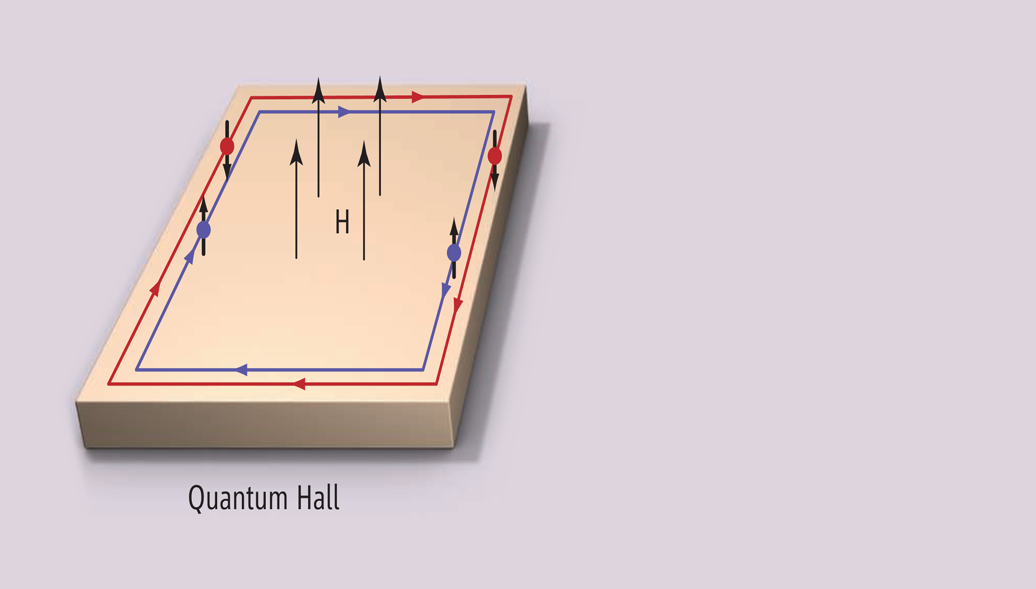

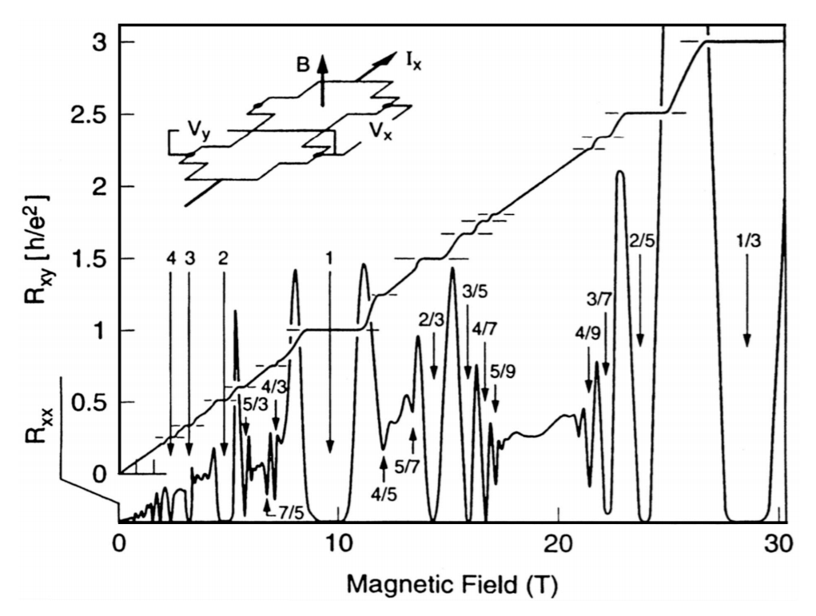
Edge states
Edge states are a hallmark of topological states of matter
(Nobel Physics 2016)
chiral edge currents
Figure from S. Oh, Science 340, 153 (2013)

Slide 13
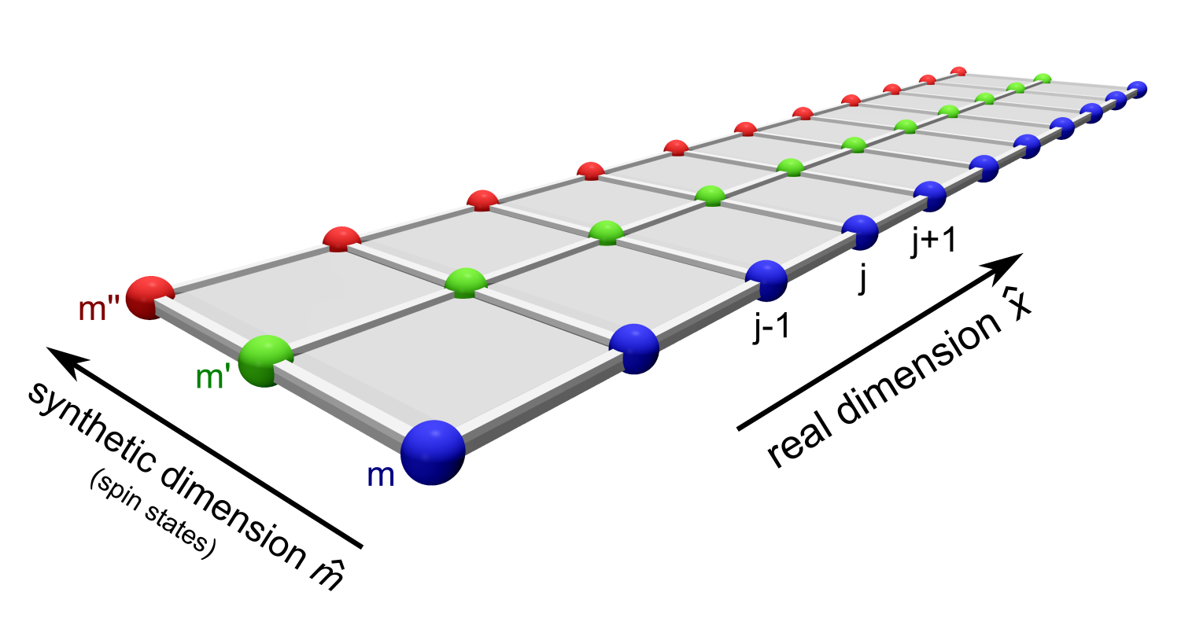
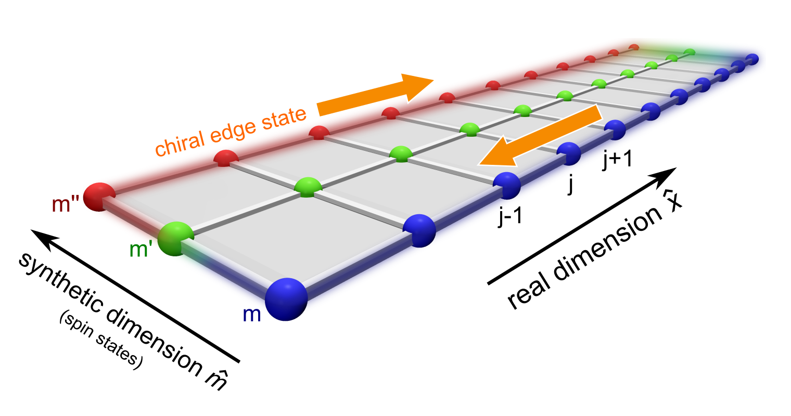
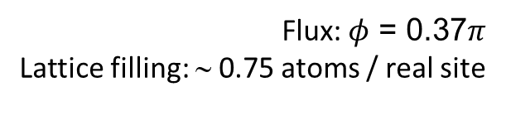
Observing chiral edge states
M. Mancini et al., Science 349, 1510 (2015)
Adiabatic preparation of a Fermi gas in a 3-leg synthetix flux ladder
Flux:$φ$ = 0.37$π$
Lattice filling: ∼ 0.75 atoms / real site
Spin-selective detection = single-site imaging in synthetic dimension

Slide 14
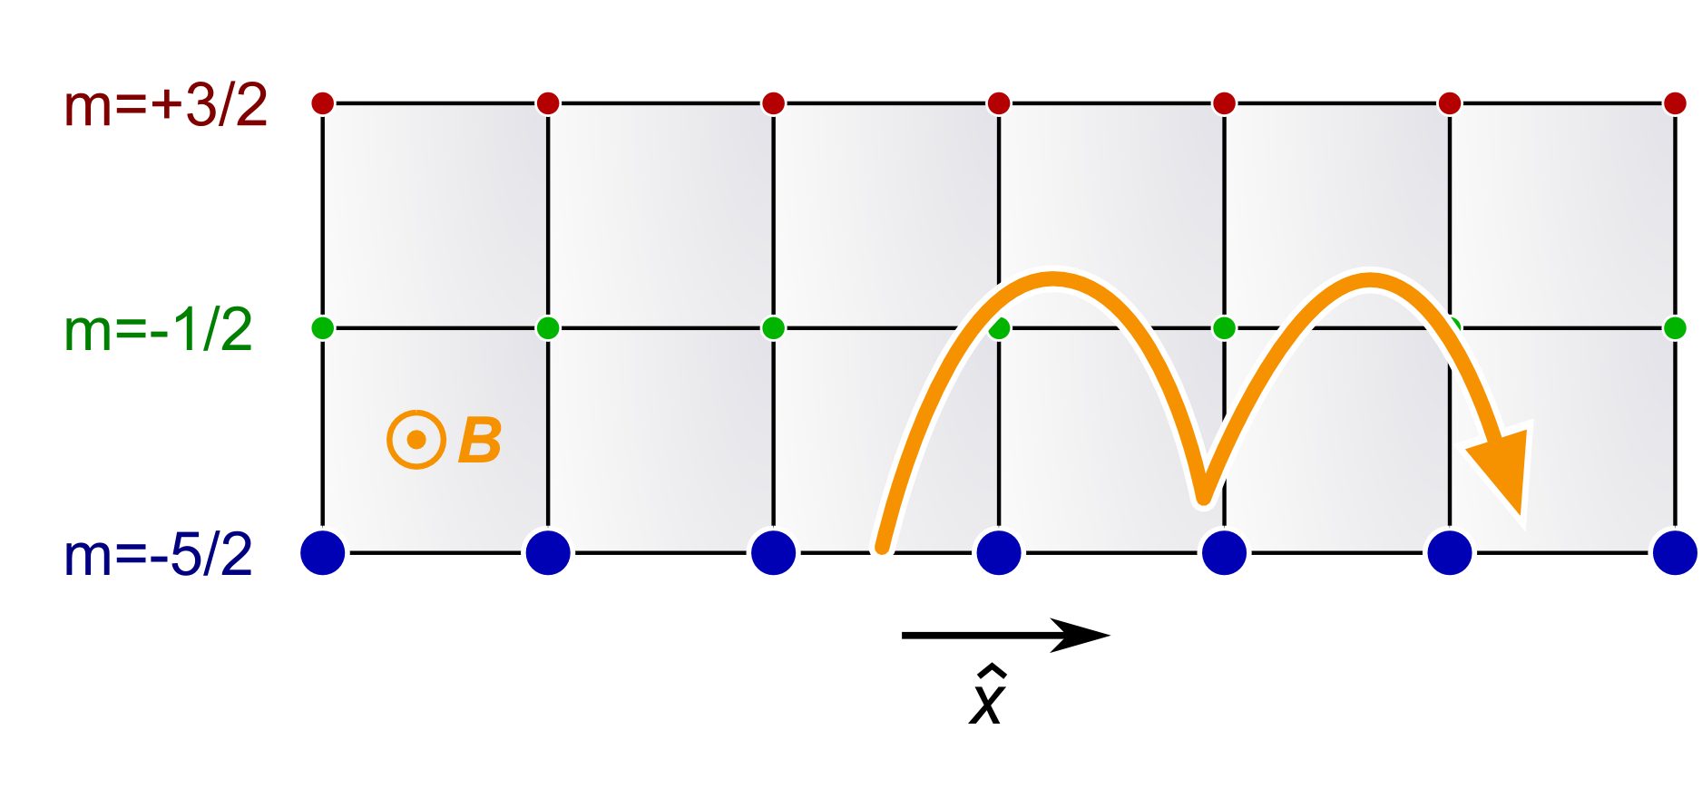
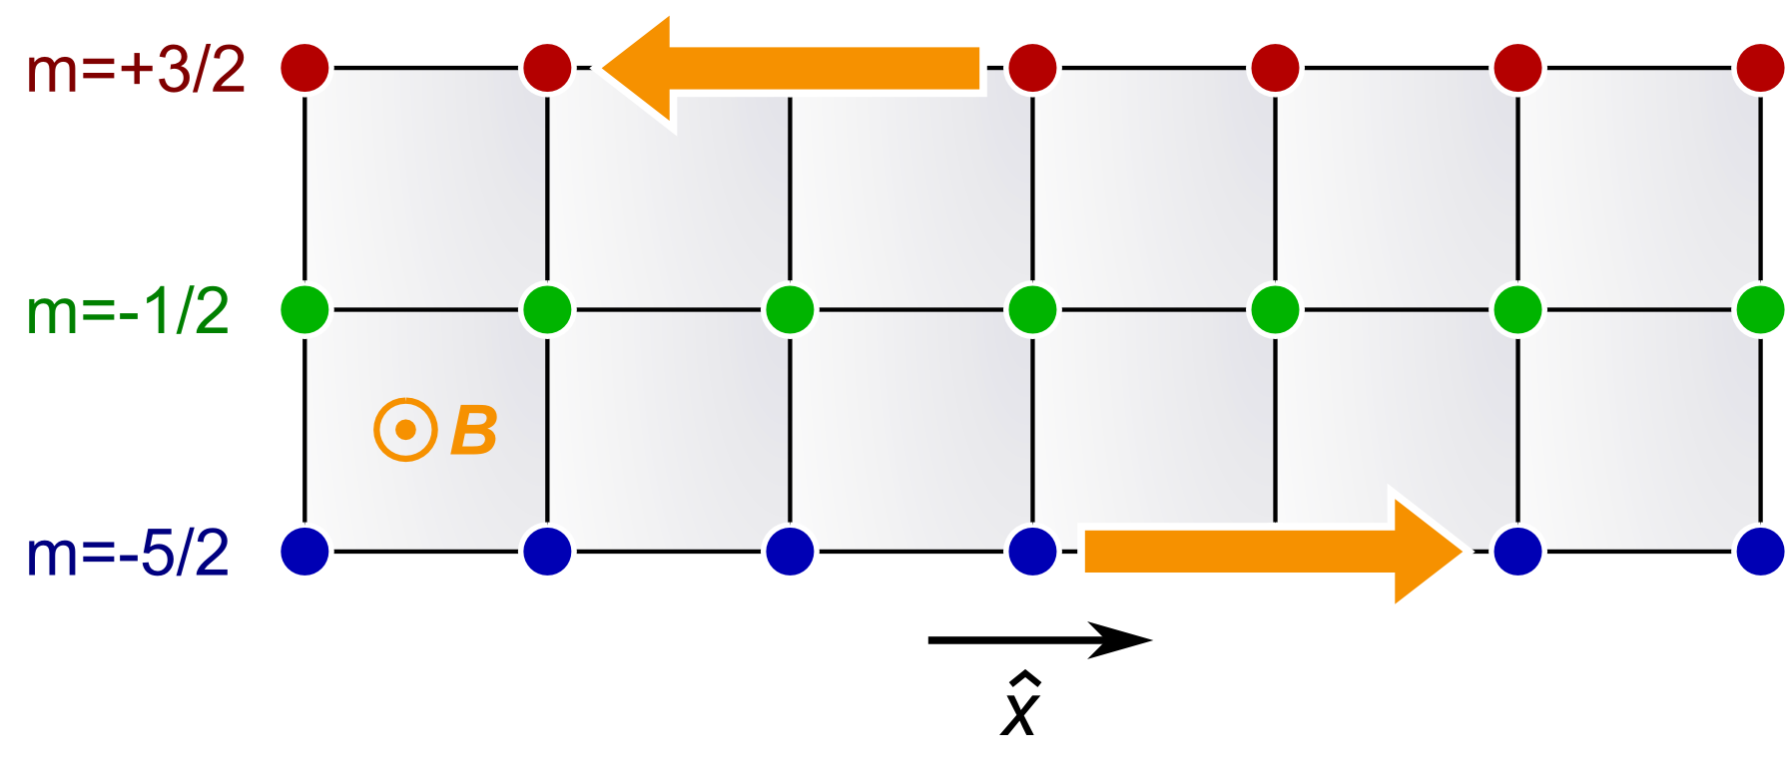
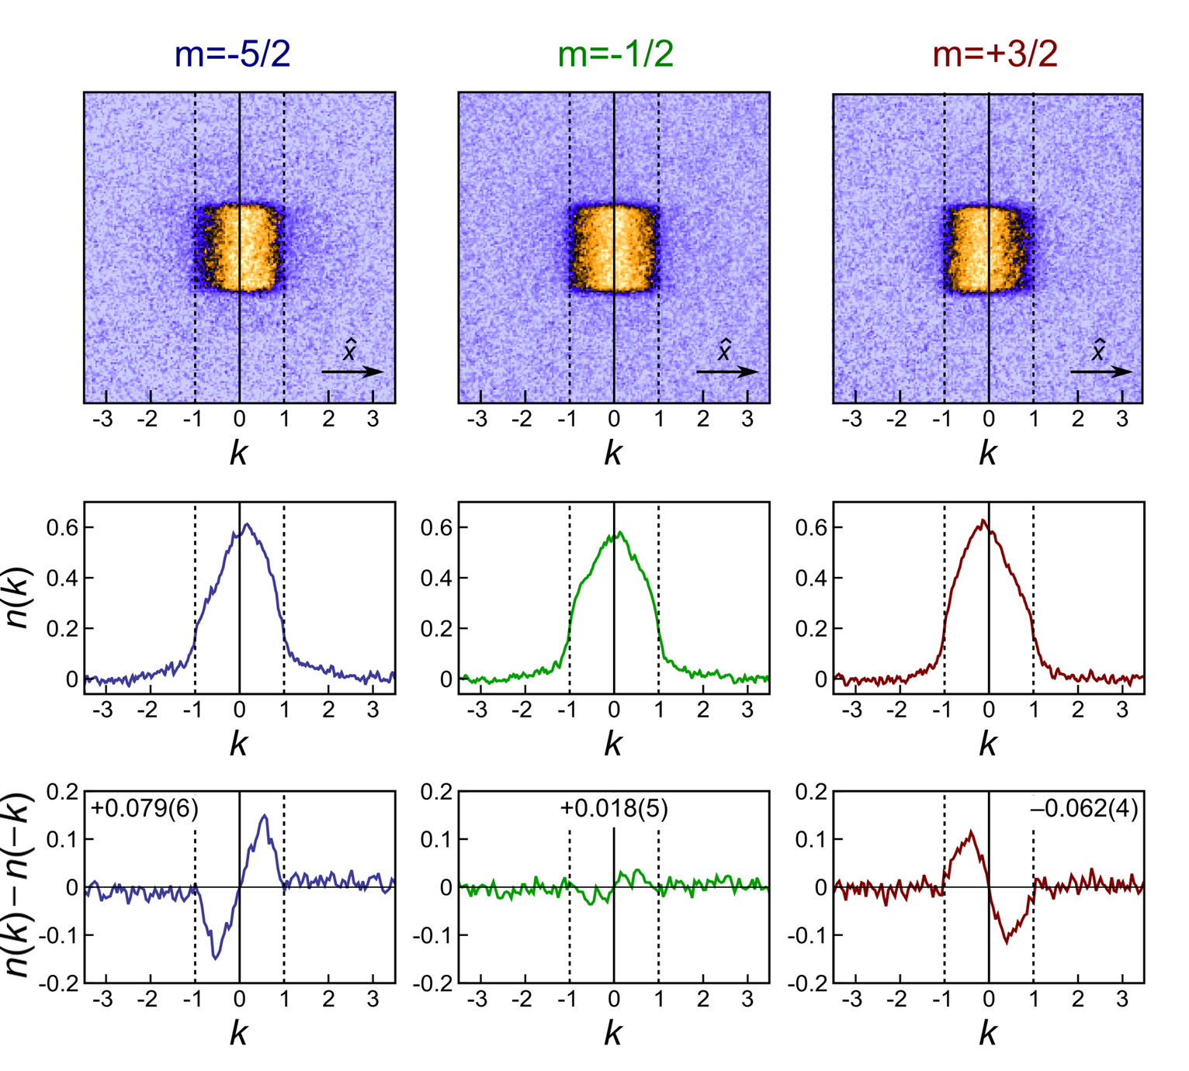
Observing chiral edge currents
M. Mancini et al., Science 349, 1510 (2015)
Spin-selective lattice momentum distribution:
Observation of
chiral edge currents
Collaboration with M. Dalmonte,
P. Zoller, M. Rider (Innsbruck)
related work on bosonic 2-leg ladders:
M. Atala et al., Nature Phys. 10, 588 (2014)

Slide 15

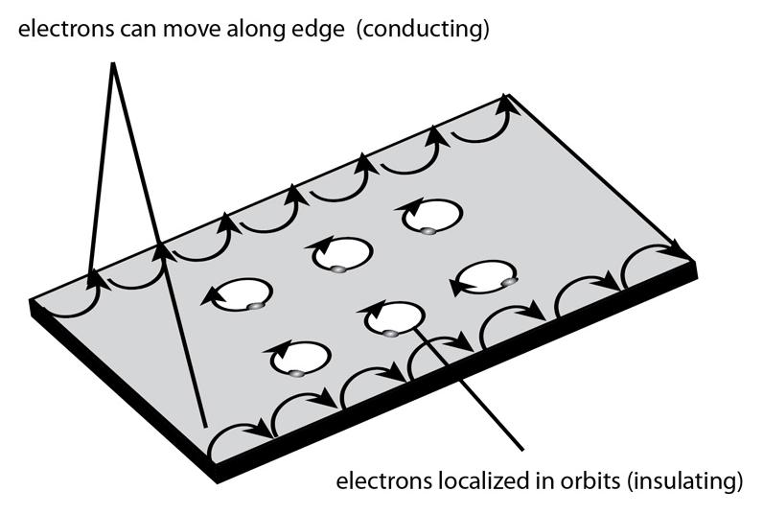
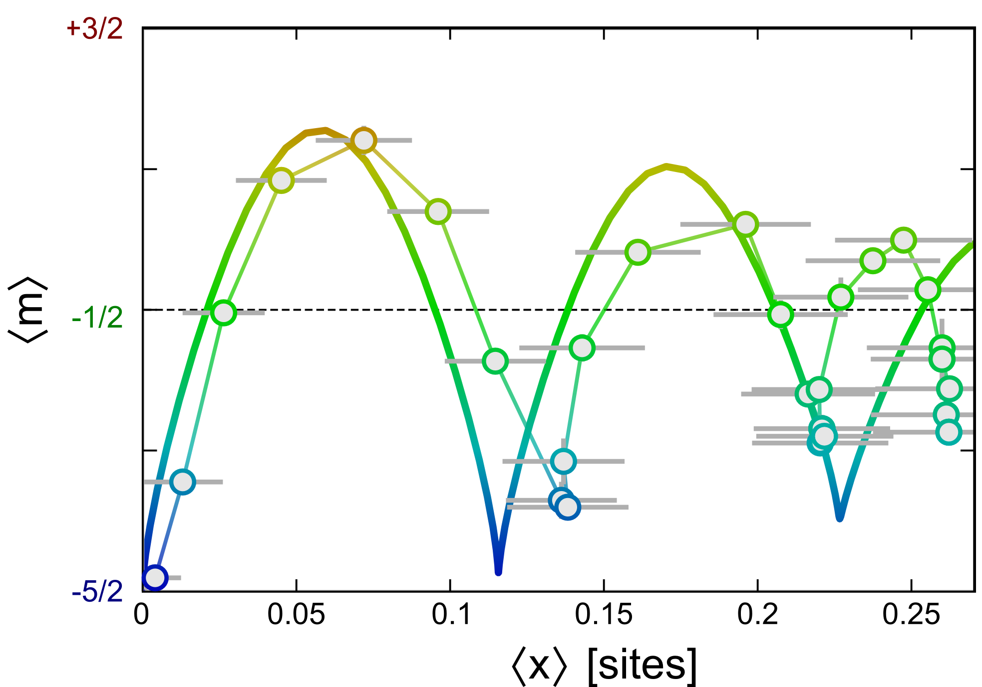
Edge-cyclotron orbits
M. Mancini et al., Science 349, 1510 (2015)
Experimental reconstruction of the average trajectory on the ribbon surface:
Edge-cyclotron orbits:
a hallmark of Hall physics
Related work at JQI/NIST:
B. K. Stuhl et al., Science 349, 1514 (2015)

Slide 16
Intermezzo: spin-orbit coupling
and synthetic flux ladders

Slide 17
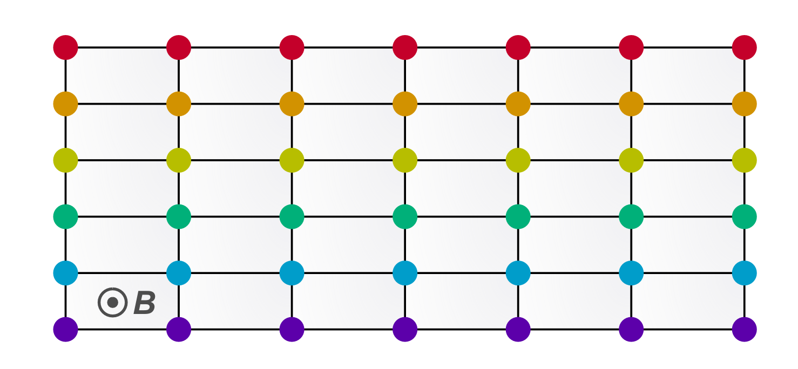

Synthetic spin ladders
artificial magnetic field in synthetic ladders
-5/2
δk
-3/2
B ∝ δk
-1/2
1/2
k
k'
3/2
5/2
two-photon
Raman transitions
+δk
+δk
+δk
+δk
+δk
5/2
3/2
1/2
-1/2
-3/2
-5/2

Slide 18
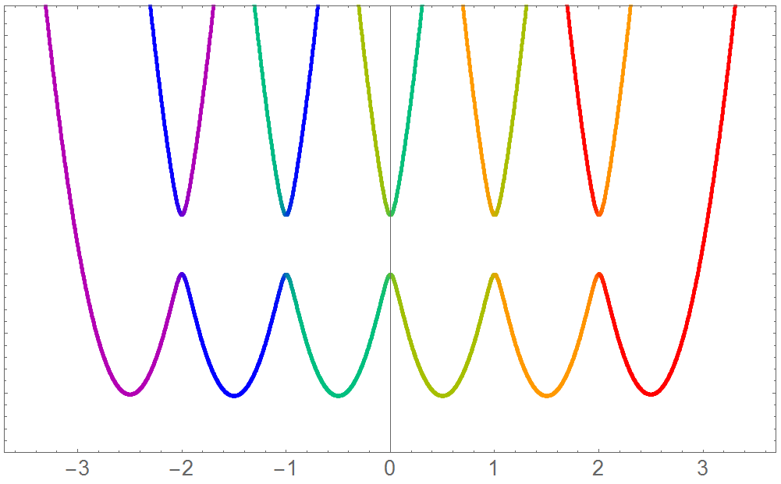
Synthetic spin ladders
spin-orbit coupling in real space
energy
∼Ω
+δk
+δk
+δk
+δk
+δk
momentum [k]
two-photon
Raman transitions
+δk
+δk
+δk
+δk
+δk
-5/2
-3/2
-1/2
1/2
3/2
5/2
3/2
1/2
-1/2
-3/2
-5/2
5/2

Slide 19
Electronic state:
spin-orbit coupling and tunable-flux ladders
or: How to realize a 5th (tiny) dimension
L. F. Livi et al., PRL 117, 220401 (2016)

Slide 20
A new internal degree of freedom
Electronic (orbital) state:
a new degree of freedom for quantum simulation
e
e
³P₀
³P₀
5/2
5/2
3/2
3/2
1/2
1/2
-1/2
-1/2
-3/2
-3/2
-5/2
-5/2
g
¹S₀
5/2
3/2
1/2
-1/2
-3/2
-5/2

Slide 21
Optical clock transition
Electronic (orbital) state:
a new degree of freedom for quantum simulation
e
e
³P₀
τ ∼ 20 s
single-photon optical
clock transition
λ = 578 nm
f = 518 294 576 845 268 (10) Hz
γ ∼ 10 mHz
g
¹S₀
stable

Slide 22
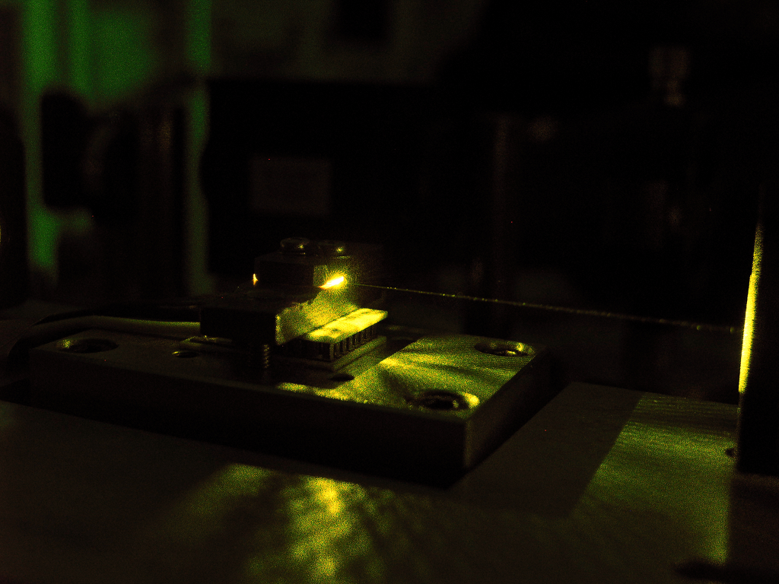
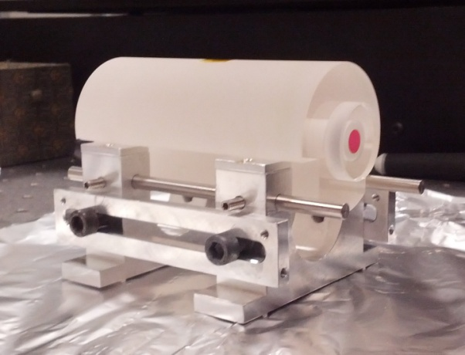
Optical clock transition
G. Cappellini et al., Rev. Sci. Instr. 86, 073111 (2015)
Optical clock technology
Collaboration with INRIM (Turin)
e
e
³P₀
τ ∼ 20 s
single-photon optical
clock transition
λ = 578 nm
f = 518 294 576 845 268 (10) Hz
γ ∼ 10 mHz
g
¹S₀
stable

Slide 23
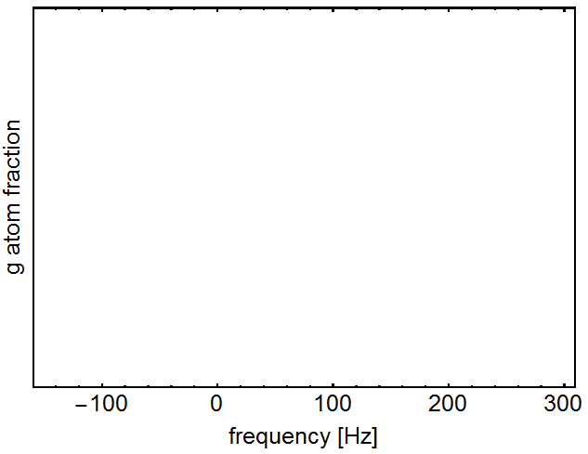
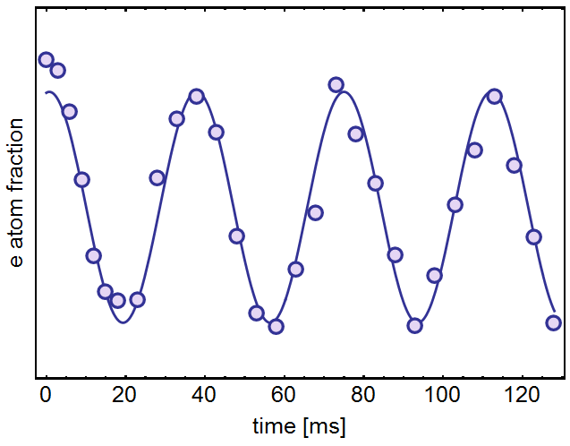
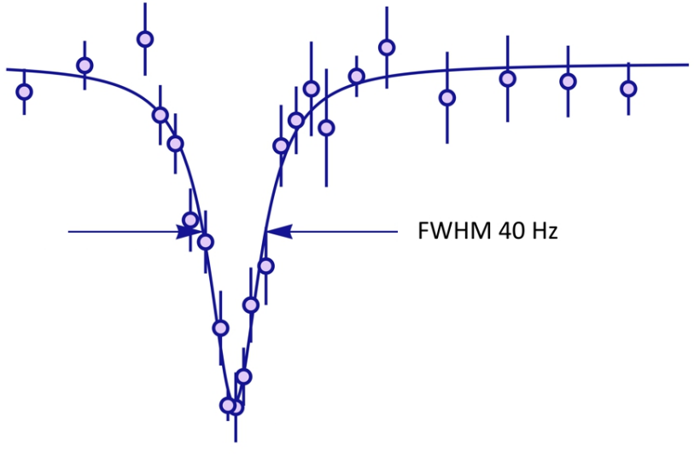
Optical clock transition
G. Cappellini et al., Rev. Sci. Instr. 86, 073111 (2015)
Optical clock technology
Collaboration with INRIM (Turin)
Clock transition spectrum @ 578nm:
Rabi oscillations:
e
e
³P₀
τ ∼ 20 s
single-photon optical
clock transition
λ = 578 nm
<40 Hz FWHM
f = 518 294 576 845 268 (10) Hz
γ ∼ 10 mHz
f = 518 294 576 845 268 (10) Hz
g
¹S₀
stable

Slide 24
Single-photon "spin"-orbit coupling
Transfer of momentum between two stable states with a single photon:
single-photon "spin"-orbit coupling
F. Gerbier & J. Dalibard, NJP 12, 033007 (2010)
M. Wall et al., PRL 116, 035301 (2016)
e
e
³P₀
| +1/2, k + δk ⟩
τ ∼ 20 s
Feature #1:
Pure two-level system
(no heating by intermediate Raman states)
Feature #2:
Simplest exp. configuration
(just one laser beam to align!)
$$H \sim B(k)∙σ$$
+δk
$$B\left(k\right)=(Ω,0,∆E\left(k\right))$$
g
¹S₀
| –1/2, k ⟩
stable

Slide 25
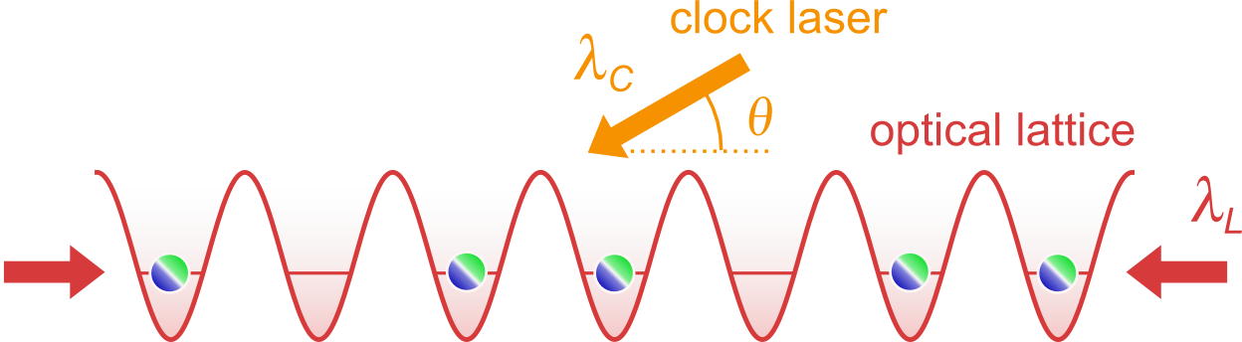
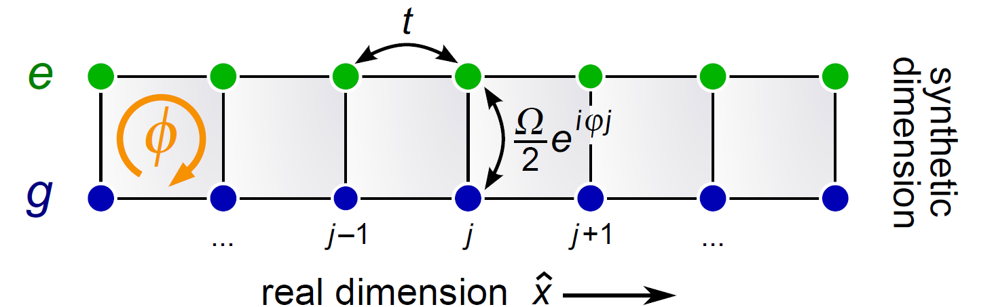

Synthetic "electronic" ladders
L. Livi et al., PRL 117, 220401 (2016)
The simplest experimental arrangement for producing flux ladders
A new synthetic dimension
$$φ =π\frac{λ_{C}}{λ_{L}}\cos{θ}$$
Easily tunable flux!

Slide 26
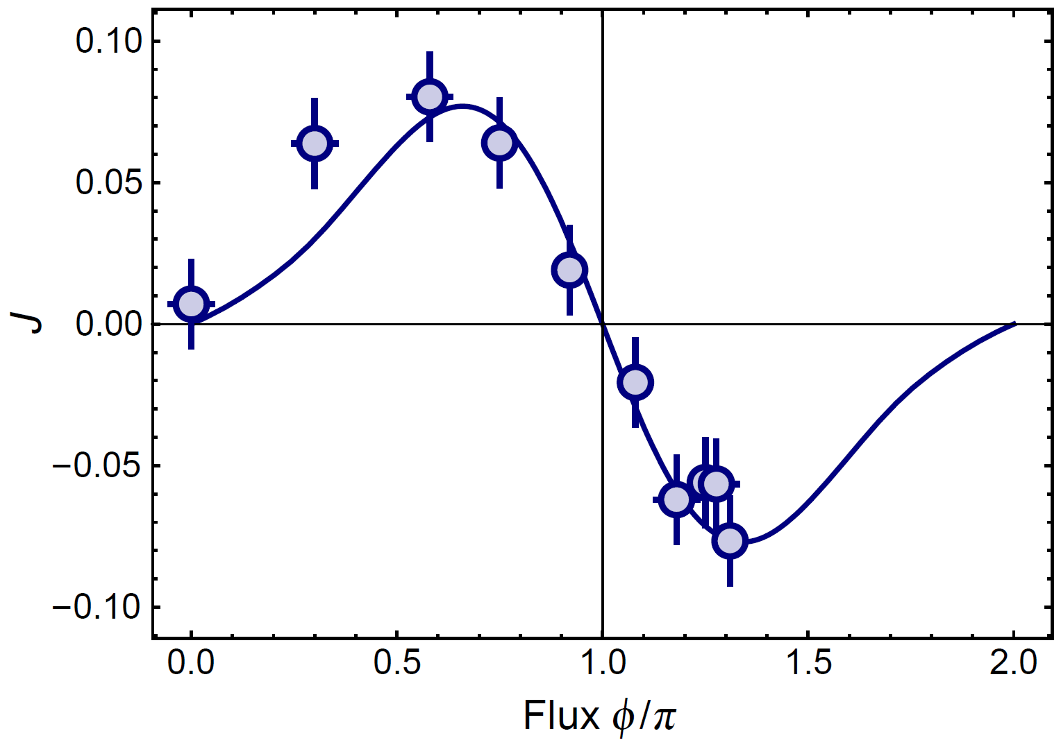


Chiral currents with tunable flux
L. Livi et al., PRL 117, 220401 (2016)
Measurement of
chiral current J vs $φ$
B
B
B
B
effective field: 10⁴ T!

Slide 27
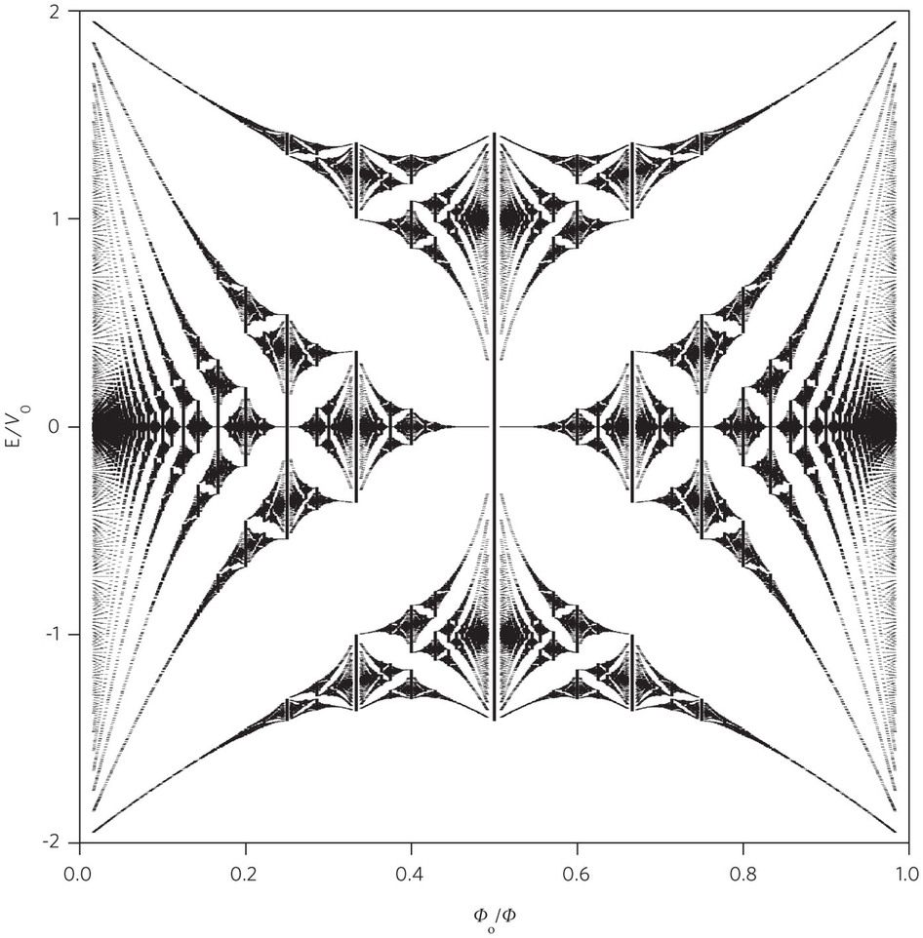
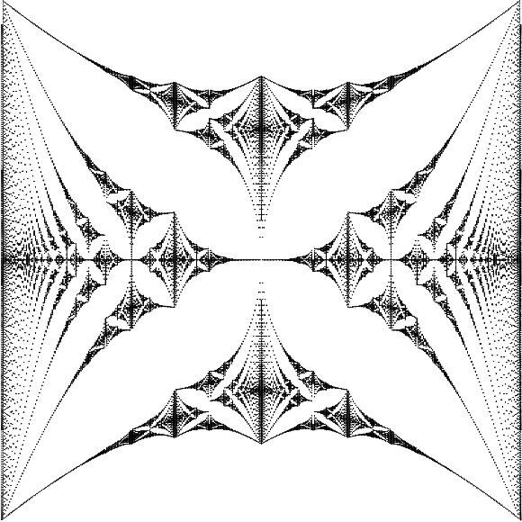
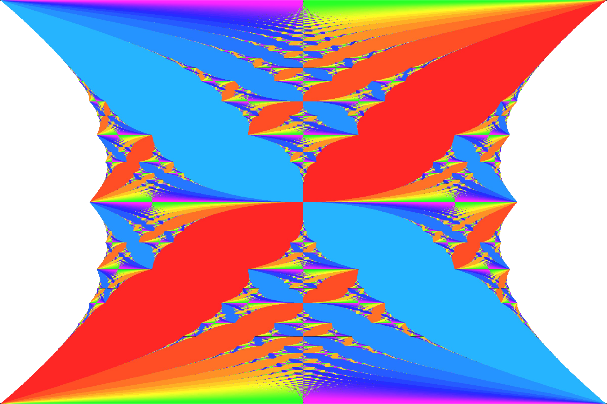
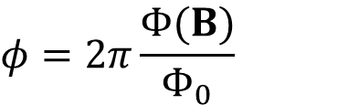




Chiral currents with tunable flux
L. Livi et al., PRL 117, 220401 (2016)
Measurement of
chiral current J vs $φ$
Inversion of J
above $π$flux
Chern number
$$φ=2π\frac{Φ(B)}{Φ_{0}}$$
B
energy
$$J\left(φ\right)=−J(−φ)$$
time-reversal
flux $φ/2π$
$$J\left(φ\right)=J(2π+φ)$$
lattice
Hofstadter's butterfly

Slide 28
Outlook

Slide 29
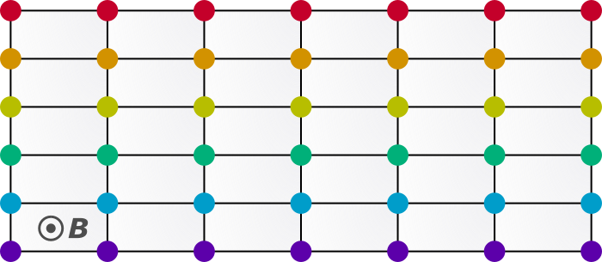
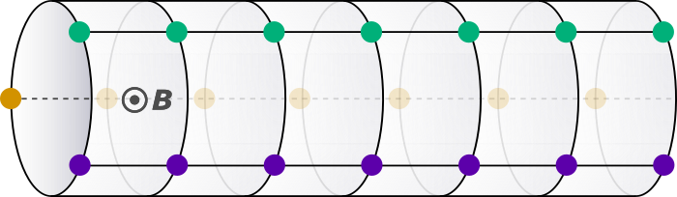



Outlook
#1: Engineering the synthetic dimension
Open / periodic boundary conditions
E. Boada et al., NJP 17, 045007 (2015)
Topological ladders
E. Anisimovas et al., PRA 94, 063632 (2016)
J. Junemann et al., PRX 7, 031057 (2017)
Interactions + gauge fields
Multidim. structures and 4D quantum Hall effect
E. Boada et al., PRL 108, 133001 (2012)
H. Price et al., PRL 115, 195303 (2015)
+ refs from Oded’s talk

Slide 30

Outlook
#2: Effect of interactions and new quantum phases
Long-range interactions in the hybrid lattice:
Same interaction strength btw. different spins
SU(N) interactions
Magnetic crystals, Laughlin-like states, fractional charge pumping
S. Barbarino et al., Nat. Comm. 6, 8134 (2015)
S. Barbarino et al., NJP 18, 035010 (2016)
L. Taddia et al., PRL 118, 230402 (2017)
M. Calvanese Strinati et al., PRX 7, 021033 (2017)

Slide 31









Credits
Lorenzo Franchi
Daniel B. Orenes
Lorenzo Livi
Giacomo Cappellini
Massimo Inguscio
Jacopo Catani
L. F.
Exp. collaboration with INRIM
Funding: ERC (CoG 2016 TOPSIM), EU, MIUR, INFN

Slide 32

Thank you!
Strongly interacting SU(N) fermions
G. Pagano et al., Nature Phys. 10, 198 (2014)
Synthetic dimensions and gauge fields
M. Mancini et al., Science 349, 1510 (2015)
L. F. Livi et al., PRL 117, 220401 (2016)
Nuclear spin and electronic state: engineering new interactions
G. Cappellini et al., PRL 113, 120402 (2014)
G. Pagano et al., PRL 115, 265301 (2015)
Precision spectroscopy and fiber-link frequency metrology
C. Clivati et al., Opt. Express 24, 11865 (2016)
L. Franchi et al., New J. Phys. 19, 103037 (2017)
Majorana zero-energy modes (theory proposal)
F. Iemini et al., PRL 118, 200404 (2017)
<40 Hz FWHM
quantumgases.lens.unifi.it
fallani@lens.unifi.it

Slide 33

Organizers:
Leonardo Fallani
Tommaso Macrì
Cristophe Salomon
Luis Santos
www.iip.ufrn.br

