Slide 1
Creating and detecting ultra-long-range Rydberg molecules and their ghosts
Chris Greene, Purdue University
with Matt Eiles and Jesus Perez-Rios on the
Rydberg molecule theory
Experimental collaboration groups: Herwig Ott’s group at Kaiserslautern and Tilman Pfau’s group at Stuttgart on recent Rydberg molecule experiments
and thanks to the NSF for support

Slide 2
This talk is has two themes:
1. The unreasonably powerful effect of a short range phaseshift
2. The strongly nonperturbative implications of high degeneracy
With this in mind, I will discuss:
Ultra-long-range Rydberg molecules and their Ghosts
Efimov physics with a charged particle – a challenge, never yet observed in experiment

Slide 3
A common thread through nearly all ultracold systems, both few-body and many-body, is that particles are DILUTE, and only occasionally collide, and in those short range collisions they acquire a phase change due to the short range interaction. This can sometimes be nonresonant and cause a small energy shift, sometimes be strong enough to bind, sometimes cause a low energy scattering resonance
Thanks, Enrico Fermi!

Slide 4
A very recent review of ultra-long-range Rydberg molecules:
*Shaffer, Rittenhouse, and Sadeghpour, Nature Comm. 9, 1965 (2018)
Some recent reviews of few-body physics (universality & Efimov physics):
*Naidon and Endo, Rep. Prog. Phys. 80 056001 (2017)
*D’Incao, J. Phys. B 51 043001 (2018)
*CHG with Giannakeas and Perez-Rios Rev. Mod. Phys. 89 035006 (2017)
Of particular interest in the realm of few-body physics are systems with very large interaction lengths, i.e. scattering lengths or scattering volumes

Slide 5
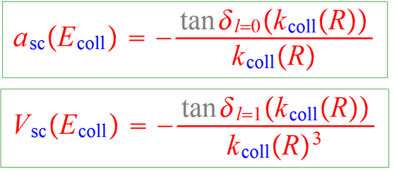
As reported in our 2000 PRL, it struck us (Alan Dickinson, Hossein Sadeghpour, and myself) that these oscillating potential curves can hold real vibrational bound states, molecules held together by this “sheep-dog binding” mechanism
This is epitomized by the Fermi-Omont-type zero-range pseudopotential which depends on the scattering length (S-wave) and on the scattering volume (P-wave):

Slide 6
This is epitomized by the Fermi-Omont-type zero-range pseudopotential which depends on the scattering length (S-wave) and on the scattering volume (P-wave):
Extensive physics in many fields is controlled to a large extent by this Hamiltonian:
GP equation (BEC),
Degenerate Fermi gas,
Bogoliubov theory,
effective field theory
and in few-body physics,
the Efimov effect,
nuclear physics at the unitarity limit,
ultra-long-range Rydberg molecules

Slide 7
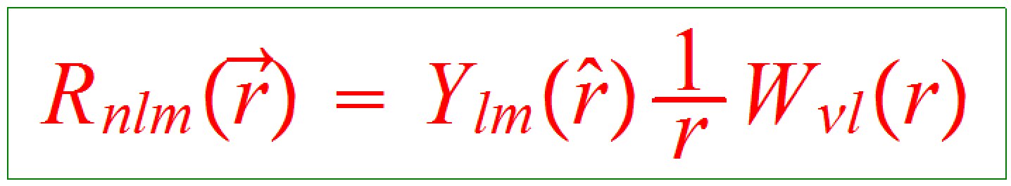
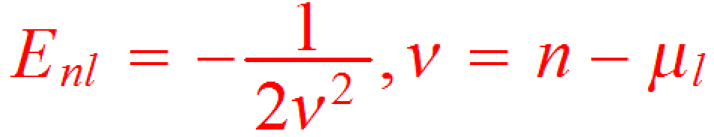
Then starting from unperturbed Rydberg atom eigenstates of the atomic Hamiltonian (e.g. Rb*), which of course for an alkali atom like Rb* are simple one-electron functions including their quantum defects, i.e. at distances beyond r ~ 5 bohr, the Whittaker functions:
It is pretty simple to see that the effect of a delta function interaction potential will now produce Born-Oppenheimer potential curves that oscillate just like the radial wavefunction, in first order nondegenerate perturbation theory, i.e.:
μ = quantum defect, approx. indep. of n

Slide 8
Experimental groups with observations of Rydbeg+Ground State ultra-long-range Rydberg molecules
U. Stuttgart (Pfau)
U. Oklahoma (Shaffer)
U. Michigan (Raithel)
Rice Univ. (Killian,Dunning)
U. Connecticut (Gould, Eyler)
ETH Zurich (Deiglmayr, Merkt)
U. Kaiserslautern (H. Ott)
U. Ulm (Denschlag, preliminary)

Slide 9
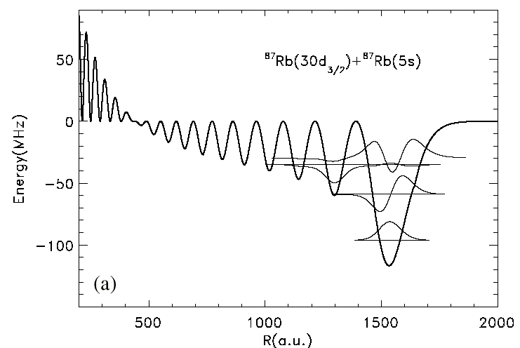
Bendkowsky, Pfau, Shaffer et al. 2009 Nature, 1st observation
CHG, Dickinson, Sadeghpour 2000 PRL
Anderson, Raithel et al. 2014 PRL
Cs*Cs → PRL 2015

Slide 10
Gaj et al. (Pfau group expt)
Comparison with theory:

Slide 11
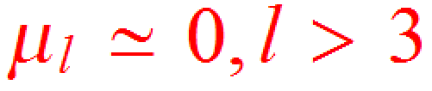
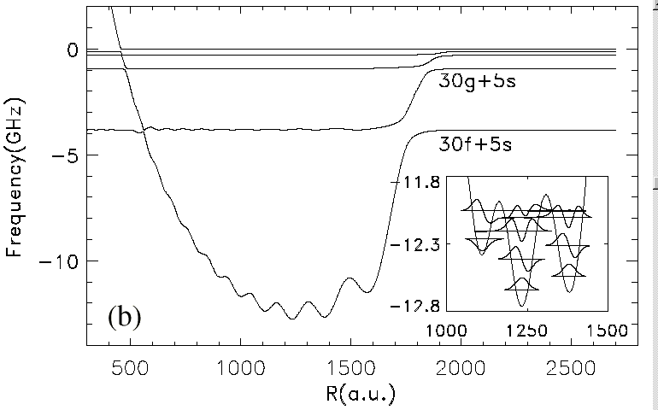
But from a theory point of view, first-order nondegenerate perturbation theory is …. to be blunt….. BORING
A system with high degeneracy can have strong, qualitatively different behavior, and Rydberg molecules are no exception to this rule
Recall that in all atoms in the periodic table, only the low-l states have sizeable quantum defects, i.e.
Therefore, since degenerate states can hybridize with no energy cost to minimize the energy of the system, they create far stronger interactions. To put it as an oxymoron, one might even assert that:
DEGENERATE PERTURBATION THEORY IS NONPERTURBATIVE
Low-l state, shallow (100 MHz)
High-l states, deep (10 GHz)
→

Slide 12
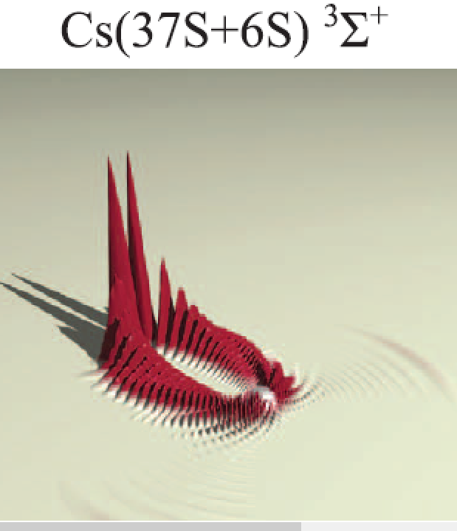
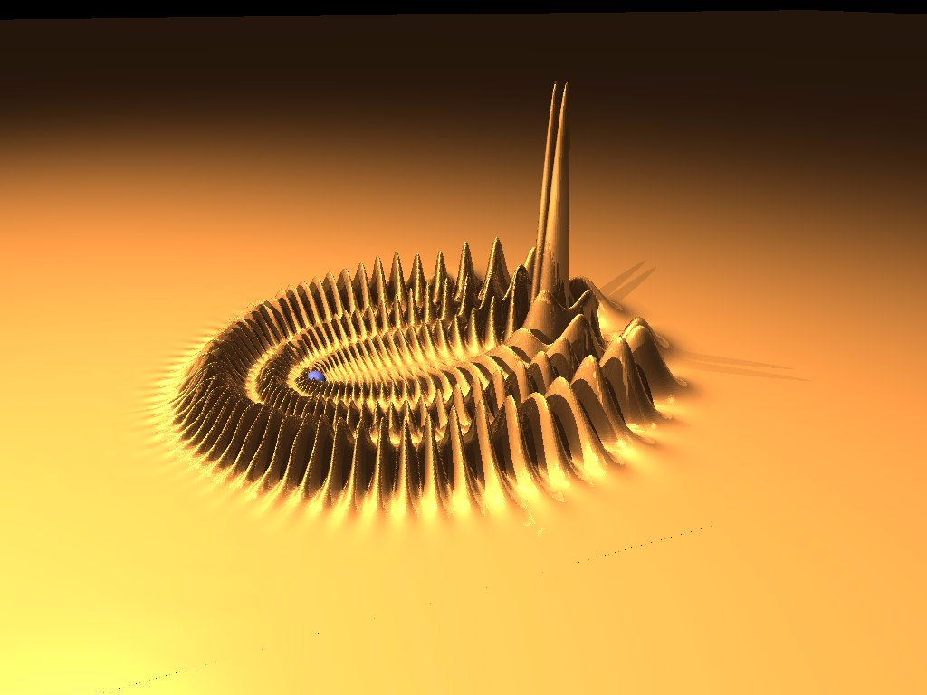
And you can see this difference far more dramatically in the wavefunction plots:
Low l, 35s state
Cs*-Cs trilobite that is mixed with the 37s state:
→
High l>2, n=30 state
The “Trilobite” molecule, Rb*-Rb
Experimentally observed, Shaffer group, 2015 Science
→
PRL 85 2458 (2000)

Slide 13
Spin-orbit splitting can be important in the P-wave electron-atom scattering phaseshifts that are used in the Omont zero-range pseudopotential, as seen from the Bahrim & Thumm & Fabrikant results shown for Cs and Rb:
e-Cs
e-Rb

Slide 14
A recent extension to capture the J-dependent electron-atom scattering in the ³P_{J} partial wave of the electron-atom collision:
Matt Eiles & CHG,
Phys. Rev. A 95, 042515 (2017); + erratum Phys. Rev. A 98, 019901 (2018)
(for an earlier, more approximate treatment, see Markson, Rittenhouse, Schmidt, Shaffer, and Sadeghpour, 2016 ChemPhysChem)
Omont’s P-wave term (L=1) in irreducible tensorial form:
... which we have recoupled to display the J-dependence explicitly→
where

Slide 15
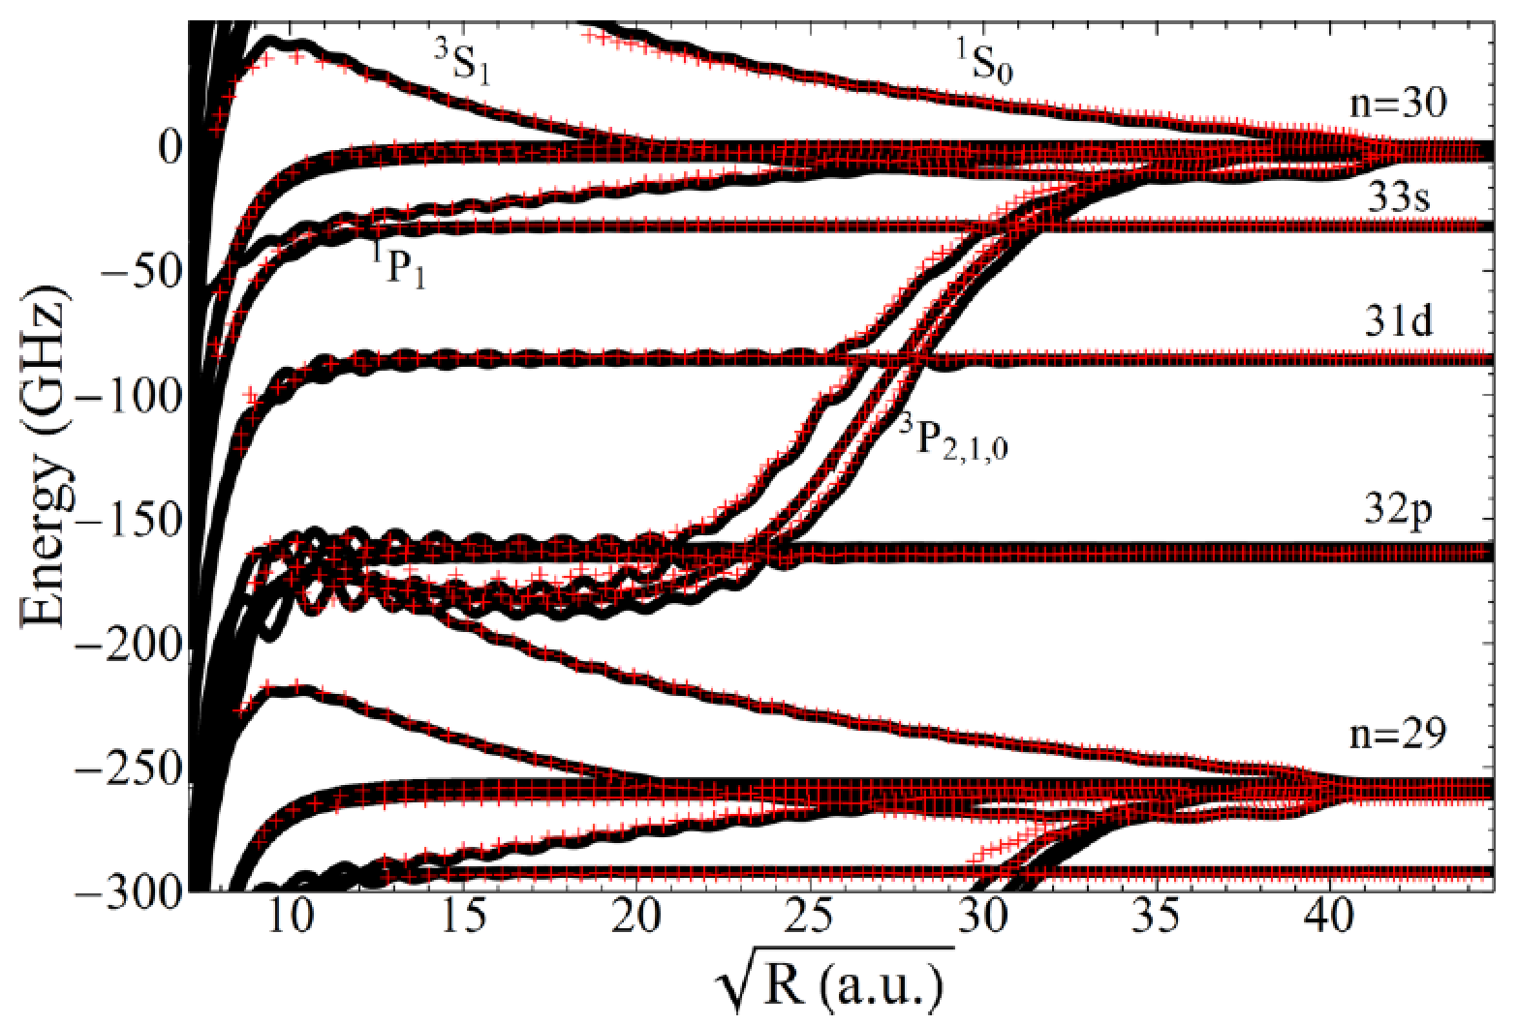
Comparison of our recoupled Omont-style J-dependent operator with the Green’s function treatment of Khuskivadze, Chibisov, and Fabrikant for Rb*Rb
Encouraging agreement between our Omont-style generalized operator and their GF treatment
Note: this spin-dependent treatment yields improved agreement for the electric dipole moments of the butterfly Rydberg states measured by Herwig Ott’s group in a Rb BEC: Nature Commun. 2016 by Niederpruem, Thomas, Eichert, Lippe, Perez-Rios, CHG & Ott

Slide 16
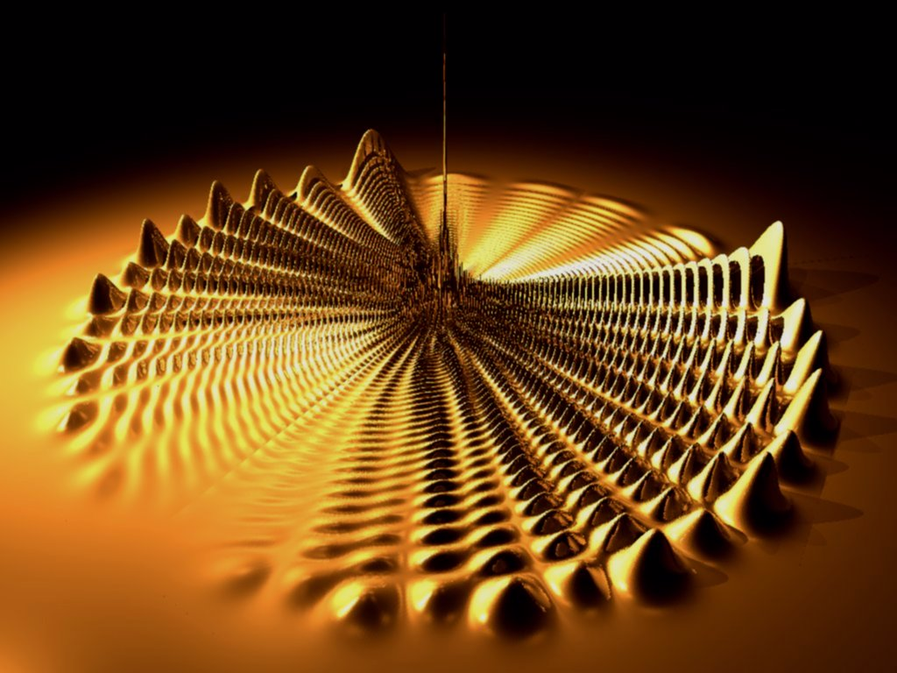
But until 2016, only indirect evidence of butterfly Rydberg molecules had been seen. Now, the group of Herwig Ott has observed them in spectroscopic detail.
Butterfly Rydberg molecule, n=70
J. Phys. B: 35 (2002) L199–L206

Slide 17
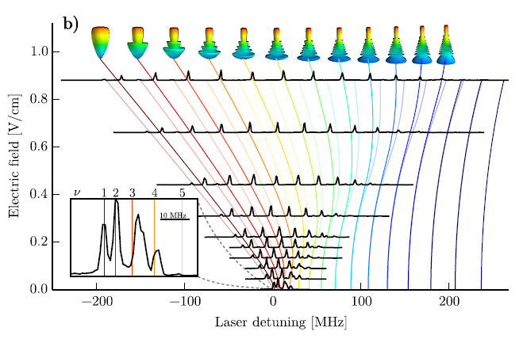
Stark spectroscopy of the butterfly Rydberg molecules, showing the pendular states associated with permanent electric dipole moments of the molecules
Herwig Ott group,
Nature Commun. 7, 12820 (2016)

Slide 18
Next, let’s build on this capability to excite states with huge dipole moments. An experiment proposed by Matt Eiles, J. Perez-Rios, H. Lee, and CHG in PRA 95 052708 2017

Slide 19
Ghost Trilobite Chemical Bond:
An application of coherent control
(Matt Eiles, Zhengjia (Jaron) Tong, & CHG
arXiv:1806.02963
Observe that the trilobite and butterfly chemical bonds are simply linear combinations of the degenerate hydrogenic states
This linear combination would be a stationary state even if there is no distant ground state atom
This means it is simply a problem of coherent control to create such a chemical bond, even with no second atom present to bind

Slide 20
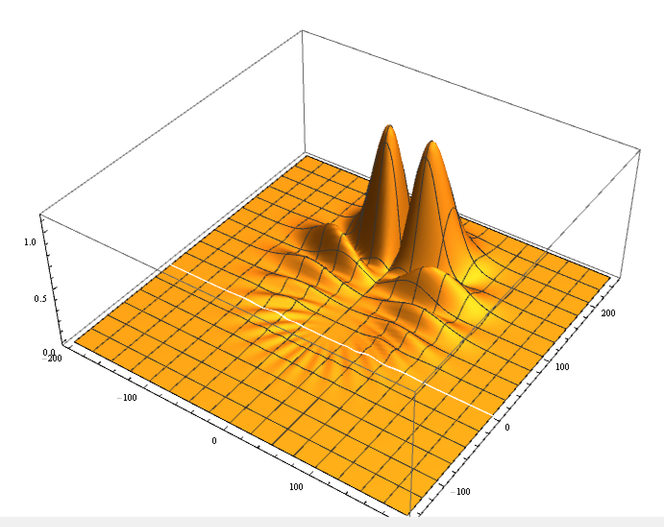
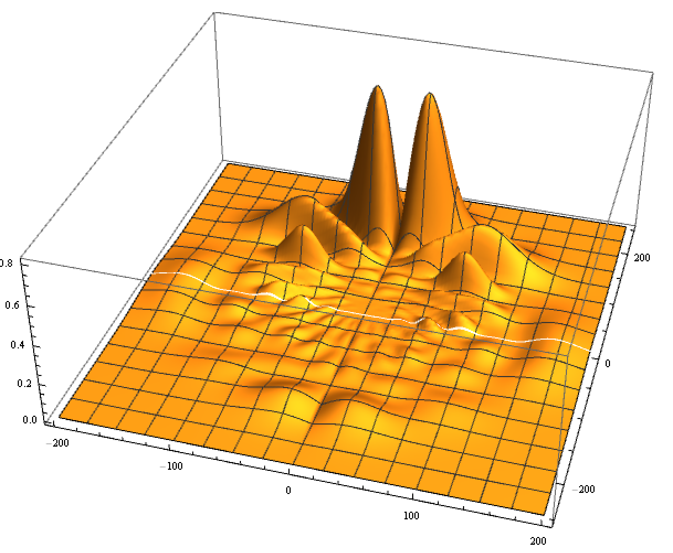
An early example we tried, using a random Monte Carlo search through the field pulse parameters.
Conclusion: it is hard to find a pulse sequence this way that gives better than about an 80% trilobite for n=10
Solution: Use instead a “machine learning” gradient ascent algorithm to optimize the pulse sequence
A “Ghost trilobite” state of one atom only, created by laser excitation followed by a sequence of E and B pulses
Exact electronic wavefunction of an n=10 trilobite molecule

Slide 21
In this study, we explore the possibility of creating a trilobite-like chemical bond through a sequence of controlled field pulses, before there is even a second atom present to bind with
The Scheme
A sequence of electric and magnetic field pulses can in principle be used, but it is difficult to turn magnetic fields off and on sufficiently rapidly.
The method we propose involves the following steps:
1. A two-photon excitation pulse to a high S-state (70s)
2. A comparatively slow ramp-on of a static magnetic field (B~100G) which is then held fixed until the end
3. A sequence of electric field pulses of fixed magnitude but variable time intervals
4. A slow ramp-down of the magnetic field down to zero

Slide 22
Goal - create the trilobite state, which has the following form:
original depiction in cylindrical coordinates
The proposed scheme, illustrated with the n = 70; b = 1 trilobite and the same color scheme as in Fig. 1. a) An nS Rydberg state is created. b) The magnetic field ramps on over tens of microseconds, creating a quadratic Zeeman state. c,d) Many short electric field pulses are applied over the constant magnetic field background, creating complicated superpositions of the degenerate states. e) At the end of the sequence of electric field pulses, a proto-trilobite is created. The magnetic field ramps on and this state evolves into the true trilobite state, f), which is detected.

Slide 23
When the electric field is off →
When the electric field is on →
(A simple application of “machine learning”)

Slide 24
Evolution of the L-distributions during the pulse sequence

Slide 26
Two possible methods to observe the trilobite nature of a bond
(e,2e) spectroscopy (high E) measures the momentum space wavefunction
or... x-ray diffraction measures the Fourier transform of the spatial density |psi|^2

Slide 27
Efimov physics with an electron and two ground state atoms
Recall that Efimov physics becomes more prominent and observable when there are two heavy particles and one light particle, e.g. with Cs-Li-Cs, where the usual homonuclear scaling between Efimov resonances 22.7 changes to 4.8, allowing multiple Efimov resonances to be observable
Another possibility hinted at for years (Efimov 1973, Pen’kov 1996) but not yet observed: use an electron as the light particle. Then, for instance, for the Rb – e – Rb system, the homonuclear Efimov scaling factor 22.7 is modified to 1.020.
A recent discussion of this physics is developed in a preprint:
→H. Han & CHG, arXiv:1803.05333 Observability of the Efimov spectrum in an electron-atom-atom system

Slide 28
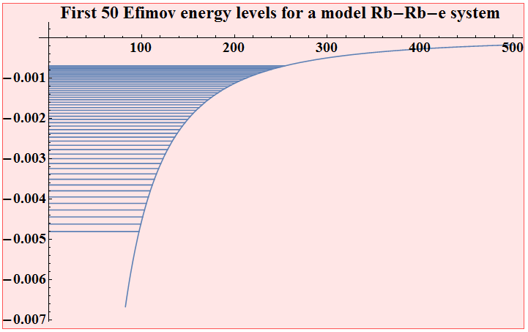
More speculations…. What if, instead of three neutral atoms…..
…the light particle is an electron, e.g. for Rb-Rb-e,
the Efimov scaling factor is s0* = 160.28 and exp(pi/s0*)=1.020
Mass ratio is now
M/m=1.6 x 10⁵
The density of levels looks more like a Rydberg series, except the scaling is geometric, i.e. E_{n+1} = E_{n} x 1.020

Slide 30
Relevant dimensions in distance and energy:
Unitarity energy spectrum for the Rb-e-Rb system, showing the dense quasi-Efimov character of the weakly bound energy levels
Note: because the energy levels are so dense, only every second energy level is plotted.
Here a very large Rb-Rb scattering length is assumed, as would be appropriate for ⁸⁵Rb triplet.

Slide 31
Observability of the Efimov spectrum in an electron-atom-atom system
Huili Han & CHG, arXiv: 1803.05333
= an extreme heavy-heavy-light system!
Here the Efimov scaling factor 22.7 → 1.02 !

Slide 32
The full Efimov-style plot for this system shows a very interesting high density of levels, with spacings that evolve smoothly from nonuniversal to quasi-Efimov to a true Efimov spacing regime

Slide 33
This figure shows that the approach to universality even for infinite scattering lengths is rather gradual. The Efimov universal value for this ratio is:
1/1.02² ~0.96

Slide 34
Conclusions
One can in principle form a “ghost chemical bond” out of the degenerate hydrogenic manifold, i.e. a “pre-formed” chemical bond with no distant bonded atom present.
A promising set of dense “quasi-Efimov-levels” should exist for an electron in the field of two neutral atoms, which are observable even at fixed electron-atom scattering length. Nevertheless, it is desirable to find ways to manipulate the electron-atom scattering length like we do in ultracold atomic physics

