Slide 1
How to dress RF photons with tunable momentum, and magnetic spin-orbit coupling
Wolfgang Ketterle
Massachusetts Institute of Technology MIT-Harvard Center for Ultracold Atoms
July 30, 2018
Humboldt Kolleg, Vilnius

Slide 2
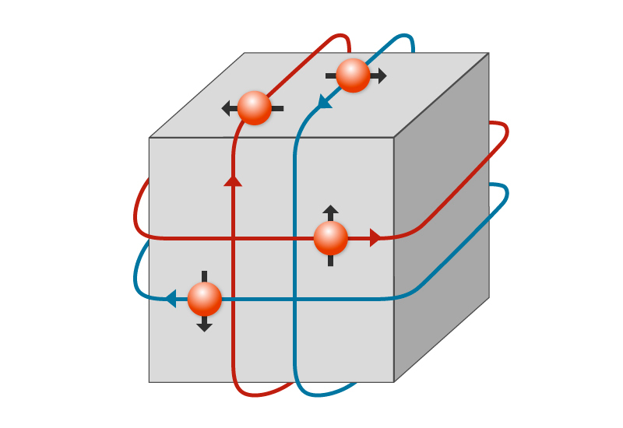
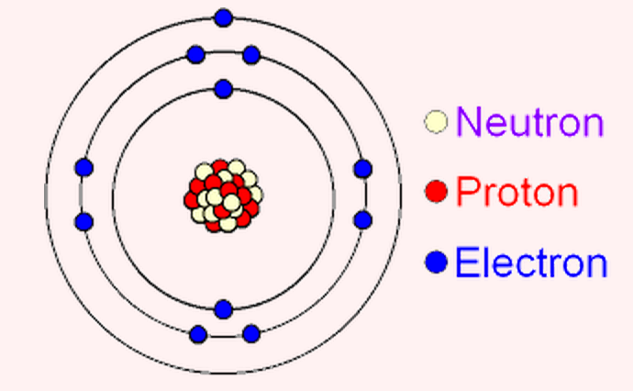
Spin-orbit coupling leads to new materials with fundamentally different properties
SOC in atomic physics
SOC in condensed matter
p ⋅ σ
atomic internal structure
fine structure splitting
Topological insulator
quantum anomalous Hall effect
topological superconductor
Majorana fermions …
supersolids

Slide 3
1D Spin orbit coupling is equivalent to
a spinflip with momentum kick
Two-photon Raman transition
Exp. demonstration: Lin, Y.-J., Jiménez-García, K., and Spielman, I. B. , Nature 471, 83–86 (2011).
Early suggestions: Osterloh, K., Baig, M., Santos, L., Zoller, P. & Lewenstein, M., Phys. Rev. Lett. 95, 010403 (2005); Ruseckas, J., Juzeliūnas, G., Ohberg, P. & Fleischhauer, M., Phys. Rev. Lett. 95, 010404 (2005).

Slide 4
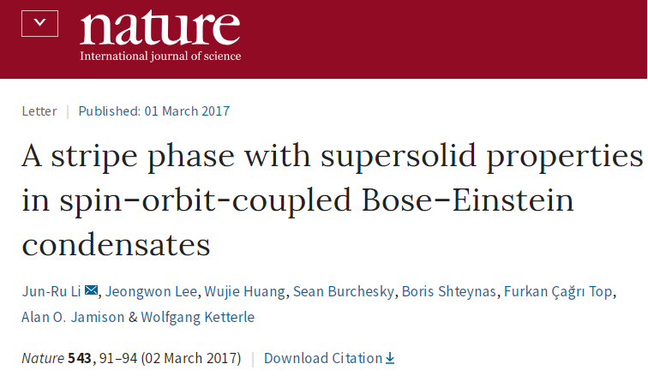

Slide 5
Laser beams
Ultrahigh vacuum chamber
Rf and microwaves
a million nanokelvin atoms
Box made with
electric and/or magnetic fields

Slide 6
Powerful extension of this method:
Use time-modulated or pulsed electromagnetic fields or laser beams
“Floquet engineering”
Floquet's theorem:
for fast periodic driving, the time evolution can be separated
"slow" part described by an effective time-independent Hamiltonian
“fast” part ("micromotion“), describes dynamics within a driving period.

Slide 7
Famous example:
Paul trap (quadrupole trap) for charge particles
Because div E =0, it is not possible to have a 3D inward force
for charged particles.

Slide 8
Famous example:
Paul trap (quadrupole trap) for charge particles
Because div E =0, it is not possible to have a 3D inward force
for charged particles.
Solution: alternate inward and outward forces (alternating gradient focusing in particle accelerators)
Net effect:
focussing
with time-modulated fields you can realize Hamiltonians which
are impossible to create with static fields

Slide 9
Actually, the scheme for the supersolid involved spinflips
induced by a periodically modulated lattice

Slide 10
How to dress RF photons with momentum
or
Floquet engineering of photon recoil
or
Spin-orbit coupling with magnetic forces
B. Shteynas, J. Lee, F.C. Top, J. Li, A.O. Jamison, G. Juzeliunas, W.K., Preprint, arXiv: 1807.07041

Slide 11
Two ingredients:
oscillating magnetic force (AC gradient of magnetic field)
RF spinflip (10 MHz)
None of them transfers net momentum

Slide 12
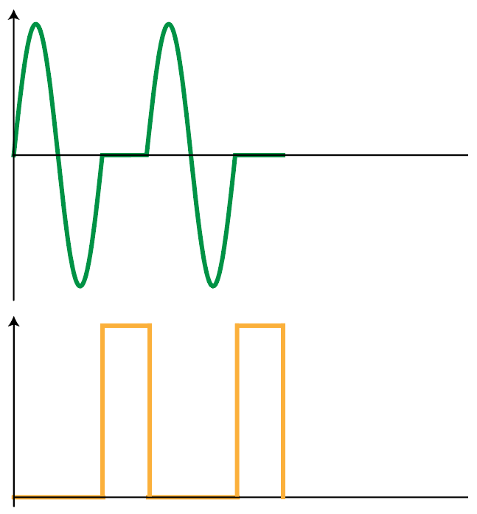
$$B′$$
RF
weak
RF pulses
magnetic force:
extra kick = recoil

Slide 13
$$B′$$
RF

Slide 14
$$B′$$
RF

Slide 15
$$B′$$
RF

Slide 16
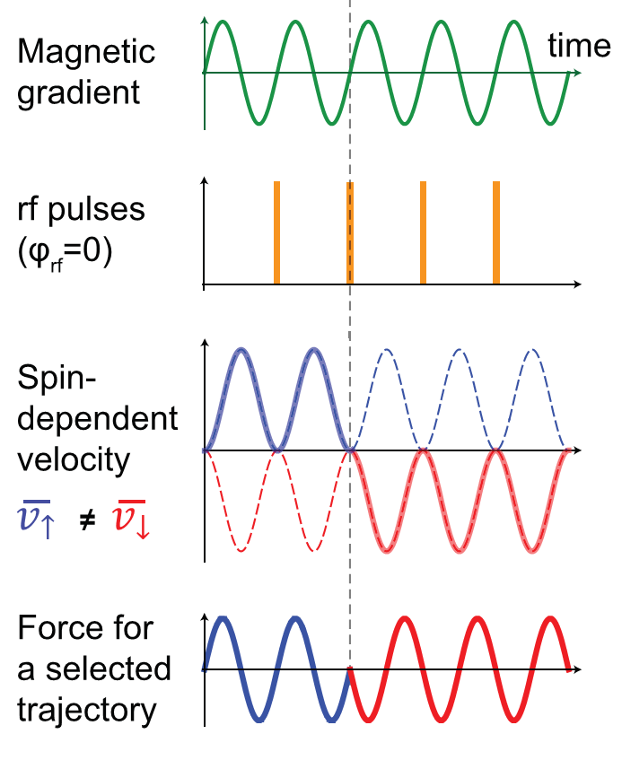

Slide 17
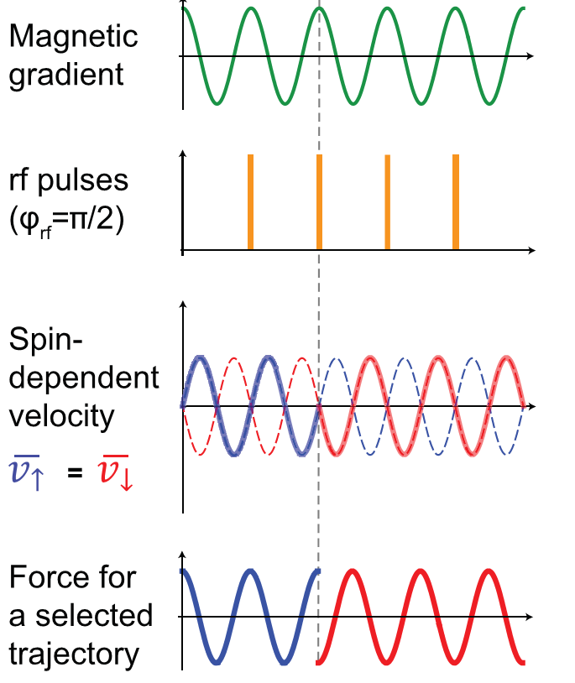

Slide 18
So we have recoil
What about Doppler shift δω = k v ?

Slide 19
Energy conservation

Slide 20
Energy conservation
Doppler
shift
recoil shift

Slide 21
π pulse would flip ALL velocity classes
resonance = RF resonance (no Doppler shift)
energy comes from time-dependent magnetic field

Slide 22
weak RF pulses
⇒ Doppler shift

Slide 23
Doppler Sensitive RF spin-flip
Between RF pulses:
free evolution
Frequency:

Slide 24
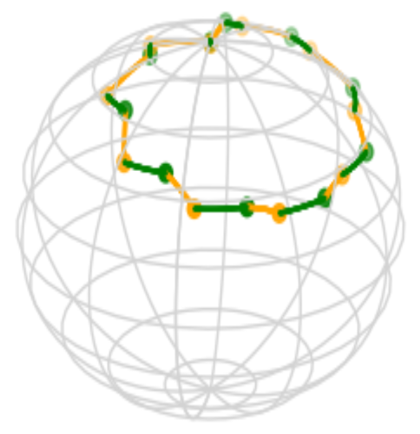
Doppler Sensitive RF spin-flip
Case 1: Rf phase of 0 relative to B’ & off-resonant
Bloch sphere picture

Slide 25
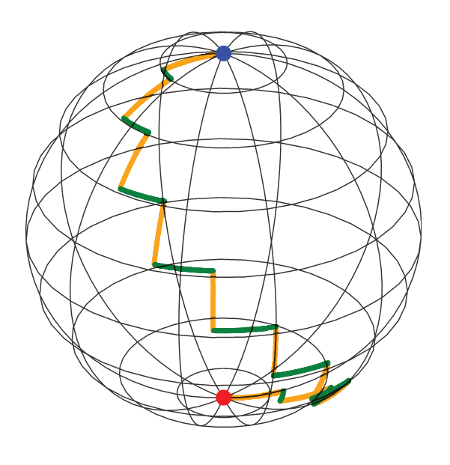
Doppler Sensitive RF spin-flip
Case 2: Rf phase of 0 relative to B’ & on-resonant
Bloch sphere picture
…
…
…

Slide 26
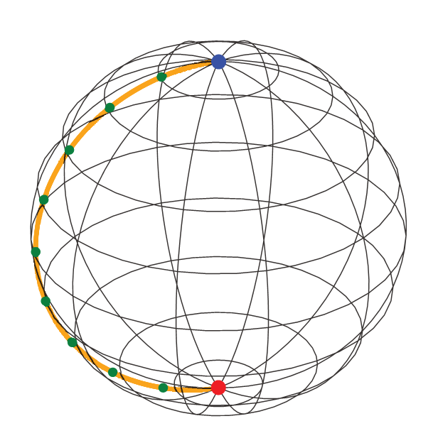
Doppler Insensitive RF spin-flip
Case 3: Rf phase of π/2 relative to B’
Bloch sphere picture
No Doppler shift

Slide 27
Summary:
spin dependent oscillating force
phase shift

Slide 28
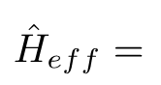
Floquet treatment:
K: kick operator
$$B′$$
For weak resonant RF pulses
RF

Slide 29
Our system:
Thermal cloud of Na just above BEC
optical trap
F=1, M=0 coupled to F=1, M=-1
shaking at ≈100 G/cm at 5-10 kHz, k_{recoil} ≈ 0.1 k_{optical}
for 1-2 ms

Slide 30
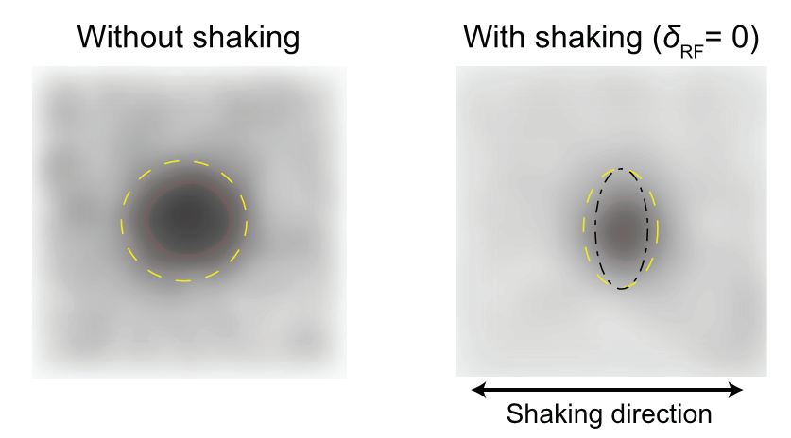
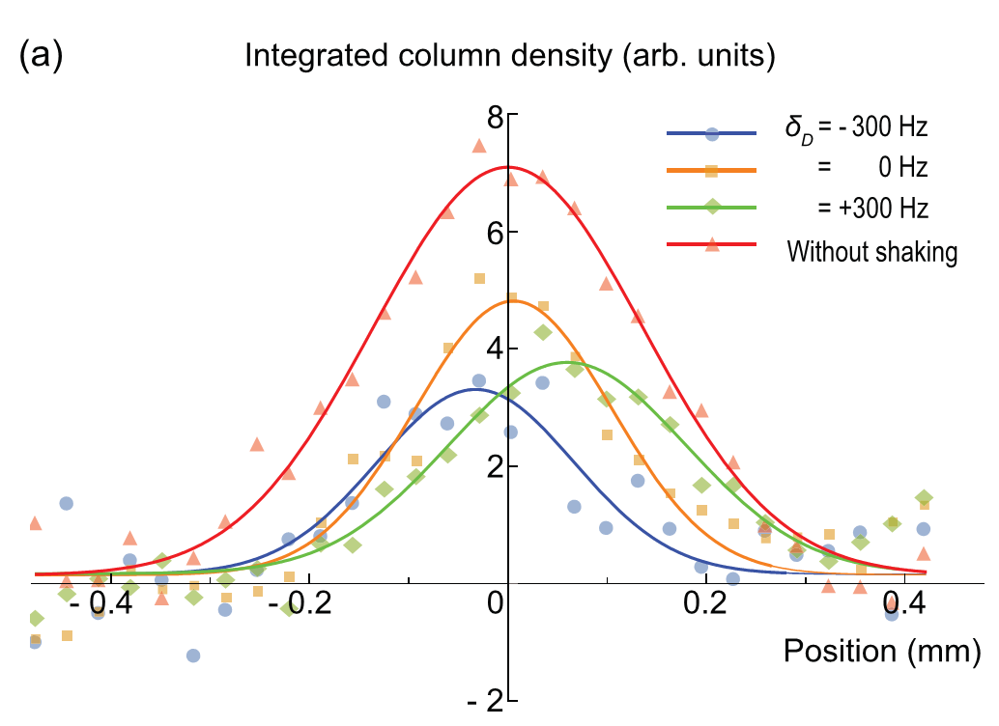
Observation of velocity selective Rf transitions in ballistic expansion

Slide 31
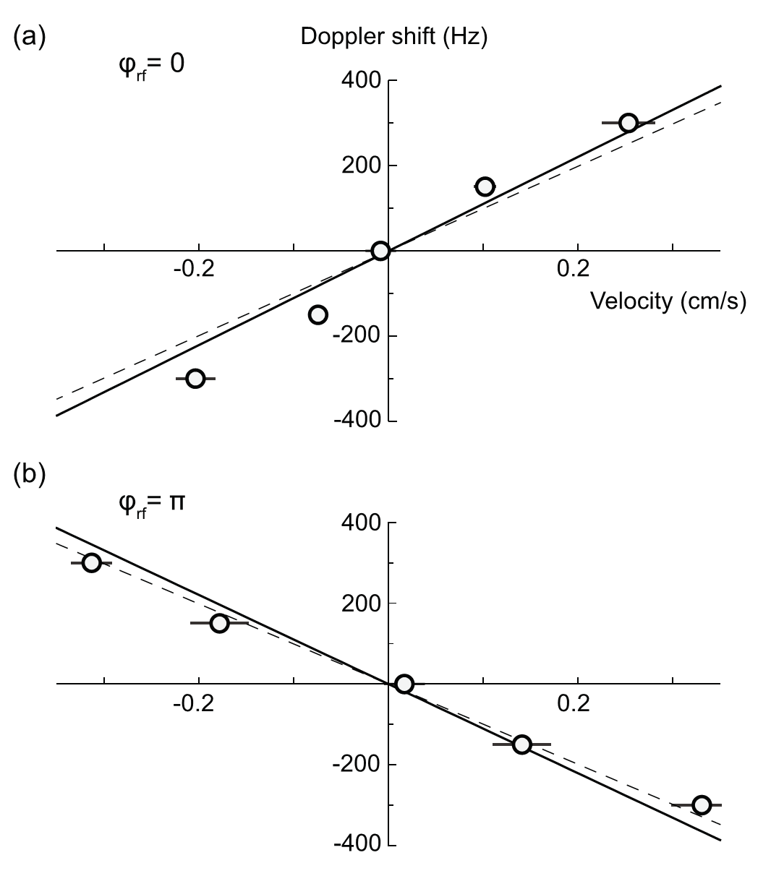
Observation of Rf phase dependent velocity selectivity: φ=0
Spin-up velocity slice [vs] Rf detuning

Slide 32
Observation of Rf phase dependent velocity selectivity: φ= π
Velocity (cm/s)
Spin-up velocity slice [vs] Rf detuning

Slide 33
Back to spin-orbit coupling:
Spin orbit coupling is (often) equivalent to a spinflip with momentum kick

Slide 34
Back to spin-orbit coupling:

Slide 35
Back to spin-orbit coupling:

Slide 36
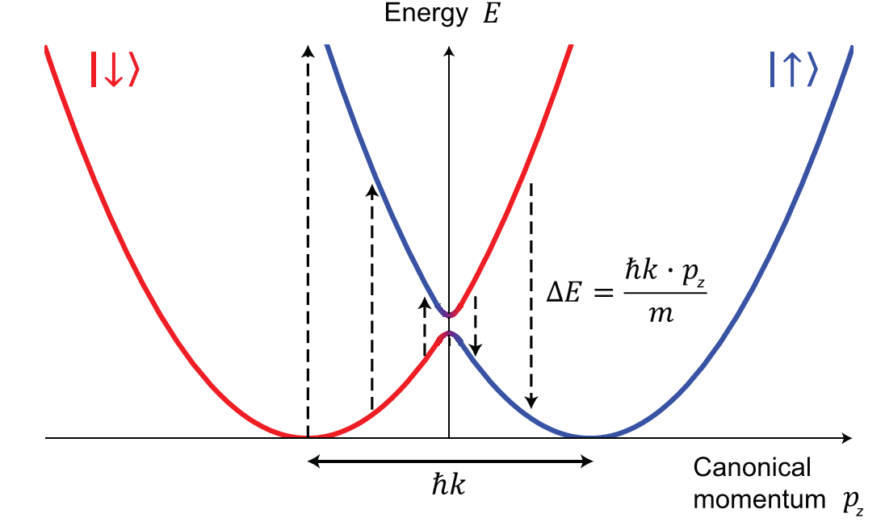
Spin-Orbit Coupling without lasers:
Floquet engineered Rf transitions
Vertical dashed arrows
= Doppler sensitive Rf transitions

Slide 37
Spin-orbit coupling by magnetic shaking
Theoretical suggestions:
2D spin orbit coupling:
Z.-F. Xu, Li You, M. Ueda, PRA 87, 063634 (2013); B.M. Anderson, I.B. Spielman, G. Juzeliunas, PRL 111, 125301 (2013)
Our 1D scheme:
X. Luo, …, L. You, R. Wang, Tunable atomic spin-orbit coupling synthesized with a modulating gradient magnetic field. Sci. Rep. 6, 18983 (2016).
Related work on spin-dependent lattices
J. Struck, J. Simonet, K. Sengstock, PRA 90, 031601(R) (2014)
G. Jotzu, …, T. Esslinger, PRL 115, 073002 (2015)

Slide 38
Magnetic shaking without RF transitions:
X. Luo, …, L. You, R. Wang, Tunable atomic spin-orbit coupling synthesized with a modulating gradient magnetic field. Sci. Rep. 6, 18983 (2016).
L.-N. Wu, …, M. Ueda, R. Wang, L. You, Harmonic trap resonance enhanced synthetic atomic spin-orbit coupling. Sci. Rep. 7, 46756 (2017).
does not realize spin-orbit coupling

Slide 39
Magnetic shaking without RF transitions:
X. Luo, …, L. You, R. Wang, Tunable atomic spin-orbit coupling synthesized with a modulating gradient magnetic field. Sci. Rep. 6, 18983 (2016).
L.-N. Wu, …, M. Ueda, R. Wang, L. You, Harmonic trap resonance enhanced synthetic atomic spin-orbit coupling. Sci. Rep. 7, 46756 (2017).
does not realize spin-orbit coupling
free particle Hamiltonian
magnetic shaking involves only kick operator K

Slide 40
Magnetic shaking without RF transitions:
X. Luo, …, L. You, R. Wang, Tunable atomic spin-orbit coupling synthesized with a modulating gradient magnetic field. Sci. Rep. 6, 18983 (2016).
L.-N. Wu, …, M. Ueda, R. Wang, L. You, Harmonic trap resonance enhanced synthetic atomic spin-orbit coupling. Sci. Rep. 7, 46756 (2017).
does not realize spin-orbit coupling
free particle Hamiltonian
magnetic shaking involves only kick operator K

Slide 41
Experimental challenges:
(sub-)kHz resolution, (sub-)mG field stability
stainless steel chamber: eddy currents
limit Q of antenna ⇒ lots of RF power
increase real part of impedance of shaking coils (10 V ⇒ 100 V)
We shake in z direction at frequency ω
however, eddy currents create oscillating bias field along y at ω,
results in shaking force at 2 ω
creates tilt of velocity slices (which depends on z bias field)

Slide 42
Conclusion:
RF photons can have recoil momentum and
behave like optical photons!
Observed: recoil enhanced by 6 x 10⁶
sign reversal

Slide 43
Heating?
Collision rate
Energy transfer rate
BEC
observed lifetime 8 s
Fermions
Pauli suppression

Slide 44
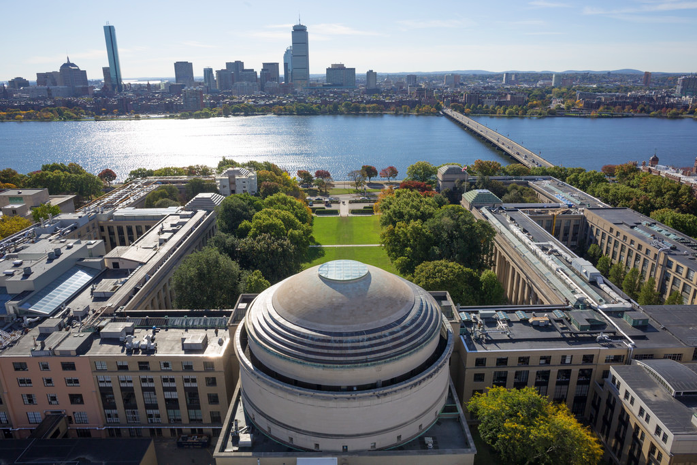
Credits:
BEC 2
Junru Li
Boris Shteynas
Furkan Top
Jeongwon Lee
Alan Jamison
Supersolid
Spin orbit coupling
Theory collaboration
G. Juzeliunas
$$
NSF
NSF-CUA MURI-AFOSR
Vannevar Bush F.
ONR
NASA

