Slide 1


Cooling close to absolute zero temperature:
a recipe for discoveries
Wolfgang Ketterle
Massachusetts Institute of Technology
MIT-Harvard Center for Ultracold Atoms
August 1, 2018
Humboldt Kolleg
Vilnius

Slide 2
Lower temperature - a recipe for discoveries

Slide 3
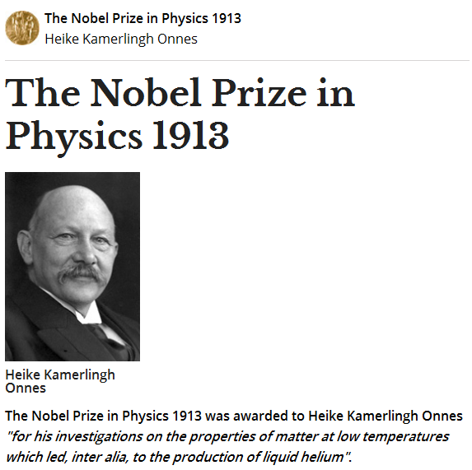
Kelvin physics
Liquid helium, superconductivity

Slide 4
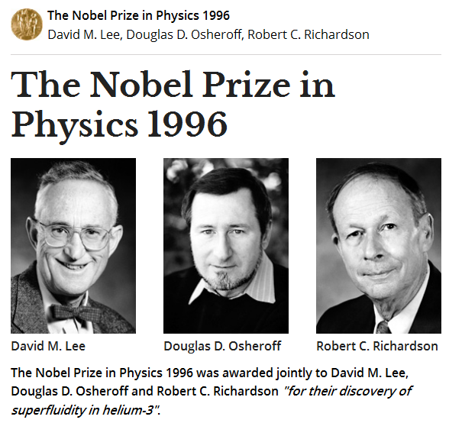
milli-Kelvin physics
Superfluid helium-3

Slide 5
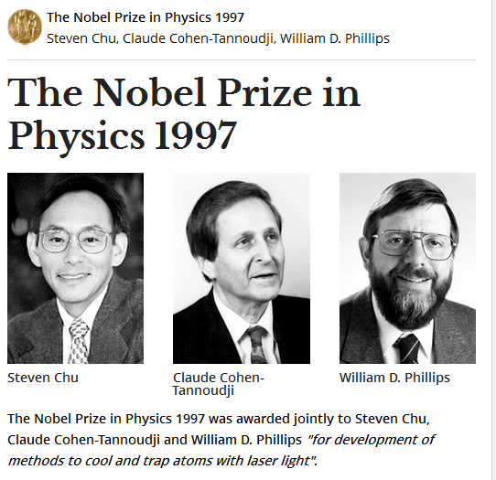
micro-Kelvin physics
Laser cooling, trapping of atoms

Slide 6
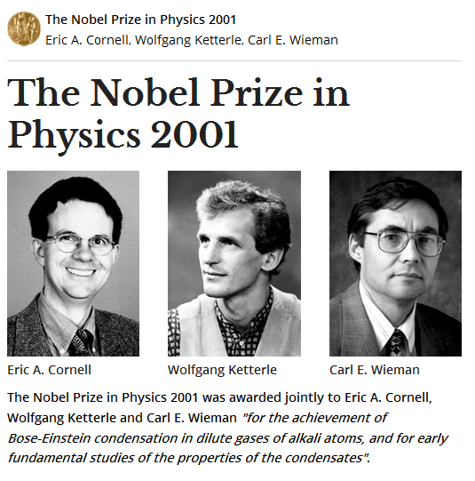
nano-Kelvin physics
Bose-Einstein condensation

Slide 7
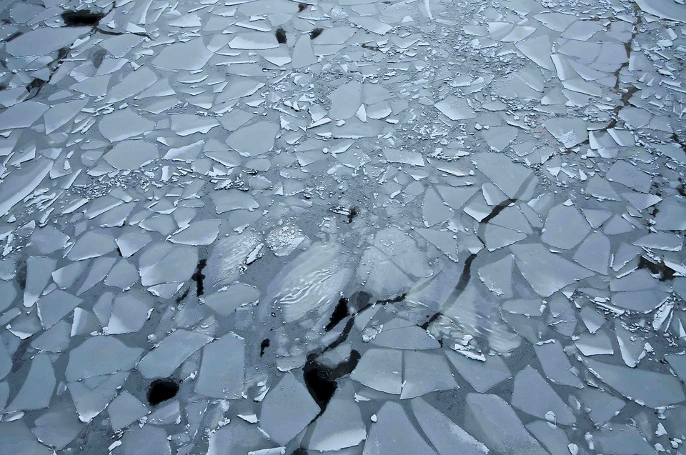
Phase transitions: properties of matter change dramatically when cooled below a specific temperature
Water/Ice: 0 degrees Celsius, 273 Kelvin
Demo

Slide 8
Phase transitions from liquid to solid
Water freezes at 0°C
Domestic freezer: -20°C
Whisky: 80 Proof (vol. 40) freezing point of -26°C
Dry Ice: -78°C
Pure alcohol
Methanol (-98°C), Ethanol (-114°C), Isopropanol (-89°C)
Liquid oxygen -183°C
Liquid nitrogen -196°C

Slide 9
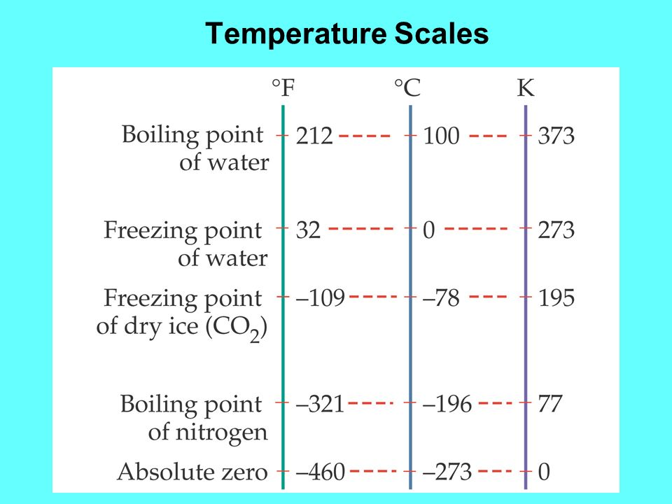

Slide 10
4 Kelvin: helium gas becomes liquid
2.8 Kelvin: temperature of interstellar space
(cosmic microwave background)
100 times colder than room temperature
Millikelvin
Microkelvin
Nanokelvin: 10⁻⁹ Kelvin
100 billion times colder than room temperature

Slide 11
Nanokelvin atoms
The coldest matter
in the universe
and a very special phase transition:
Bose-Einstein condensation

Slide 12
What happens to atoms or molecules in a gas
at low temperatures?
They slow down
300 m/sec (1000 km/h)
1 mm/sec

Slide 13

pressure =
density times kinetic energy
Lower temperature leads to lower pressure
Demo

Slide 14
What happens to atoms or molecules in a gas
at low temperatures?
They slow down
300 m/sec (1000 km/h)
1 mm/sec
They march in lockstep

Slide 15
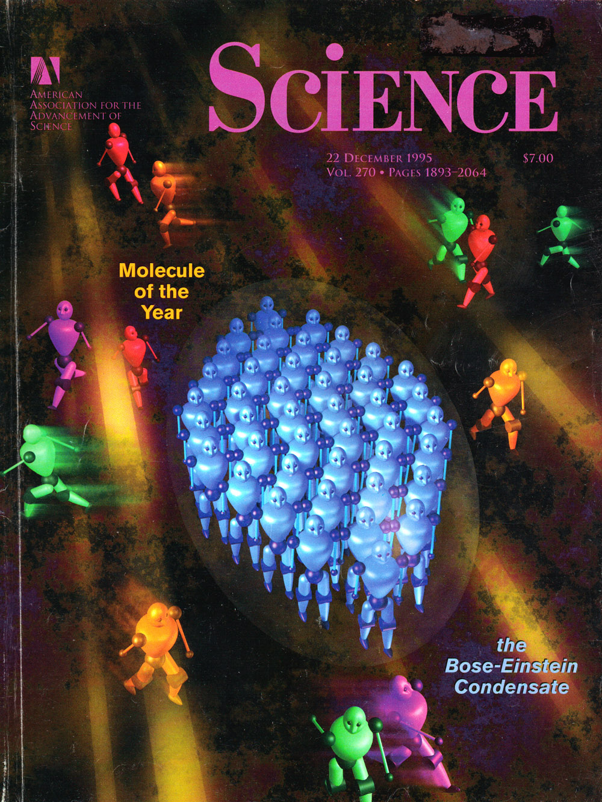
Molecule of the year
Atoms marching in lockstep
Matter made of waves!

Slide 16
Molecule of the year

Slide 17
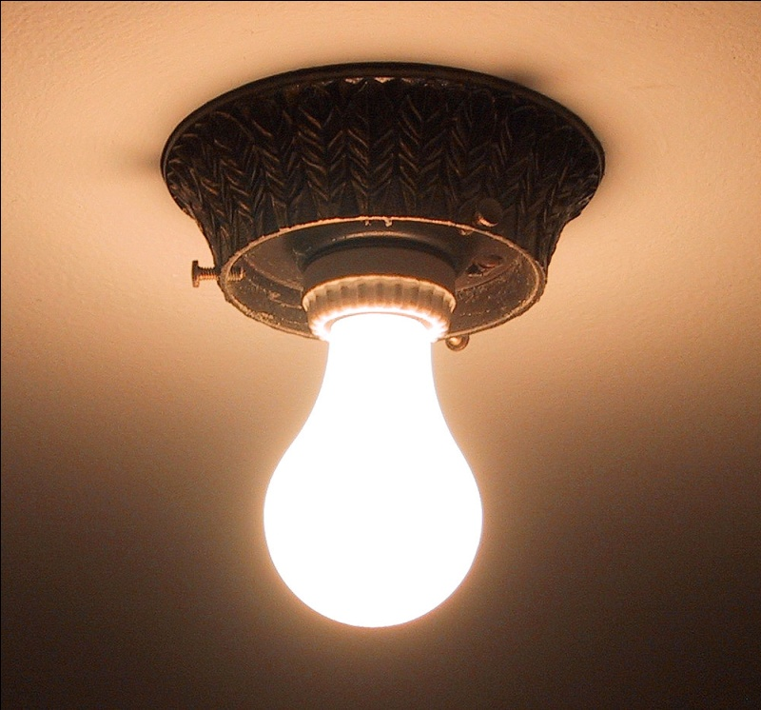
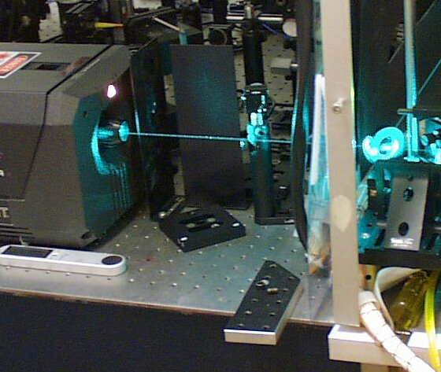
Laser beam and light bulb
Ordinary light
Laser light
Photons/atoms moving randomly
Photons/atoms are one big wave

Slide 18
How to get nanokelvin atoms?
Cooling methods
Laser cooling
Evaporative cooling
Trapping methods
Magnetic traps
Optical traps

Slide 19
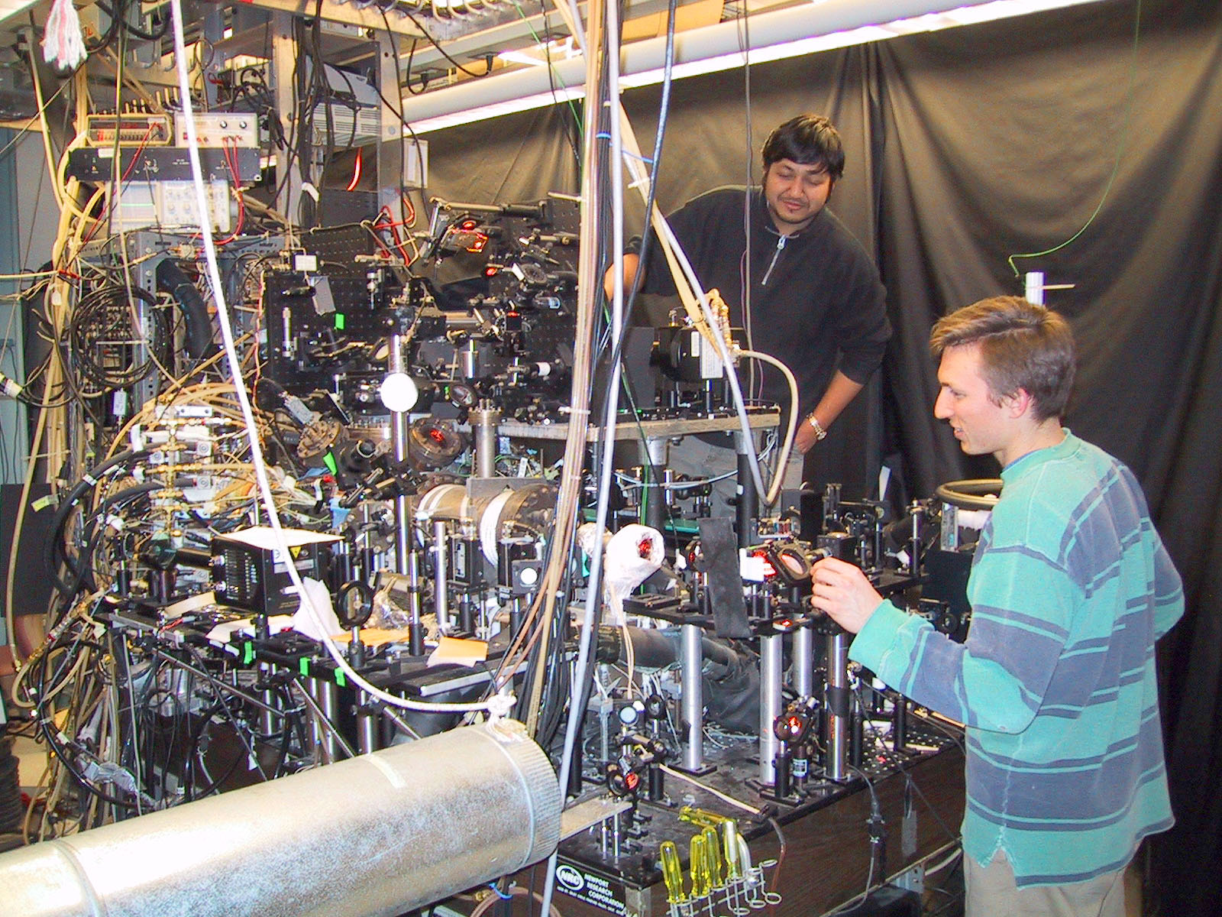

Slide 20
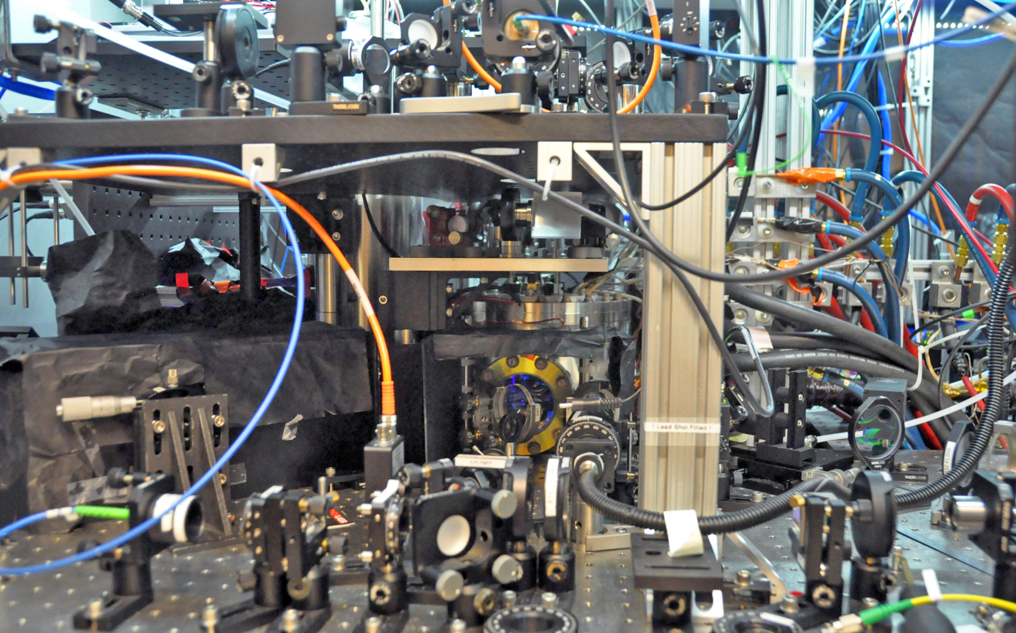

Slide 21
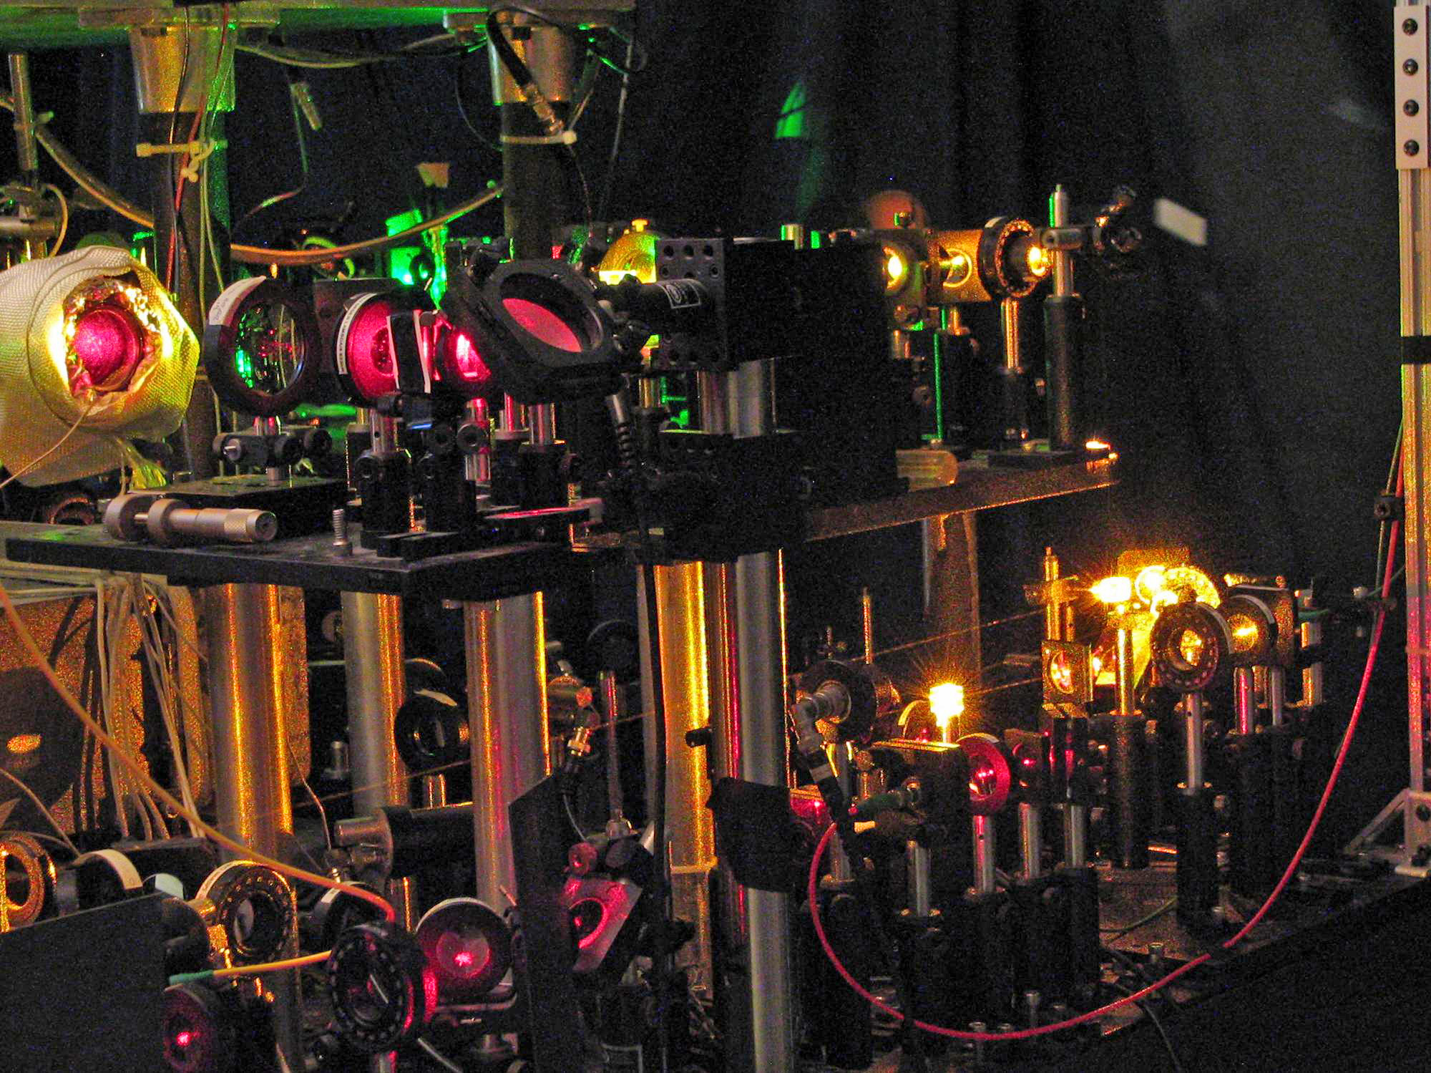

Slide 22
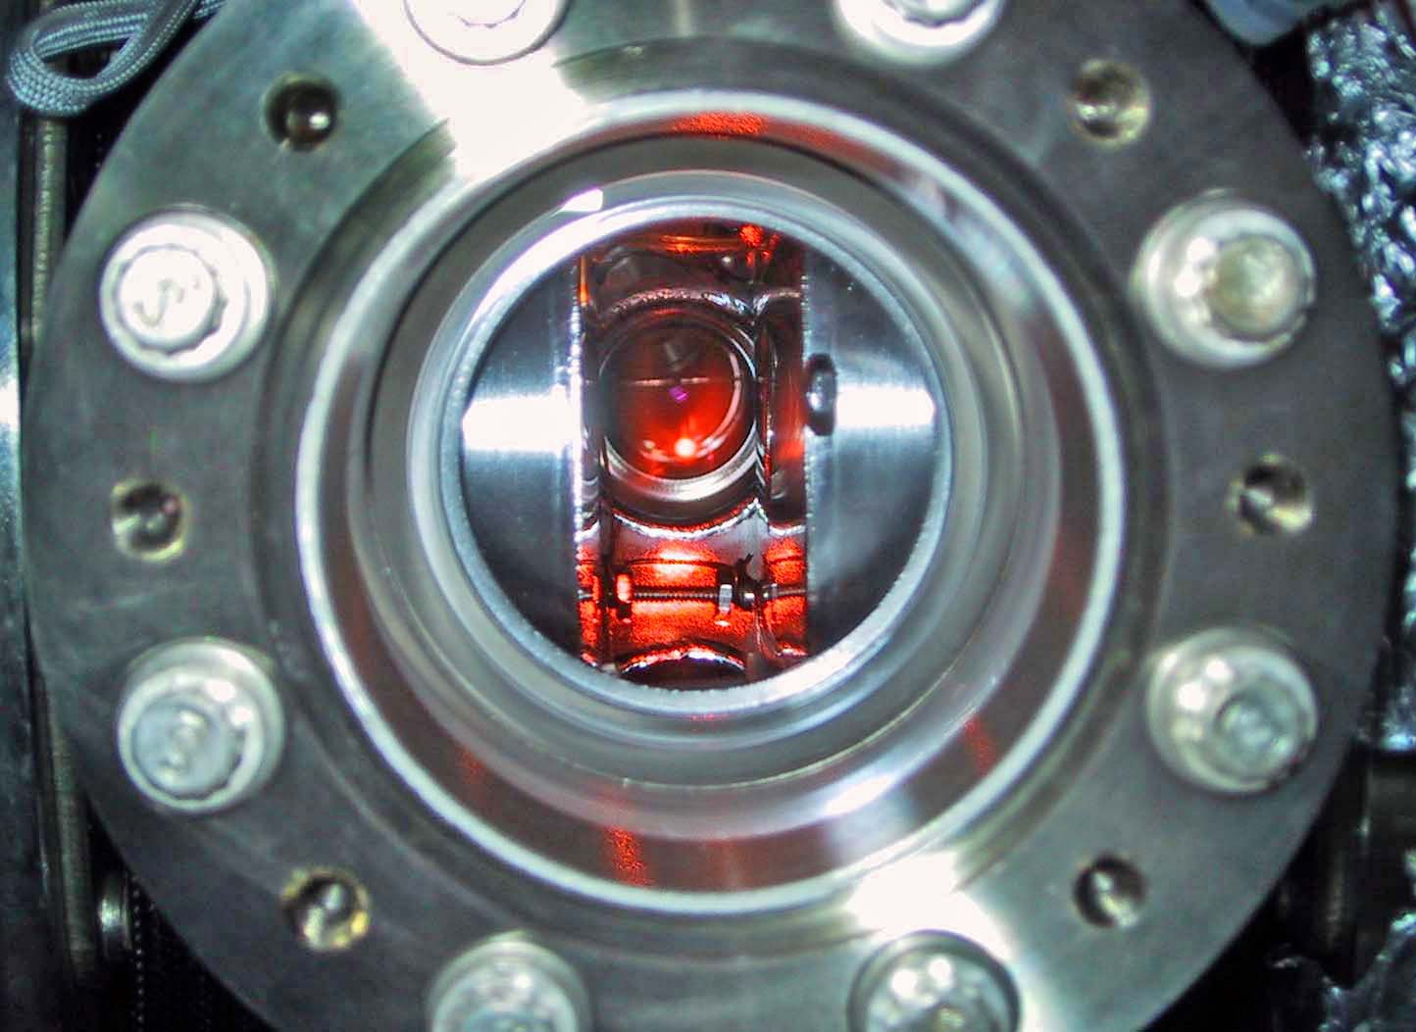
MOT
Laser cooling
2.5 cm

Slide 23
Ultrahigh vacuum chamber –
the world’s best thermos
a million nanokelvin atoms
Box made with
electric and/or
magnetic fields

Slide 24

Ultrahigh vacuum chamber
CCD
1 mm

Slide 25
How to measure temperature?
v=radius/time of flight
Kinetic energy mv²/2 = k_{B}T/2

Slide 26
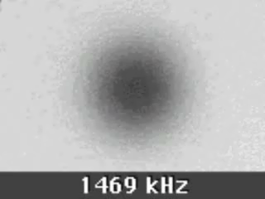
The shadow of a cloud of bosons
as the temperature is decreased
(Ballistic expansion for a fixed time-of-flight)
Temperature is linearly related to the rf frequency
which controls the evaporation

Slide 27
The shadow of a cloud of bosons
as the temperature is decreased
(Ballistic expansion for a fixed time-of-flight)
Temperature is linearly related to the rf frequency
which controls the evaporation

Slide 28
Molecule of the year
How can you prove that atoms march in lockstep?
Atoms are one single wave
Atoms are coherent

Slide 29
One paint ball on a white wall
Two
Paint does not show wave properties

Slide 30
One laser beam on a white wall
Light shows wave properties

Slide 31
One laser beam on a white wall
Two
Fringe pattern:
Bright-dark-bright-dark
Light shows wave properties

Slide 32
Cutting condensates
Two condensates ...

Slide 33
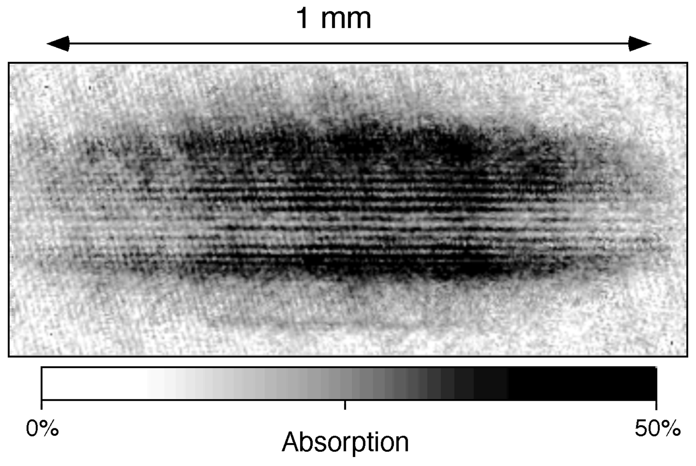
Interference pattern
Interference between two condensates
Andrews, Townsend, Miesner, Durfee, Kurn, Ketterle, Science 275, 589 (1997)

Slide 34
Superconductivity = electrons march in lockstep
This can create a current which flows without dissipation
(no power supply, no battery)
This current creates a magnetic field

Slide 35
Demonstration:
eddy currents– currents in copper which create a
magnetic field
Demo

Slide 36
Demonstration:
eddy currents– currents in copper which create a
magnetic field
Superconductor

Slide 37
Demonstration:
a piece of (copper oxide) ceramic is cooled down
there is a phase transition
at the phase transition, electrons can march in lockstep
(they pair up and form a macroscopic quantum state)
this superconducting current has no dissipation
(no electrical resistance) and is therefore persistent
it creates a magnetic field, and the magnet floats
Demo

Slide 38
This can be explained by Faraday’s law of induction and dissipationless currents.
But there is more!
Now: cool down

Slide 39
This can be explained by Faraday’s law of induction and dissipationless currents.
But there is more!
At the phase transition, the superconducting material becomes
an extreme diamagnetic material, which expels all magnetic
fields by generating the opposite magnetic field
Meissner effect
But there is more!
Demo

Slide 40
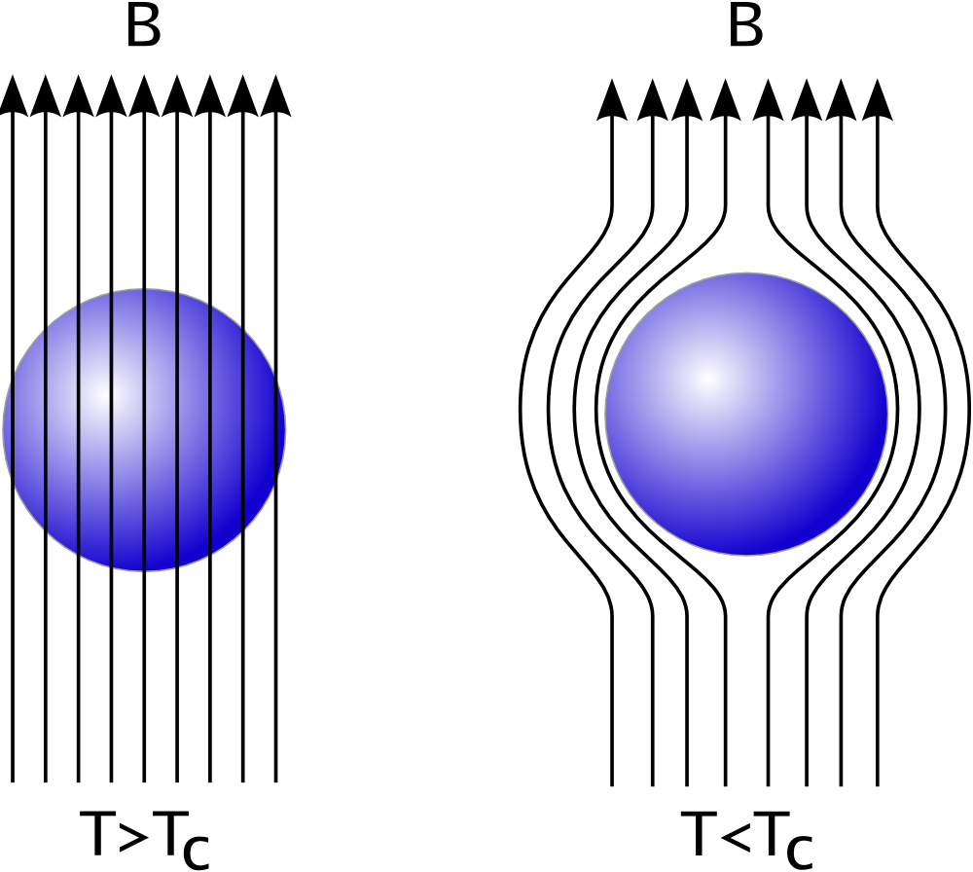
Meissner effect

Slide 41
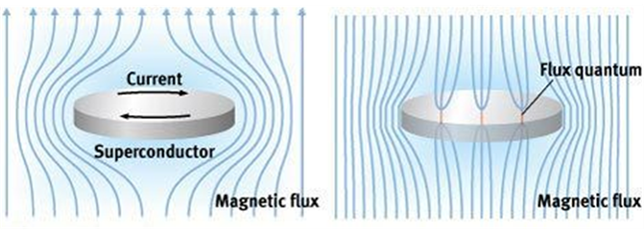
Meissner effect
Flux penetration and pinning
Type I superconductors
Type II superconductors at
low magnetic fields
Type II superconductors at
high magnetic fields

Slide 42
“Our” superconductor:
Yttrium barium copper oxide (YBCO), type II superconductor
T_{c} around 90 K (-183°C)
So far:
Polycrystalline form with small grains
Low critical current. Meissner effect dominates over flux pinning.
(However, due to saturated current, flux is not completely expelled).
Now:
Single domain (single crystal): high critical current.
Flux penetration
Flux pinning enhanced with impurities (e.g. silver).
Demo

Slide 43
We have seen:
Persistent currents
Phase transition to diamagnetic material (Meissner effect)
Flux pinning and hysteresis
Flux pinning provides lateral forces
Forces are attractive and repulsive:
Magnetic suspension effect
Magnetic bearing

Slide 44
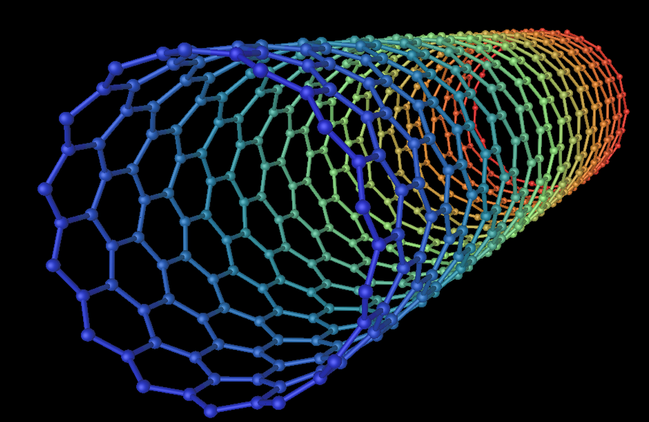
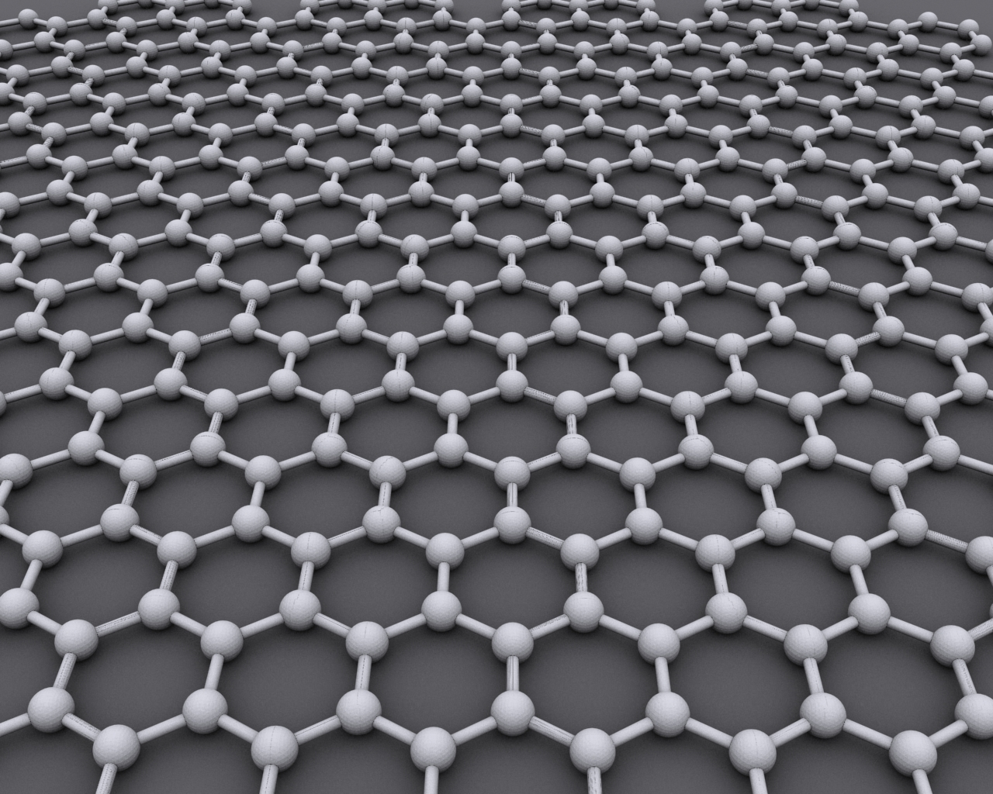
A new material!
Very cold
Made of waves
Superfluid
Modern materials change the world

Slide 45
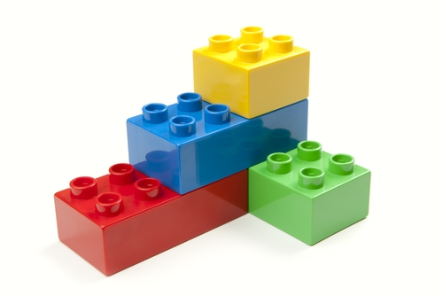
Study of materials at a fundamental level
Our approach: Atomic legos
Freeze atoms close to absolute zero:
nanokelvin, make them stand still
Assemble them to behave
like important materials
Quantum simulator:
a special purpose quantum computer

Slide 46
Ultrahigh vacuum chamber –
the world’s best thermos
a million nanokelvin atoms
Box made with
electric and/or
magnetic fields

Slide 47
Laser beams
Ultrahigh vacuum chamber
Rf and microwaves
a million nanokelvin atoms
Box made with
electric and/or
magnetic fields

Slide 48
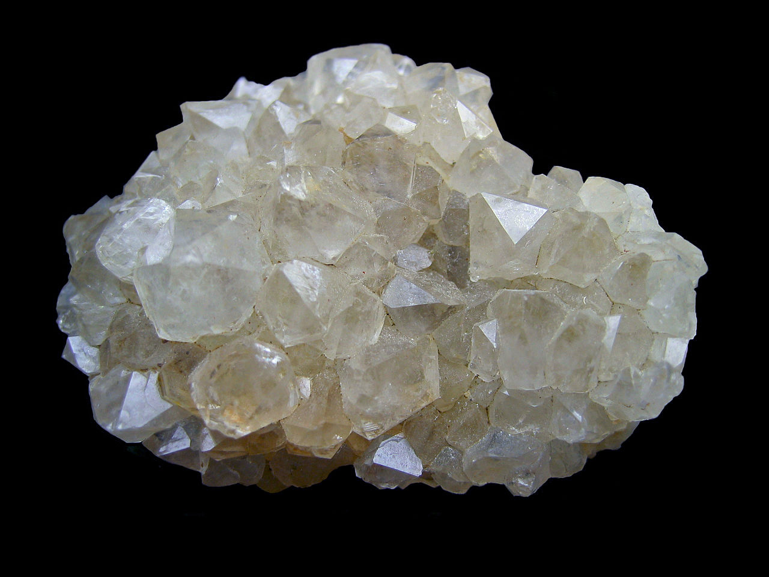
Quartz crystal

Slide 49
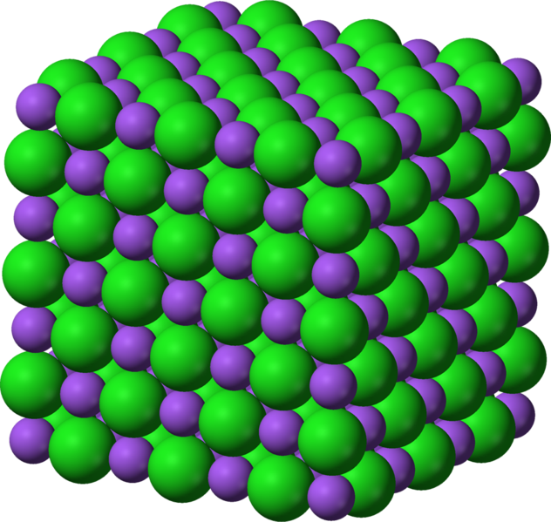
Table salt
NaCl

Slide 50
How to create a periodic potential for the atoms?
(lattice physics, insulator, metal, band structure etc.)

Slide 51
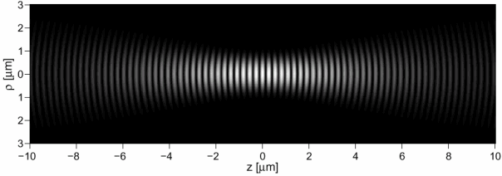
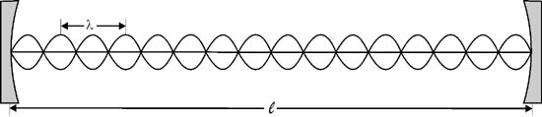
Two laser beams form a standing wave

Slide 52
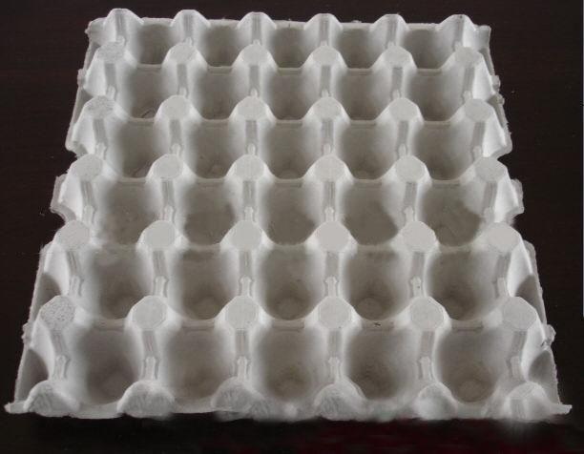
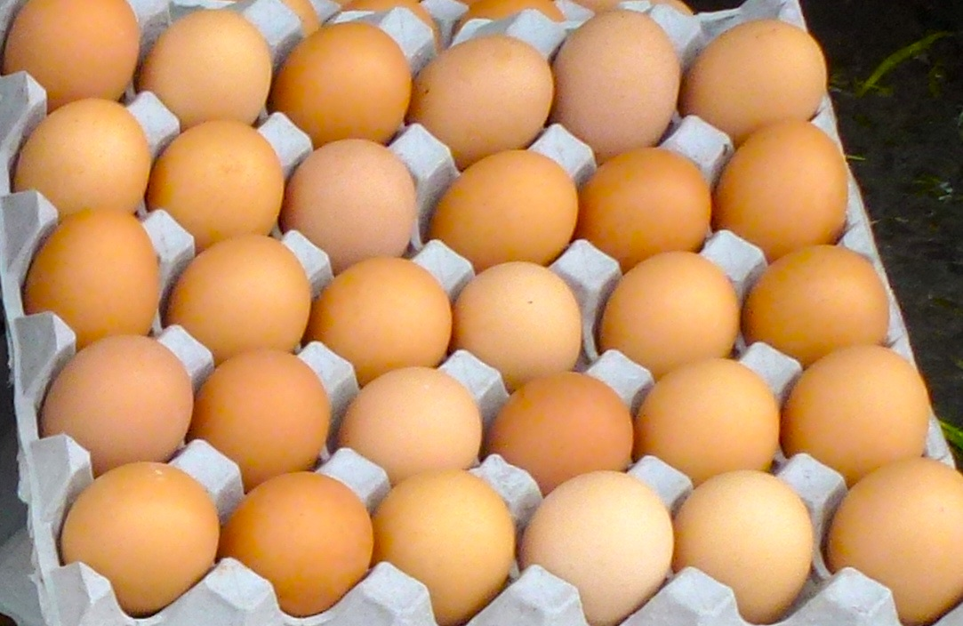

Slide 53
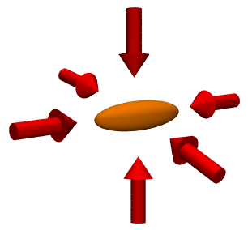
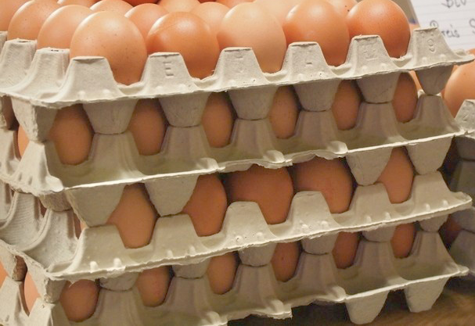
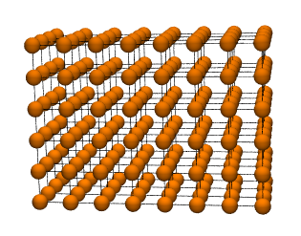
Three-dimensional optical lattice

Slide 54
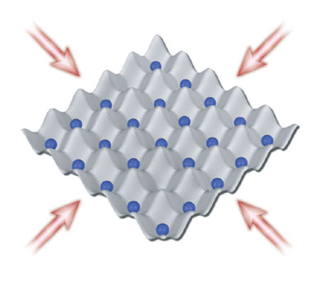
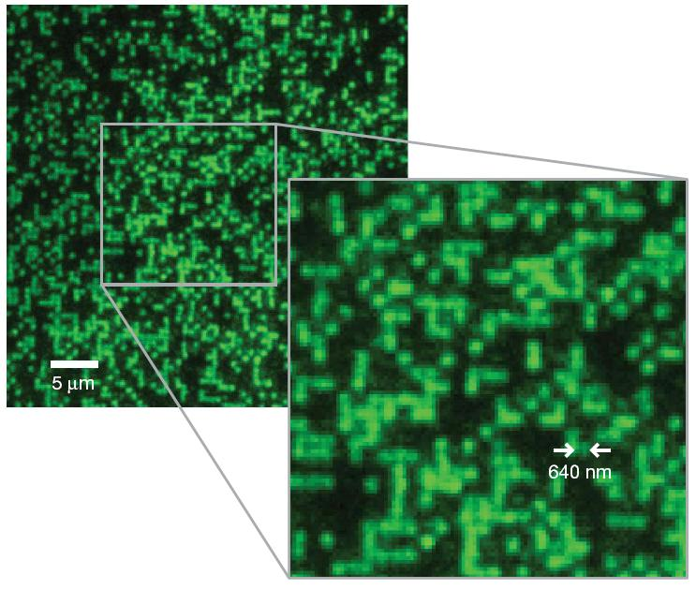
Greiner labs, Harvard

Slide 55
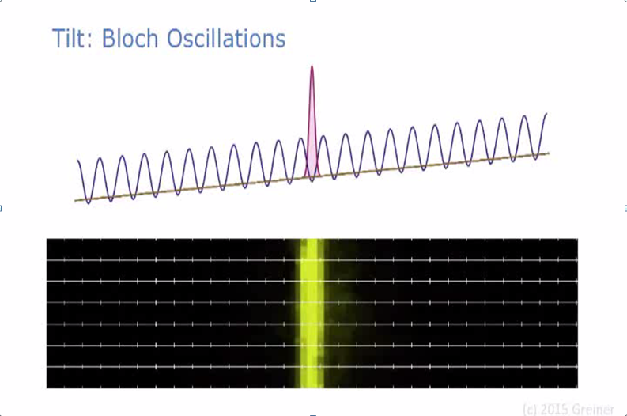
Tunneling: Atoms go through the “walls” of the egg carton

Slide 56
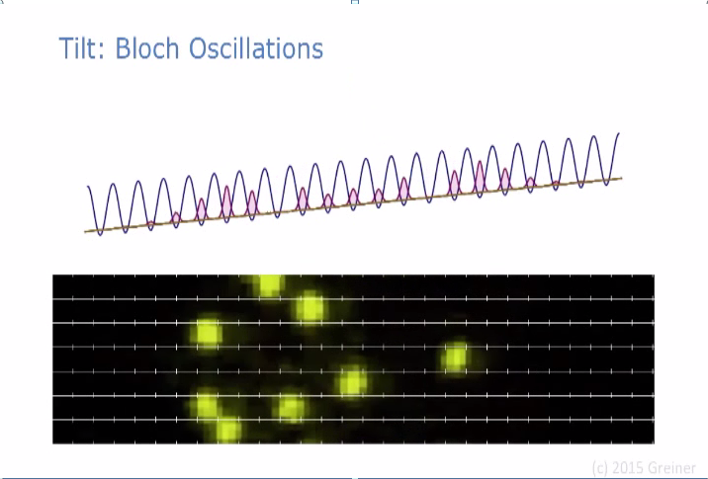
Tunneling: Atoms go through the “walls” of the egg carton

Slide 57
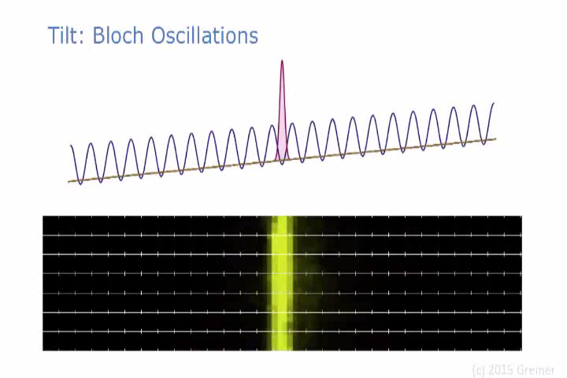
Atoms tunnel coherently – they behave as one quantum wave

Slide 58
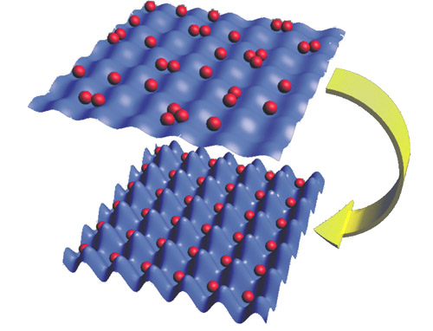
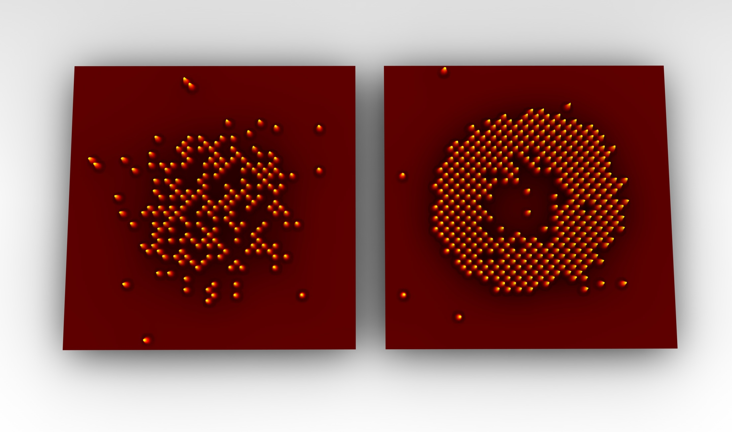
Quantum phase transition
from a superfluid to an
insulator
MPQ, Garching

Slide 59
Supersolidity – a new form of matter
… it is a gas, liquid, solid ….
… all at the same time ….
Major motivation:
helium-4: elusive search for supersolid
(which, in its simplest form, would be a Bose-Einstein condensate of dilute vacancies)

Slide 60
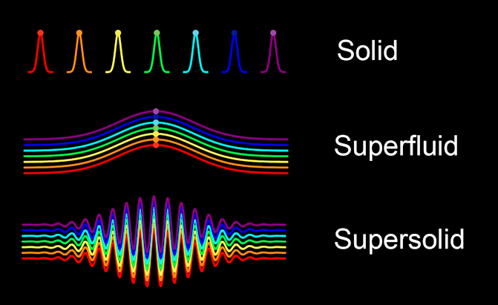

Slide 61
The quest for new materials
Understanding the properties of matter in a “model” which is 1,000x magnified
(distance between atoms is micrometer and not nanometer)
Try out (and understand) what materials and phenomena are possible in Nature
Use quantum mechanics for new applications
Quantum metrology
Quantum computer
Quantum technology
Quantum cryptography
Quantum devices

