Slide 1
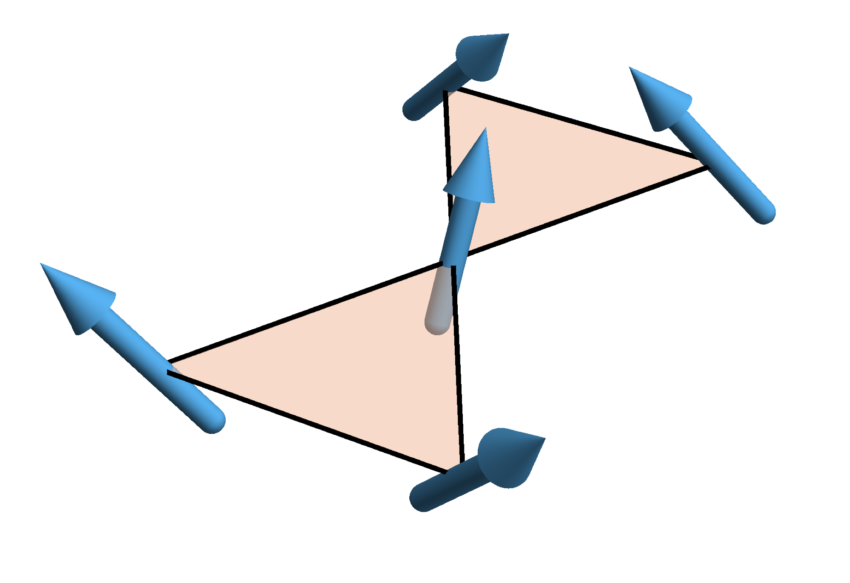
Floquet engineering in Mott insulators
and control of spin chirality
Takashi Oka
Max Planck institute PKS and CPfS (Dresden)
Acknowledge: Sota Kitamura
Take home message
Mott insulator + Circularly polarized light
~ J-J_{χ} model “spin-version of the Haldane model”
scalar spin chirality
Detection by circular dichroism
Kitamura, Oka, Aoki, Phys. Rev. B 96, 014406 (2017)

Slide 2
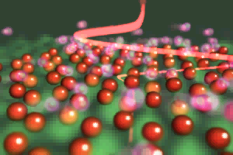
Floquet engineering in Solids
J. Orenstein “Ultrafast spectroscopy of quantum materials” Physics today 2012
animation
by K. Tanaka (Kyoto)

Slide 3
Floquet engineering in Solids
Ultrafast control of spin, Mott transition, and topology (Floquet TI)
Oka, Kitamura arXiv’18 (Annual reviews in CMP)
Magnetization controlled by CPL
Kimel et al. (Rasing) Nature ‘05
Stanciu et al. (Rasing) PRL ‘07
effective Zeeman field
circularly polarized laser
~5Tesla

Slide 4
Solids vs Artificial matter
Laser irradiated material
Cold atoms in shaken optical lattice
Jotzu et al. Nature ‘14
Photonic system
c.f. Oded Zilberber
Wang (Gedik group) et al. Science ‘13
Floquet side bands
and topological gap opening
Rechtsman et al. Nature’13
ω < band width
ω > band width

Slide 5
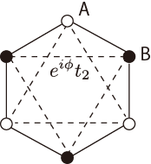
Honeycomb lattice + Circularly polarized light
~ Haldane model (Chern ins.)
Oka, Aoki ’09
Kitagawa, Oka, et al. ‘11
~
Floquet topolotical insulators
also by Lindner, Rafael, Galitski ’11 (semiconductor)
Add Interaction
Mott insulator + Circularly polarized light
~ J-J_{χ} model =“spin-version of the Haldane model”
scalar spin chirality
Kitamura, Oka, Aoki, Phys. Rev. B 96, 014406 (2017)
also by Claassen, Jiang, Moritz, Devereaux, Nat. Com. 8, 1192 (2017)
Comment:
We must be careful in the ω < band width regime (solid state)

Slide 6
Honeycomb lattice + Circularly polarized light
~ Haldane model (Chern ins.)
Oka, Aoki ’09
Kitagawa, Oka, et al. ‘11
~
Floquet topolotical insulators
also by Lindner, Rafael, Galitski ’11 (semiconductor)
Add Interaction
Mott insulator + Circularly polarized light
~ J-J_{χ} model =“spin-version of the Haldane model”
scalar spin chirality
Kitamura, Oka, Aoki, PRB’17
also by Claassen, Jiang, Moritz, Devereaux, Nat. Com. ‘17
Comment:
We must be careful in the ω < band width regime (solid state)

Slide 7
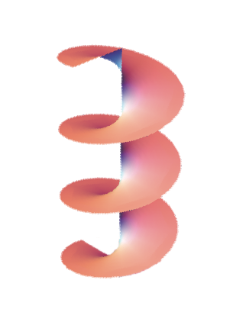
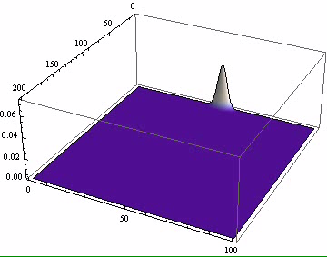
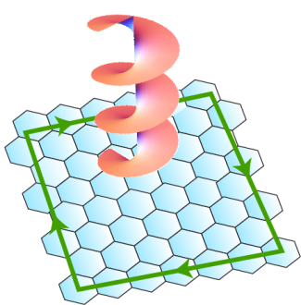
Floquet topological insulator
Oka, Aoki ’09
Lindner, Rafael, Galitski ’11
(semiconductor)
Graphene + circularly polarized laser (CPL)

Slide 8
Phase diagram of the
“Graphene + circularly polarized laser” model
ω
Chern number of a Floquet band
Jotzu et al. ‘14
Rechtsman et al. ’13
Haldane
Guglielmon, Huang, Cheng, Rechtsman ’17
A = E/Ω
Mikami, Oka et al. PRB’ 16
C = chiral edge channel

Slide 9
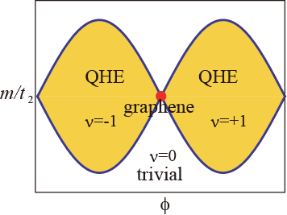

Large ω limit (Floquet-Magnus expansion)
Kitagawa, Oka, Fu, Brataas, Demler ’11
n.n. hopping with phase π/2
= Haldane Model of QHE without LL (1988)
large Ω
local magnetic field φ
AB-level offset m

Slide 10
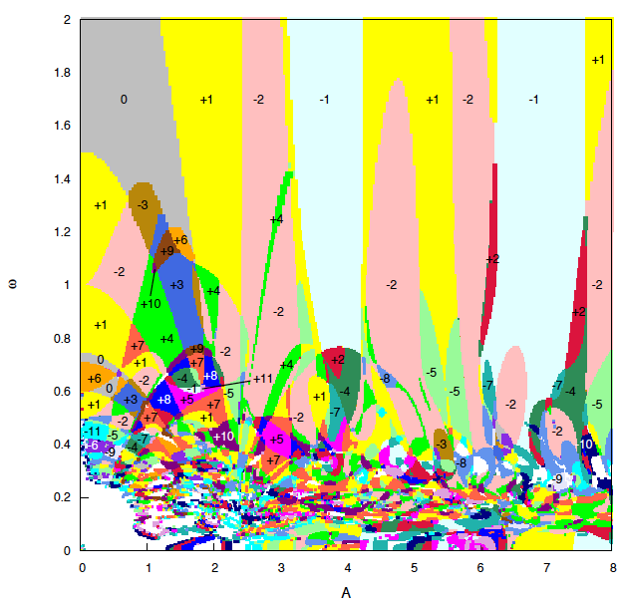
Phase diagram of the
“Graphene + circularly polarized laser” model
ω
ω
Chern number of a Floquet band
Jotzu et al. ‘14
Rechtsman et al. ’13
Haldane
Guglielmon, Huang, Cheng, Rechtsman ’17
Lower frequency
A = E/Ω
Mikami, Oka et al. PRB’ 16

Slide 11
Phase diagram of the
“Graphene + circularly polarized laser” model
ω
topological insulator (TI) to TI transitions
Chern number
Relevant regime for solid states
Measuring the Hall coefficient is an open problem
Ω=1.5eV
Gedik (MIT)
Science ’13
(Ω=0.2eV)
Mikami, Oka et al. PRB’ 16

Slide 12
Spin chirality
J-J_{χ} model
J_{χ} induces
breaking P and T symmetries
Delafossite PdCrO₂ (triangular) Takatsu et al. PRL 105, 137201 (2010)
Kagome lattice
Bauer et al. Nat. Com. 5:5137 (2014)
chiral spin liquid
0
~0.15
J_{χ} /J
gapless edge mode
groundstate degeneracy
anyon
Kalmeyer, Laughlin ‘87

Slide 13
Hubbard model + Circularly polarized light
regime 1
regime 2
ω >> U >> |J_{ij}|
U > ω >> |J_{ij}|
shaken cold atom
solid state Mott ins.
with midgap laser
J-J_{χ} model
+… (heating)
Comment:
We must be careful in the ω < band width regime (solid state)

Slide 14
Hubbard model + Circularly polarized light
regime 1
1/ω Floquet Magnus expansion
Kitagawa, Oka, Fu, Brataas, Demler ’11
ω >> U >> |J_{ij}|
Haldane Hubbard model
1/U expansion (Schrieffer–Wolff transformation)
MacDonald, Girvin, Yoshioka, PRB ‘88
Motrunich, PRB ‘06
J-J_{χ} model
4th order in t
ω >> U >> |J_{ij}|
Comment:
We must be careful in the ω < band width regime (solid state)

Slide 15
Hubbard model + Circularly polarized light
1/(U-nω) (Floquet SW)-expansion
regime 2
U > ω >> |J_{ij}|
2nd order
Mentink, Balzer, Eckstein, Nat. Com.‘15
4th order
Kitamura, Oka, Aoki, PRB’17
Claassen, et al. Nat. Com. ‘17
solid state Mott ins.
with midgap laser
Comment:
We must be careful in the ω < band width regime (solid state)

Slide 16
Hubbard model + Circularly polarized light
1/(U-nω) (Floquet SW)-expansion
regime 2
absorption
(emission)
emission
(absorption)
U > ω >> |J_{ij}|
2nd order
Mentink, Balzer, Eckstein, Nat.Com.‘15
4th order
Kitamura, Oka, Aoki, PRB’17
Claassen, et al. Nat. Com. ‘17
solid state Mott ins.
with midgap laser
Comment:
We must be careful in the ω < band width regime (solid state)

Slide 17
Hubbard model + Circularly polarized light
1/(U-nω) (Floquet SW)-expansion
regime 2
absorption
(emission)
emission
(absorption)
U > ω >> |J_{ij}|
2nd order
Mentink, Balzer, Eckstein, Nat.Com.‘15
4th order
Kitamura, Oka, Aoki, PRB’17
Claassen, et al. Nat. Com. ‘17
solid state Mott ins.
with midgap laser
Comment:
We must be careful in the ω < band width regime (solid state)

Slide 18
Hubbard model + Circularly polarized light
1/(U-nω) (Floquet SW)-expansion
regime 2
absorption
(emission)
emission
(absorption)
U > ω >> |J_{ij}|
2nd order
Mentink, Balzer, Eckstein, Nat.Com.‘15
4th order
Kitamura, Oka, Aoki, PRB’17
Claassen, et al. Nat. Com. ‘17
solid state Mott ins.
with midgap laser
Comment:
We must be careful in the ω < band width regime (solid state)

Slide 19
Effective J-J_{χ} model
J_{χ}
J
exchange coupling
scalar chirality coefficient
* Independent of the lattice
Mentink, Balzer, Eckstein, Nat.Com.‘15
sign flip of exchange coupling
(spin version of “dynamic localization” and band inversion)

Slide 20
Effective J-J_{χ} model
J_{χ}
J
exchange coupling
A=1.5, U=10 → J=0.4, J_{χ} =0.2 very large!
scalar chirality coefficient
* Independent of the lattice
Mentink, Balzer, Eckstein, Nat.Com.‘15
sign flip of exchange coupling
(spin version of “dynamic localization” and band inversion)

Slide 21
Circular dichroism probes scalar spin chirality
c.f. Christof Weitenberg
coupling between CPL and spin chirality
c.f. Zeeman
Kitamura, Oka, Aoki, Phys. Rev. B 96, 014406 (2017)

Slide 22
Circular dichroism probes scalar spin chirality
optical dielectric function
Faraday effect and circular dichroism can detect scalar chirality
circular dichroism
ω=U
herbertsmithite ZnCu₃ (OH)₆ Cl₂, delafossite PdCrO₂
Kitamura, Oka, Aoki, Phys. Rev. B 96, 014406 (2017)

Slide 23
Summary
Laser can control and detect spin chirality in Mott insulators
This is based on the “Floquet effective Hamiltonian”
for the “Mott insulator + CPL”-model having the expansion
Kitamura, Oka, Aoki, Phys. Rev. B 96, 014406 (2017)
Thank you!

