Slide 1
A Diamond Quantum Simulator
Martin B Plenio
Institute of Theoretical Physics
&
Center for Quantum-BioSciences
Ulm University

Slide 2
Quantum Simulation for 2-D Systems
Why ?
Offer unusual physics
Anyons, Surface codes, Topological phase transitions, Frustration, …
Difficult to simulate by classical computers
For 1-D we have (t)-DMRG
For 2-D …
S.R. White, PRL 1992
they are much harder to simulate !

Slide 3
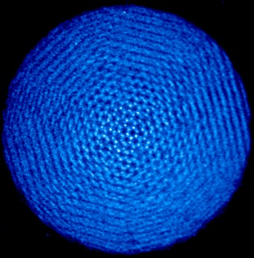
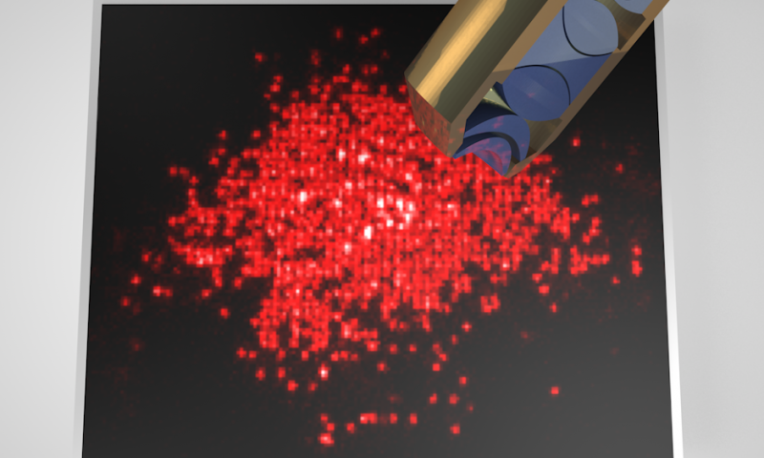
Quantum Simulation for 2-D Systems
2-D Trapped Ion Coulomb
Crystal
2-D Neutral Atom Optical
Lattice
John Bollinger @ NIST
Immanuel Bloch @ MPQ Garching

Slide 4

Diamond

Slide 5
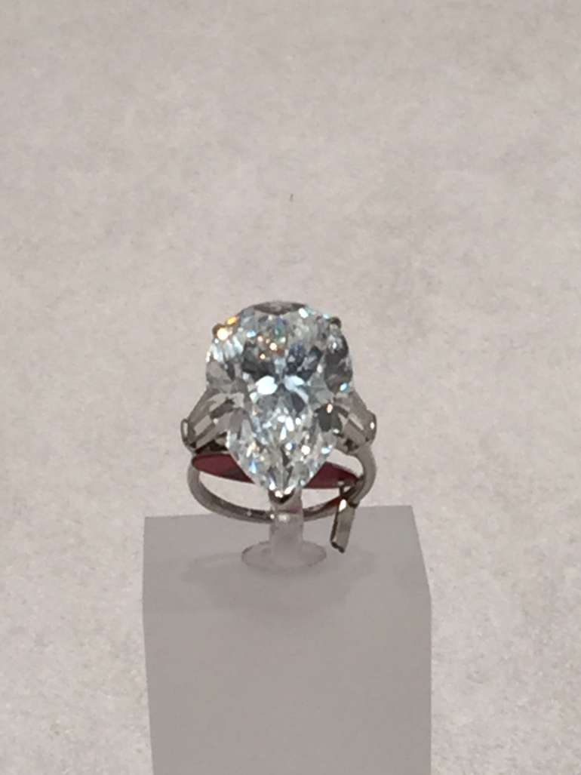
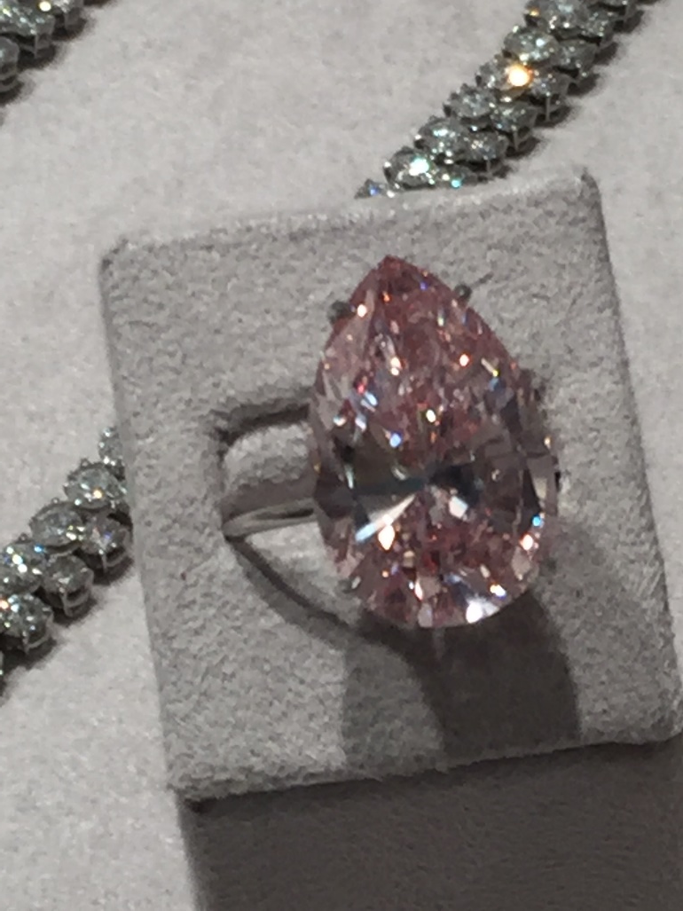
Diamond
A perfect diamond is transparent !
Photo taken at Sotheby‘s London October 2016
Some diamond have colour

Slide 6
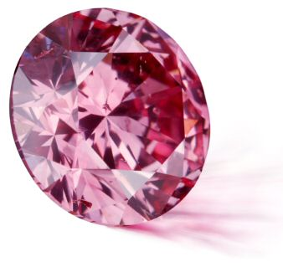
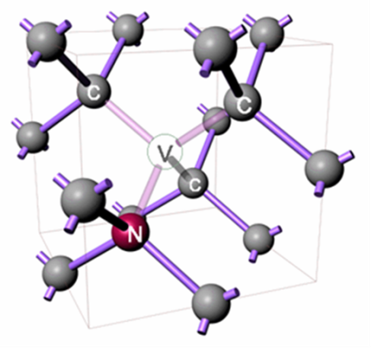
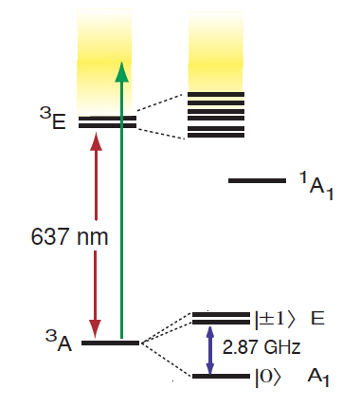
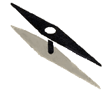


Colour Centers in Diamond
Nuclear Spin
Crystals are like people, its only the defects
that make them interesting F. Franck
Wu, Jelezko, Plenio, Weil, MiniReview Angew. Chemie Intl. Ed.2015

Slide 7
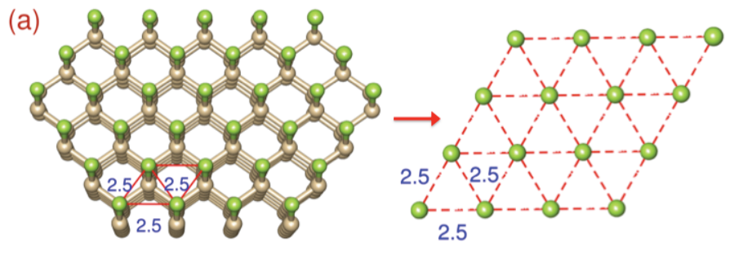
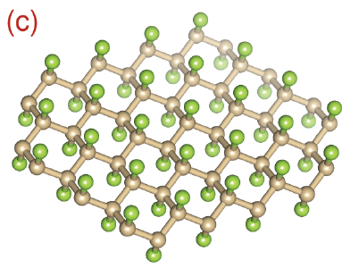
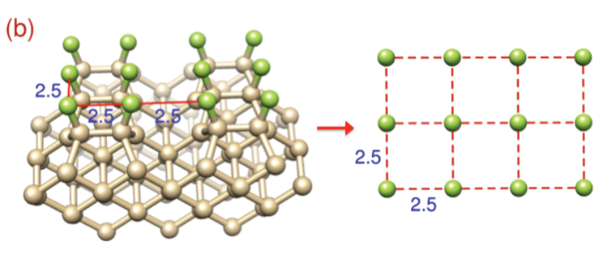
Creating 2D-Spin Layers
Diamond 111-surface
F-F (long range dipole) interaction (6.8kHz nearest neighbor)
Fluorographene
Monolayer hBN
See Lovchinsky et al, Science 2017
for MR of hBN on a diamond surface
Abdi, Hwang, Aghtar & Plenio. Phys.
Rev. Lett. (2017)
See Chou et al, Nano Letters 2017
Numerical study of nitrogen spin-1 lattice
Diamond 100-surface
Theory: Cai, Retzker, Jelezko, Plenio, Nature Phys. 2013

Slide 8
Creating Quasi-2D Spin Layers
Nitrogen introduced during the growth of the ¹³C layer, facilitating NV centers in the vicinity of the spin layer.
Unden, Tomek, Weggler, Frank, London, Zopes, Degen, Meijer, Watanabe, Itoh, Plenio, Naydenov & Jelezko. To appear npj Quant. Inf. & arXiv:1802.02921

Slide 9
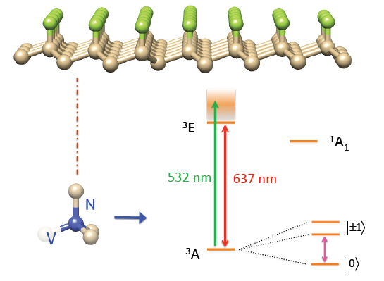
A Diamond Surface Simulator
Address three main challenges
Initialization of the nuclear spin lattice
Control of the Hamiltonian of the nuclear spin lattice
Readout from the nuclear spin lattice
Theory: Cai, Retzker, Jelezko, Plenio, Nature Phys. 2013

Slide 10
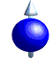
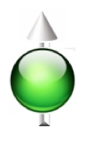
Coupling Electron Spins to Nuclei
Continuous
Resonant Drive

Slide 11
Coupling Electron Spins to Nuclei
Continuous
Resonant Drive

Slide 12
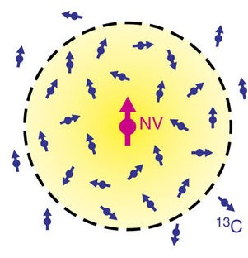
Spin Ensemble Initialisation
Polarization of nuclear spin bath
reduces linewidth due to T2 time
Polarization of nuclear spin bath
reduces NV-ESR linewidth
Numerical simulation shows >90% polarization
after 500 sweeps of closest 10% of nuclear
spins randomly placed in 4nm radius from NV.
With magnetic
field drifts
Without magnetic
field drifts
Theory & Experiment:
London, …, Plenio, Jelezko, PRL 111, 067601 (2013)

Slide 13
Concatenated Continous Dynamical Decoupling
Robustness Against Driving Field Fluctuations
Theory & Experiment Bulk Diamonds: NJP 14, 113023 (2012)
Nanodiamonds in Cells: E-print arXiv:1710.10744

Slide 14
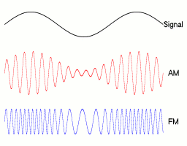
Concatenated Continous Dynamical Decoupling
Robustness Against Driving Field Fluctuations
Secondary drive parallel to primary drive: Amplitude modulation
Secondary drive orthogonal to primary drive: Phase modulation
Theory & Experiment Bulk Diamonds: NJP 14, 113023 (2012)
Nanodiamonds in Cells: E-print arXiv:1710.10744

Slide 15
Concatenated Continous Dynamical Decoupling
Robustness Against Driving Field Fluctuations
T₂= 2.5 μs
2
(Ω / Ω )
1 2
Theory & Experiment: NJP 14, 113023 (2012).

Slide 16
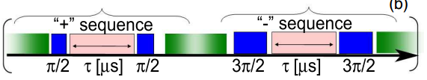
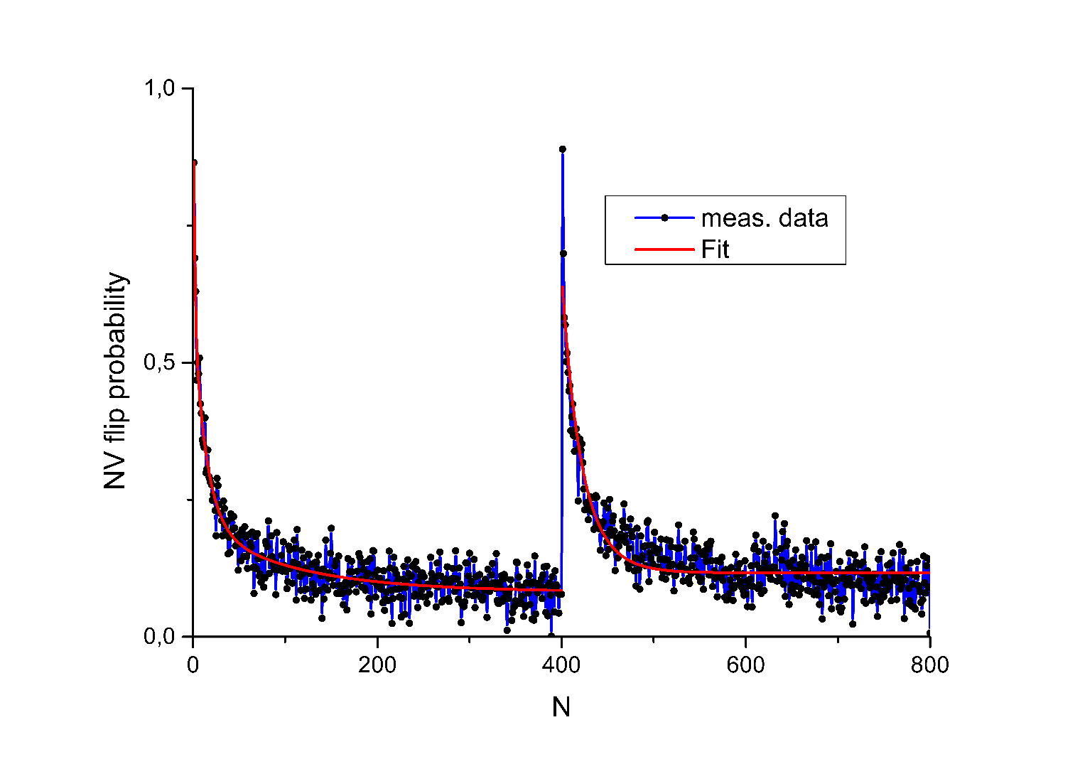
Spin Lattice Initialisation
¹²C layer
¹³C layer
N times
N times
¹²C layer
Type IIa substrate
Spin locking time of Hartmann-Hahn was fixed to 20μs
Polarisation Readout by Polarisation Inversion
See also
Scheuer, Schwartz, Müller, Chen, Dhand, Plenio,
Naydenov & Jelezko, PRB 96, 174436 (2017)
for analysis for spin ensemble around NV in
natural abundance diamond.
Unden, Tomek, Weggler, Frank, London, Zopes, Degen, Meijer, Watanabe, Itoh, Plenio, Naydenov & Jelezko. To appear npj Quant. Inf. & arXiv:1802.02921

Slide 17
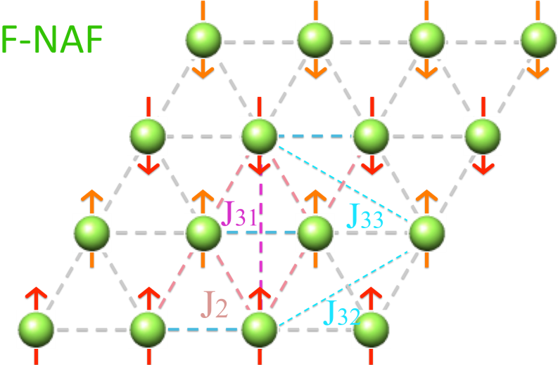
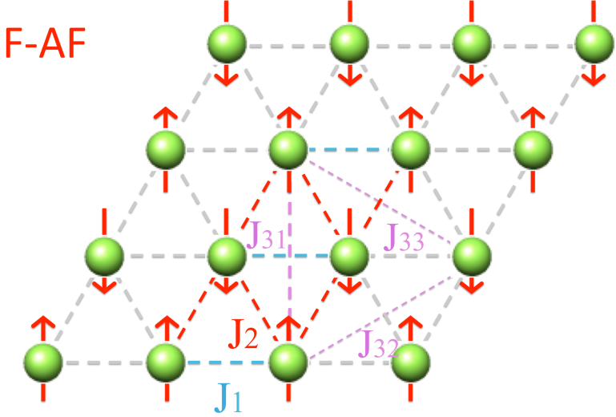
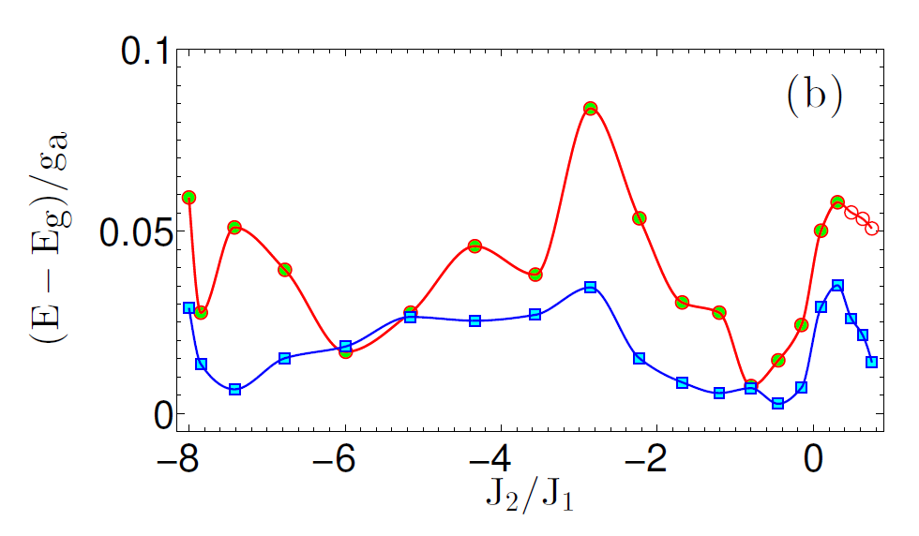
Ground State Preparation
Polarisation & Adiabatic Transfer
Theory: Cai, Retzker, Jelezko, Plenio, Nat. Phys. 9, 168 (2013)

Slide 18
Sensing Silicon Nuclear Spins above Diamond Surface
Experiment & Theory: Müller, Kong, Cai, Melentijevic, Stacey, Markham, Isoya, Pezzagna, Meijer, Du, Plenio, Naydenov, McGuinness & Jelezko., Nat. Comm. (2014)
Notes:
Fedor

Slide 19
Sensing Silicon Nuclear Spins above Diamond Surface
Experiment & Theory: Müller, Kong, Cai, Melentijevic, Stacey, Markham, Isoya, Pezzagna, Meijer, Du, Plenio, Naydenov, McGuinness & Jelezko., Nat. Comm. (2014)
Notes:
Fedor

Slide 20
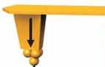


Extracting Correlations
Measurement with NV:
Spin magnetization
Magnetic gradient: magnetic tip
State-of-art: 6 Gauss per Å
Spin structure factor:
Various tricks
Theory: Cai, Retzker, Jelezko, Plenio, Nat. Phys. 9, 168 (2013)
Sufficient to predict entanglement structure:
Cramer, Plenio, Wunderlich, Phys. Rev. Lett. 2011
M. Cramer, A. Bernard, N. Fabbri, L. Fallani, C. Fort, S. Rosi, F. Caruso, M. Inguscio and M.B. Plenio. Nature Comm. 2013

Slide 21
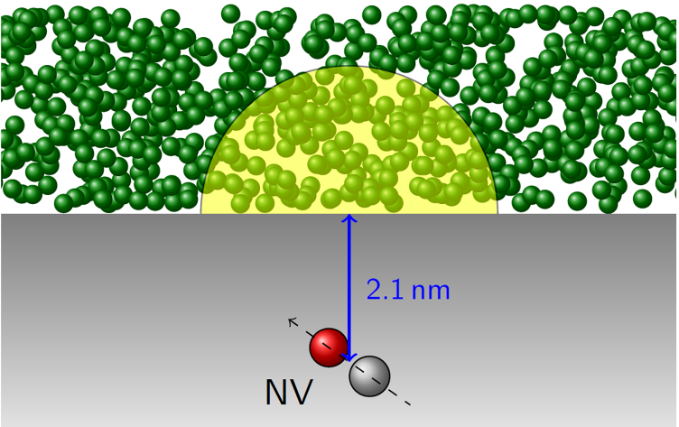
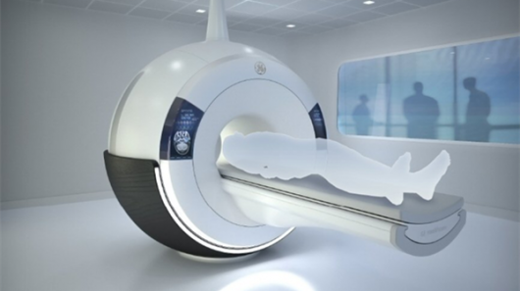
Outlook
Nuclear Spin Quantum Simulator
Nuclear Spin Polarisation of
Liquids above Diamond Surface
Fernandez-Acebal, Rosolio, Scheuer, Müller, Müller,
Schmitt, McGuinness, Schwarz, Chen, Retzker,
Naydenov, Jelezko, Plenio, Nano Letters 18, 1882 (2018)
Cai, Retzker, Jelezko, Plenio, Nature Phys. 2013
Hyperpolarised enhanced MRI
Enables metabolic MRI for cancer care, ischemic heart
disease, …

Slide 22
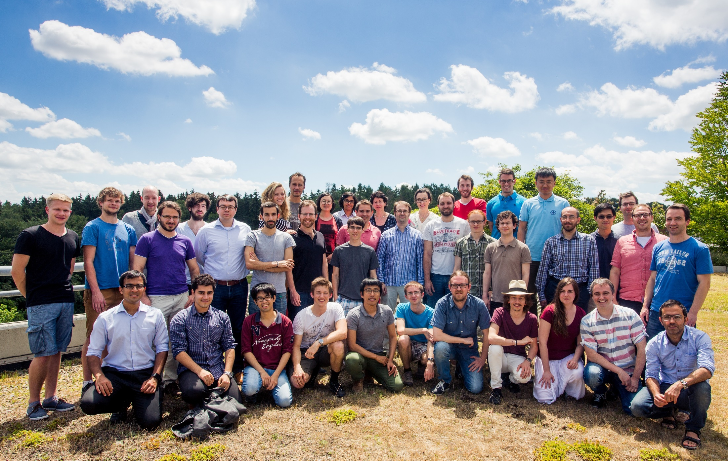
The Team @ Ulm
External Collaborators: Jianming Cai, Alex Retzker, Fedor Jelezko, Boris Naydenov, Tanja Weil

Slide 23



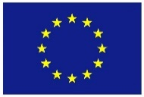


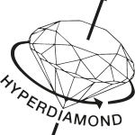


Institute
of Theoretical Physics
& Center for Quantum Biosciences
Professors
Martin Plenio
Susana Huelga
Postdocs
Ralf Aurich
Felipe Caycedo-Soler
Qiong Chen
Ish Dhand
Sandro Donadi
Myung-Joong Hwang
Jaemin Lim
Mark Mitchison
Julen Pedernales
Andrea Smirne
Zhenyu Wang
PhD students
Dario Egloff
Pelayo Fernandez-Acebal
Jan Haase
Milan Holzäpfel
Matthias Kost
Oliver Marty
Fabio Mascherpa
Andrea Mattioni
Alexander Nüßeler
Shreya Prasanna Kumar
Joachim Rosskopf
Ilai Schwarz
Alejandro Somoza Marquez
Kirill Streltsov
Thomas Theurer
Benedikt Tratzmiller
Master students
Michael Bösen Viet Tran
Fabian Höb Felix Weidner
Matthias Maucher
Synergy Grant:
Diamond Quantum
Devices and Biology
& Proof of Concept Grant
SFB TRR-21 &
SPP 1601
External Collaborators
Jianming Cai, Jorge Casanova, Alex Retzker, Fedor
Jelezko, Boris Naydenov, Liam McGuinness, Tanja Weil

