Slide 1


Accessing topological boundary phenomena using photonic waveguide arrays
PRL 109, 106402 (2012); PRL 109, 116404 (2012); PRL 110, 076403 (2013); PRL 111, 226401 (2013);
PRB 91, 064201 (2015); PRL 115, 195303 (2015), PRA 93, 043827 (2016), PRB 93, 245113 (2016),
Nat. Phys. 12, 350 (2016); Nat. Phys. 12, 624 (2016); Nature 553, 55 (2018) & Nature 553, 59 (2018),
arXiv:1802.04173 & arXiv:1805.05209
Notes:
I would to first thank Kilian, Michael, and Frederik for inviting me to speak in this symposium. I will today talk about how using time-dependent systems we can observe quantized phenomena in our world with a quantization given by the topology of a higher-dimensional manifold.

Slide 2
Accessing topological boundary phenomena using photonic waveguide arrays
T. Ozawa, H. M. Price, A. Amo, N. Goldman, M. Hafezi, L. Lu, M. Rechtsman, D. Schuster, J. Simon, OZ, and I. Carusotto, arXiv:1802.04173
PRL 109, 106402 (2012); PRL 109, 116404 (2012); PRL 110, 076403 (2013); PRL 111, 226401 (2013);
PRB 91, 064201 (2015); PRL 115, 195303 (2015), PRA 93, 043827 (2016), PRB 93, 245113 (2016),
Nat. Phys. 12, 350 (2016); Nat. Phys. 12, 624 (2016); Nature 553, 55 (2018) & Nature 553, 59 (2018),
arXiv:1802.04173 & arXiv:1805.05209
Notes:
I would to first thank Kilian, Michael, and Frederik for inviting me to speak in this symposium. I will today talk about how using time-dependent systems we can observe quantized phenomena in our world with a quantization given by the topology of a higher-dimensional manifold.

Slide 3
Photonic waveguide array
A waveguide:
A photonic crystal:
Szameit, A. et al., Opt. Expr. 15, 1579 (2007).
Lahini et al., PRL 103, 013901 (2009)
tight binding model
propagation replaces time
z
z
x

Slide 4
Photonic waveguide array
Diagonal modulation:
Off-diagonal modulation:
z
x
z
x

Slide 5
Photonic waveguide array
A. Szameit et al., Opt.
Express 13, 10 552 (2005).

Slide 6
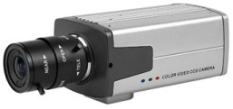
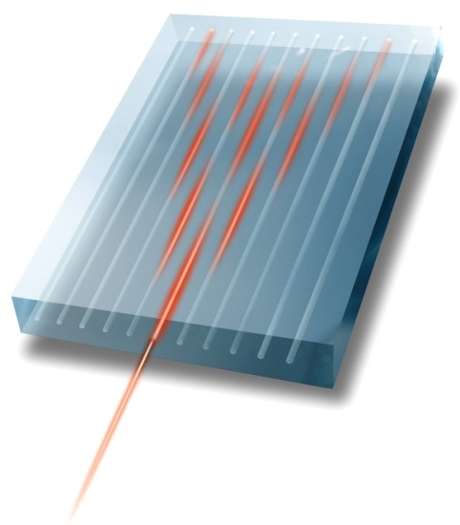
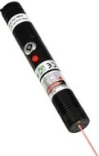
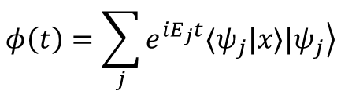
Experiment
Setup:
input: single site
output: distribution
Evolution:
overlap with eigenstates
expansion according to eigenstates
No chemical potential
z
$$φ\left(t\right)=\sum_{j}{e^{iE_{j}t}⟨ψ_{j}|x⟩\left.{|ψ}_{j}\right\rangle }$$
x

Slide 7
Topological phase transitions and bulk-boundary
phase
transition
bulk
bulk
boundary

Slide 8
Exciting the boundary

Slide 9
Floquet topological insulators
Break z-invariance
In atoms
G. Jotzu et al, Nature 515, 237 (2014)
N. Fläschner et al., Science 352, 1091 (2016)
T. Oka and H. Aoki, Phys. Rev. B 79, 081406(R) (2009); M. C. Rechtsman et al., Nature 496, 196 (2013)

Slide 10
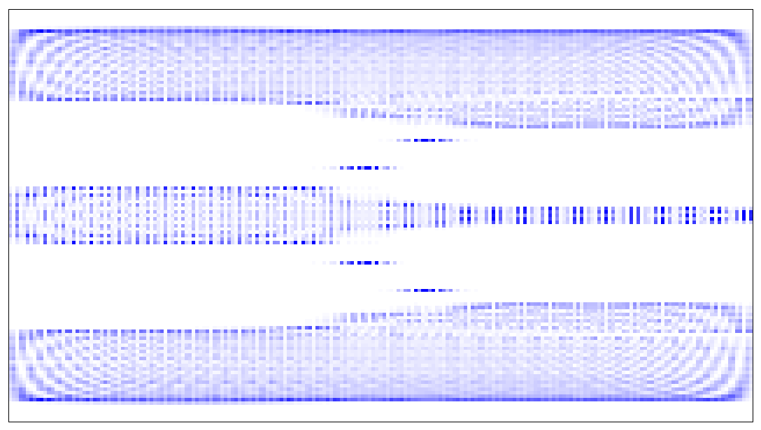
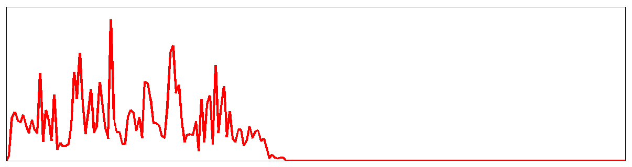
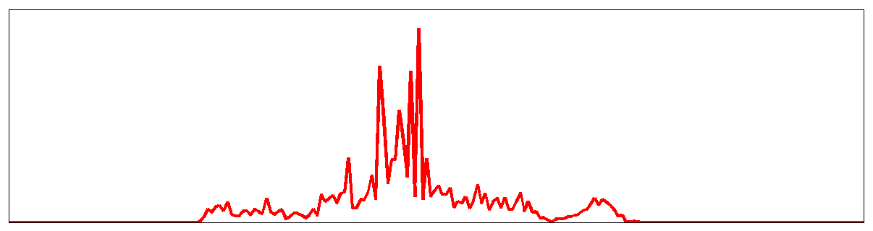
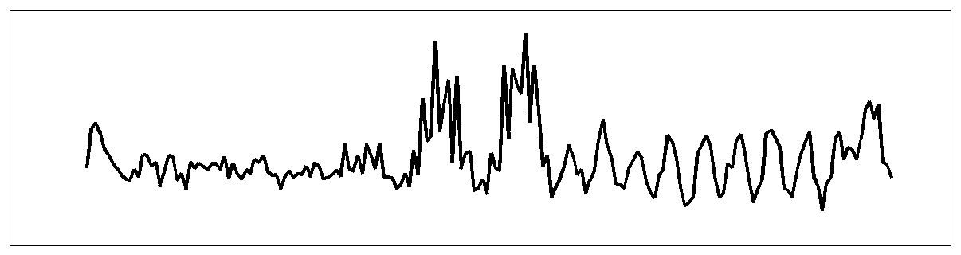
Quasi-periodic models
Fibonacci chain:
  cf., U. Schneider’s talk
L
LS
LSL
LSLLS
LSLLSLSL
2.2
E
–2.2
1
n
221
0.35
intensity
localization
0
Y. E. Kraus and OZ, Phys. Rev. Lett. 109, 116404 (2012); M. Verbin, OZ, Y. E. Kraus, Y. Lahini, and Y. Silberberg, Phys. Rev. Lett. 110, 076403 (2013)

Slide 11
Pumping the boundary

Slide 12
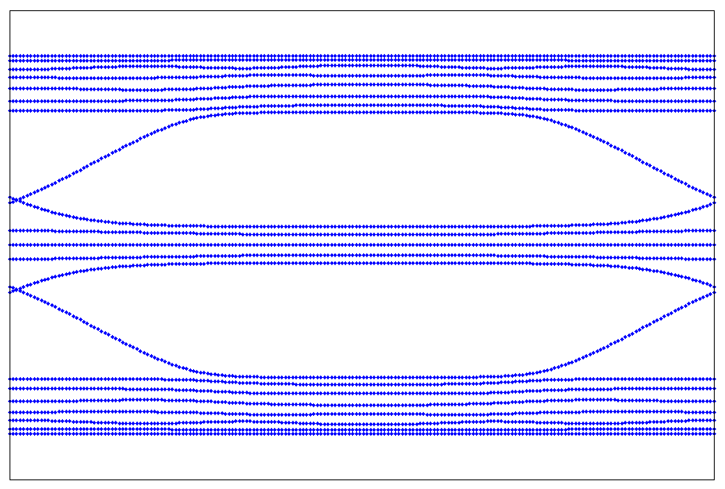
One-dimensional topological pump
Off-diagonal Harper model:
reduction
dimensional
n
2.5
x
extension
y
E
b
t_{xy}
t_{x}
-2.5
0
ϕ
2π
Y. Kraus, Y. Lahini, Z. Ringel, M. Verbin, and OZ, Phys. Rev. Lett. 109, 106402 (2012)

Slide 13
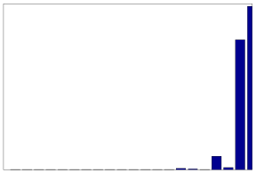
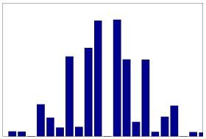
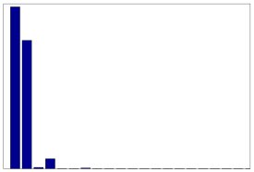
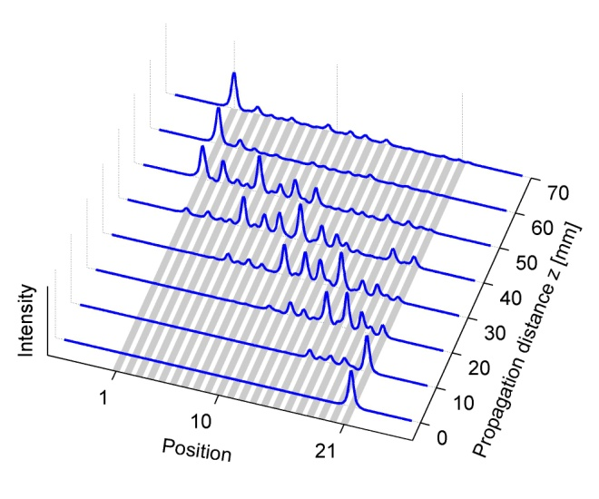
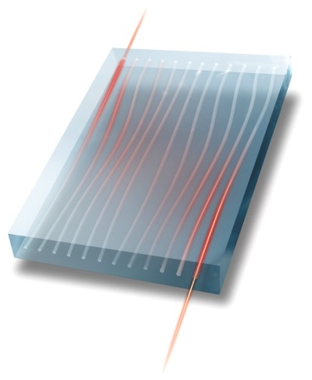
Adiabatic pumping (1D+1)
Pumping:
Adiabatic pumping:
off-diagonal
density
2.5
x
E
density
x
-2.5
0
ϕ
2π
density
x
z
intensity
z
n
Y. Kraus, Y. Lahini, Z. Ringel, M. Verbin, and OZ, Phys. Rev. Lett. 109, 106402 (2012)

Slide 14
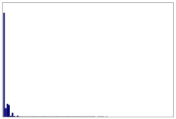
Fibonacci pumping
density
density
n
n
z
In atoms
M.. Lohse, Nat. Phys. 12, 350 (2016).
S. Nakajima et al. Nat. Phys. 12, 296 (2016)
M. Verbin , OZ, Y. Lahini, Y. E. Kraus, and Y. Silberberg, PRB 91, 064201 (2015)

Slide 15
2D photonic topological pump (2D + 2)
Topological charge pump in each direction:
  cf., K. Kraus, Z. Ringel, and OZ, PRL 111, 226401 (2013)
  And also Hannah’s talk, PRL 115, 195303 (2015), PRA 93, 043827 (2016), PRB 93 245113 (2016) with H. Price, T. Ozawa, N. Goldman, and I. Carusotto
  OZ, S. Huang, J. Guglielmon, M. Wang, K. Chen, Y. E. Kraus, and M. C. Rechtsman, Nature 553, 59 (2018)

Slide 16
2D photonic topological pump (2D + 2)
Topological charge pump in each direction:
  OZ, S. Huang, J. Guglielmon, M. Wang, K. Chen, Y. E. Kraus, and M. C. Rechtsman, Nature 553, 59 (2018)

Slide 17
2D photonic topological pump (2D + 2)
  OZ, S. Huang, J. Guglielmon, M. Wang, K. Chen, Y. E. Kraus, and M. C. Rechtsman, Nature 553, 59 (2018)

Slide 18
2D photonic topological pump (2D + 2)
In atoms
Nature 553, 55 (2018)
  OZ, S. Huang, J. Guglielmon, M. Wang, K. Chen, Y. E. Kraus, and M. C. Rechtsman, Nature 553, 59 (2018)

Slide 19
Energy resolution through fluorescent beating of modes

Slide 20
Aharonov-Bohm cages
M. Kremer, I. Petrides, E. Meyer, M. Heinrich, OZ, and A. SzameitarXiv:1805.05209

Slide 21
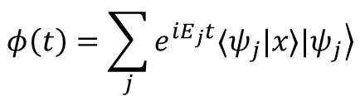


Aharonov-Bohm cages
$$±$$
$$∓$$
$$φ\left(t\right)=\sum_{j}{e^{iE_{j}t}⟨ψ_{j}|x⟩\left.{|ψ}_{j}\right\rangle }$$
M. Kremer, I. Petrides, E. Meyer, M. Heinrich, OZ, and A. SzameitarXiv:1805.05209

Slide 22
Quantum interference

Slide 23
On-chip entanglement
J.-L. Tambasco, G. Corrielli, R. J. Chapman, A. Crespi, OZ, R. Osellame, and A. Peruzzo, accepted to Sci. Adv.

Slide 24
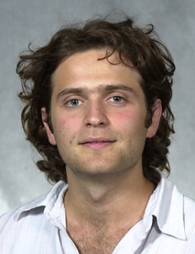
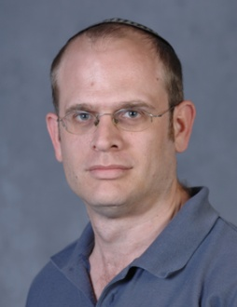
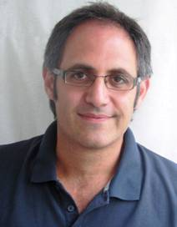
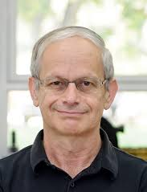
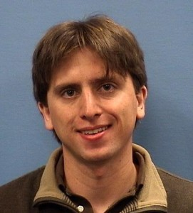
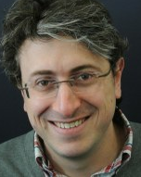

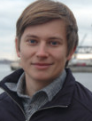


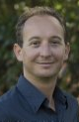

Collaborators
Photonic topological pumps
Zohar Ringel
(HUJI)
Kobi Kraus
(RIP)
Yoav Lahini
(Tel-Aviv)
Yaron Silberberg
(Weizmann)
Jonathan Guglielmon
(Penn state)
Mikael Rechtsman
(Penn state)
AB-cages
Quantum interference
Alexander Szameit
(Rostock)
Mark Kremer
(Rostock)
Jean-Luc Tambasco
(RMIT)
Roberto Osellame
(Milano)
Alberto Peruzzo
(RMIT)
Ioannis Petrides
(ETH)
Notes:
Generalizing these ideas to higher dimensions inspired physicists to postulate that our universe is curved. Current experiments, however, seem to show that it is relatively flat.

