Slide 1

Quantum and Classical thermodynamic machines: performance criteria
G. Kurizki
Weizmann Institute of Science
Coworkers: W. Niedenzu, A. Kofman, A. Ghosh, V. Mukherjee, WIS
Collaborators: O. Mustercaplioglu (Koc), A. Lvovsky (Calgary), L. Davydovich (Rio), M.O.Scully (TAMU)
Vilnius 2018

Slide 2
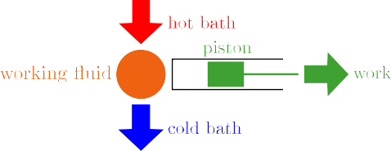
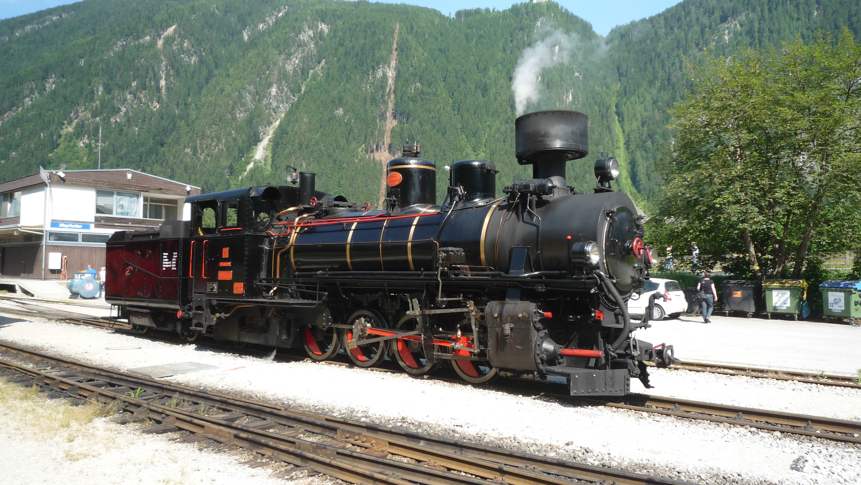

Motivation: Quantum heat engines – better than classical ?
Zillertalbahn@Wikipedia
Carnot efficiency (1824)
η := ^{−W} ≤ 1 − ^{Tc}
Q_{h} T_{h}
Quantum engines (thermal or non-thermal):
Increase efficiency beyond the Carnot bound by quantumness?
Boost power by quantumness ?
This talk: W. Niedenzu et. al., New J. Phys. 18, 083012 (2016); Nature Commun 9 165 (2018) );
A. Ghosh et al., PNAS 114, 12156 (2017); PNAS (2018); Review: arXiv: 1803.10053 [quant-ph]

Slide 3
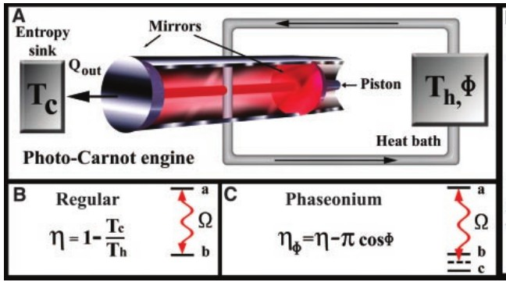
“Super-Carnot” Engines
Genuine heat engines: “Phaseonium” fuel
M. O. Scully, M. S. Zubairy, G. S. Agarwal and H. Walther, Science 299, 862 (2003).
Extra heat input via fuel coherence
→ Carnot bound for T_{c}
,T_{h}(cosφ)

Slide 4
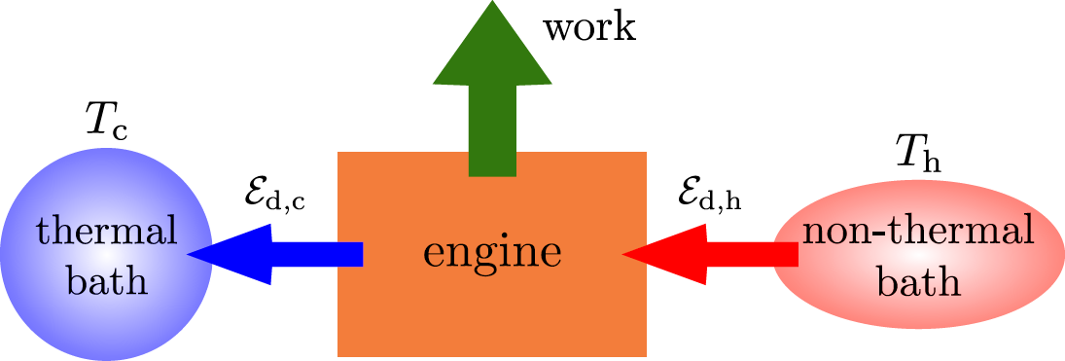
“Hybrid" engines: Squeezed thermal baths
J. Roßnagel, O. Abah, F. Schmidt-Kaler, K. Singer and E. Lutz, Phys. Rev. Lett. 112, 030602 (2014).
G. Manzano, F. Galve, R. Zambrini, and J. M. R. Parrondo, Phys. Rev. E 93, 052120 (2016).
Claim: Extra heat input via fuel squeezing?
Experiment: Optomechanical setup (Klaers et.al. PRX, 7, 031044 2017)

Slide 5
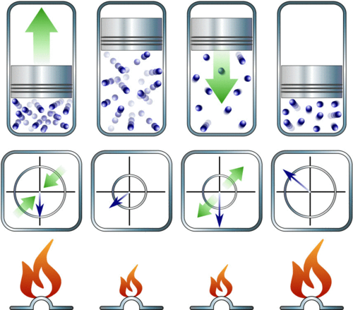
Level splitting (classical work) & coherence (quantum work)?
Kay Brandner, Michael Bauer, and Udo Seifert Phys. Rev. Lett. 119, 170602 (2017).

Slide 6




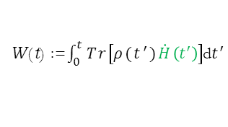
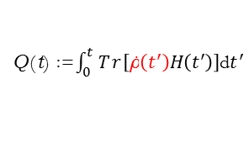
Energy exchange between a system and a bath (1st Law)
System energy E(t) = Tr[ρ(t)H(t)]:
Energy exchanged with the bath: ∆E(t) = Q (t) + W (t).
Commonly identified with
Heat:
Q(t) :=$\int_{0}^{t}{Tr\left[\text{ρ}\text{˙}\left(t^{′}\right)H\left(t^{′}\right)\right]}$d$t^{′}$
R. Alicki, J. Phys. A 12 (1979) L103
W(t) :=$\int_{0}^{t}{Tr\left[ρ(t^{′})\dot{H}\left(t^{′}\right)\right]}$d$t^{′}$
Work:
S-H Su et.al, (2017); K.Brandner et.al., PRL 119 (2017); R. Uzdin, A. Levy & R. Kosloff PRX 5 (2015).
‘‘classical’’ ‘‘quantum-coherent’’

Slide 7


Energy exchange and entropy
Introduction First law Entropy change in quantum relaxation processes Maximum engine efficiency Conclusions
The system exchanges energy with the bath, Q (t) =/ 0. But its entropy does not change.
Example: Coherent state in a cavity. No heat!

Slide 8
Radiative decay preserves the atom entropy.
Non-passive states (in both cases)

Slide 9




Introduction First law Entropy change in quantum relaxation processes
Non-passive states and ergotropy
Maximum engine efficiency
Conclusions
Same energy, different ergotropy.
non-passive passive non-passive
Ergotropy=non-passivity: maximal work extractable in a cycle: H(t_{end}) = H(t₀).
Pusz and S. L. Woronowicz, Commun. Math. Phys. 58, 273 (1978).

Slide 10










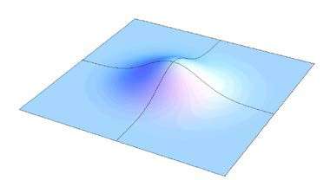

Nonpassive passive: Unitary reshuffle of eigenvalues
P
P
(π)
U
Monotonic
= passive
n
n
Passive
π
Passive - peaked at origin
non passive - displaced
The entropy of ρ(t) is that of its passive state π(t).
3

Slide 11
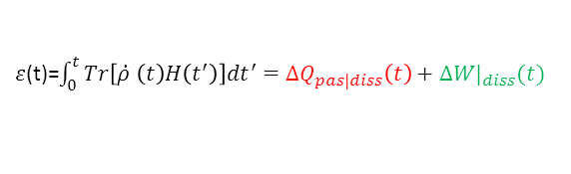
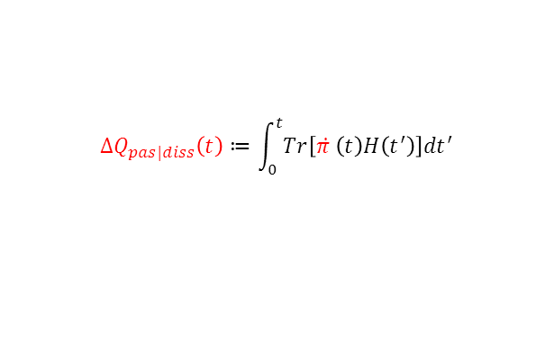
Our 1st Law Reformulation
Energy exchanged with the bath
Nature Commun. 9 165 (2018)
$ε$(t)=$\int_{0}^{t}{Tr\left[\dot{ρ }\left(t\right)H\left(t^{′}\right)\right]{dt}^{′}=ΔQ_{pas|diss}\left(t\right)+∆{W|}_{diss}(t)}$
Dissipative change in passive energy = Heat
$$ΔQ_{pas|diss}\left(t\right)≔\int_{0}^{t}{Tr\left[\dot{π }\left(t\right)H\left(t^{′}\right)\right]{dt}^{′}}$$

Slide 12


Decay of a non-passive state in a thermal bath
Second law (non-negative entropy production)
Conclusions
Spohn (1978)
∆Q_{pas} |_{diss} + ∆W |_{diss}
∆S ≥ ^{E} =
.
T T
(consistent with Clausius)
Is this the best estimate of ∆S?
2nd law doesn’t discern between passive and non-passive states

Slide 13

Conclusions
No! We contend:
Relaxation to steady state (constant Hamiltonian)
At t → ∞
∆Qpas |diss
∆S ≥
T
New inequality for ∆S
Since ∆W|_{diss} ≤ 0, our new inequality is tighter than Spohn’s.

Slide 14
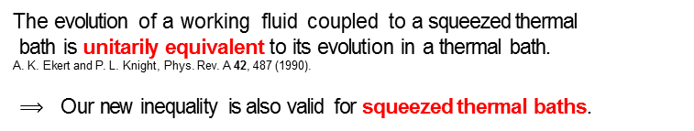

Inequality for the entropy change
For a time-dependent Hamiltonian, at t → ∞
$$∆S≥\frac{ε^{′}}{T}$$
$ε$ ' = ∆Q energy exchanged if the inital state were passive:
gen.heat
The evolution of a working fluid coupled to a squeezed thermal
bath is unitarily equivalent to its evolution in a thermal bath. A. K. Ekert and P. L. Knight, Phys. Rev. A 42, 487 (1990).
$⟹$ Our new inequality is also valid for squeezed thermal baths.

Slide 15

Introduction First law Entropy change in quantum relaxation processes
What limits the efficiency in cyclic (thermal or non-thermal) engines?
Maximum engine efficiency
Conclusions
Conditions for maximum efficiency:
Ergotropy is fully extracted (bath → piston)
Minimal heat ∆Q=T_{c}∆S_{c} is dumped into cold bath as in heat engines, but w/o reversibility.

Slide 16






Maximum engine efficiency: Universal bound
W. Niedenzu, V. Mukherjee, A. Ghosh, A. Kofman and G. K, Nat. Commun. 9 165 (2018).
Beyond 2nd law
General cycle
Thermal/
non-thermal
time dep.
time dep.
Efficiency bound from our new inequality
$η≤1−\frac{T_{c}}{T_{h}}\frac{ε_{h }^{′}}{ε_{h}}$ =:η_{max} ≤1
$ε_{h}^{′}$ exchanged energy if the bath were thermal.
Type 1:
“Mechanical” limit : $ε_{h}^{′}$⟶0: η_{max} = 1. No heat exchange
Type 2:
Heat-engine limit $ε_{h}^{′}$→ ${∆Q}_{h}$: η_{max} = η_{Carnot}.
By contrast, the bound obtained from the reversibility condition (zero entropy production) may surpass 1: unphysical! (Parrondo 2016)
Abandon Spohn’s bound to avoid unphysical efficiency bound

Slide 17
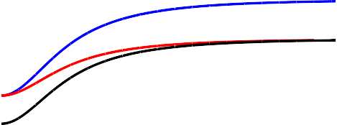

Introduction First law Entropy change in quantum relaxation processes Maximum engine efficiency
Example: Otto cycle for a squeezed bath
Conclusions
1.2
1
0.8
0.6
0.4
 |  |  | Carnot bound Σ bound our bound η
efficiency
0.2
0
0.5
1
squeezing parameter r
1.5
2
Efficiency bound
Tc ∆Qpas,h
η_{max} = 1 − _{T}
η_{C} ≤ η_{max} ≤ η_{Σ}
∆Q + W_{h}
h pas,h
Valid for all engines
$η_{c}$< η = η_{max} ≤1 only reached in the “mechanical” limit.

Slide 18

Two-level maser: quantum heat machine
A. Ghosh, D. Gelbwaser- Klimovsky, A. Lvovsky, M. O. Scully & G. K, PNAS (2018)
Autonomous machine
Signal is q. piston
$$η_{max}=\frac{ν}{ω_{0}+ν}$$
Same as Scovil-Schultz-Dubois (1959) but TLS without inversion!

Slide 19
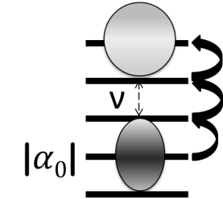
Two-level maser: quantum heat machine
Ghosh et. al., PNAS (2018)
Autonomous
Classical Signal
Modulation
Non-passive: Coherent-thermal (work + heat)
D. Gelbwaser-Klimovsky, R. Alicki, G. Kurizki, Phys. Rev. E 87, 012140 (2013)
quantum coherent signal ρ_{nm}
_{=/= 0}

Slide 20
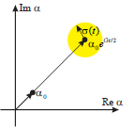
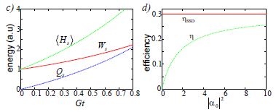
Non-passive signal: Coherent-thermal (work + heat)
Work: Classical-quantum coherence division irrelevant! Only non-passivity matters!
← Q
← W
Classical
Quantum

Slide 21
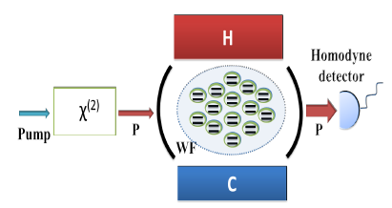
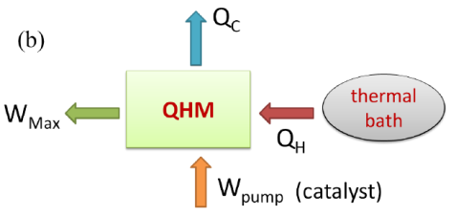

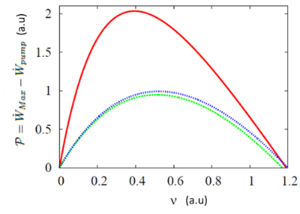
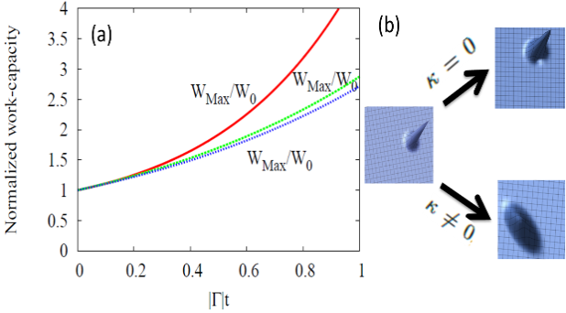
(Nonlinearly) Pumped Quantum Heat-Work Catalysis
A. Ghosh, C. Lombard, L. Davidovich & G. K, PNAS 114, 12156 (2017)
Squeezing catalysis of work/power by non-passivity
3-fold power increase

Slide 22
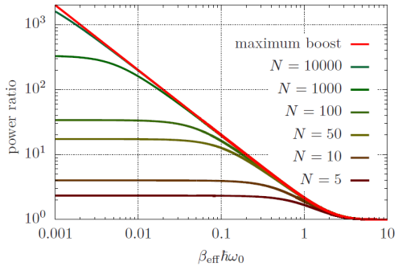
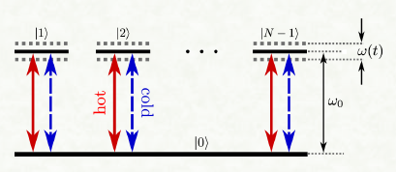
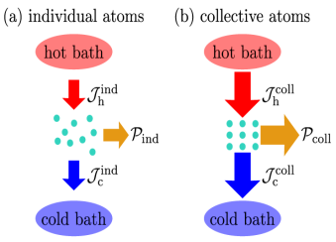


Cooperative (Dicke) quantum heat machine
W. Niedenzu & G.K.
In the high effective-temperature limit transition probabilities between individual (j excitations) are enhanced by the Clebsch–Gordan coefficients

Slide 23
Summary
Heat: a fraction of the energy exchanged with a bath that yields entropy change – 1st Law reformulated
New inequality for ∆S beyond the 2nd law: Only due to passive state change.
Maximum efficiency of quantum engines: minimal loss (energy dumped into cold bath): for non-thermal baths it does not imply reversibility.
Are there advantages in machines with quantum resources? Yes, if they change non-passivity or temp./entropy: no principle difference with classical resources.
Piston coherence
Working fluid Piston squeezing – classical/quantum?
coop. (Dicke) boost

