Slide 1
Quantum control of
Ultracold atoms near surfaces
Opportunities
  Arbitrary lattice designs and length scales
  Interfacing different lattice geometries
  Controlled disorder, designer defects, …
Challenges
  Stray electric fields
  (esp. when working with Rydberg atoms)
  Short lifetimes in sub-micron traps
  Johnson noise near metal surfaces

Slide 2
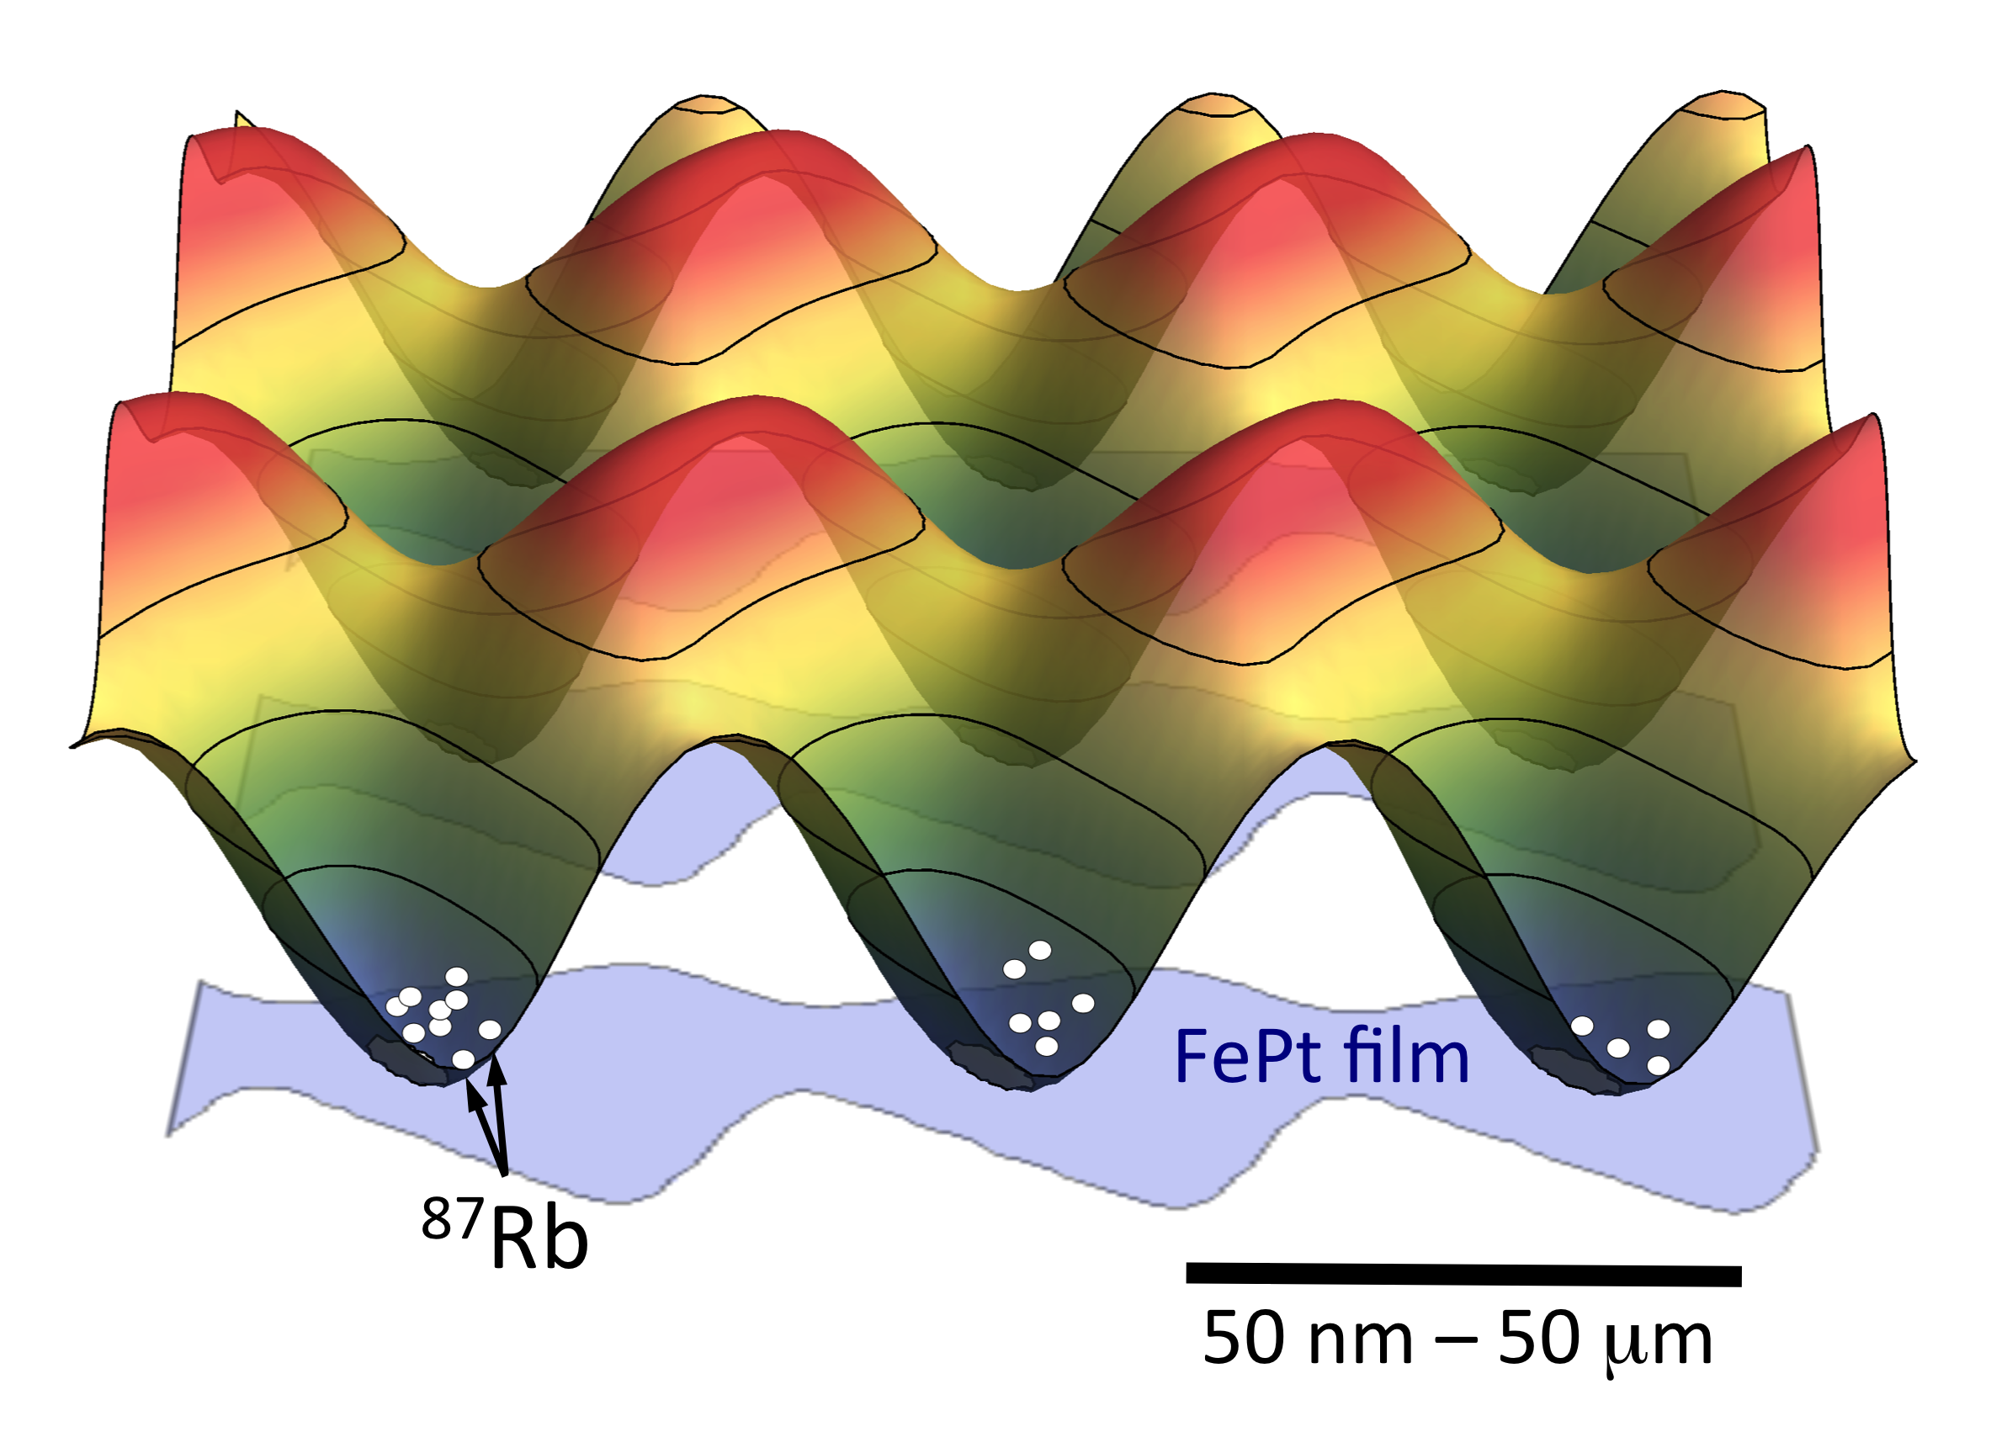

Magnetic trapping: Z-wires
Magnetic trapping potential
V(r)=g_{F} m_{F} μ_{B} |B(r)|
B_{bias}
Current carrying wire
Edge of permanent
magnet film
I_{wire}
~ 3 mm
B_{bias}
(in plane)
M
~ 1 mm
I_{eff} = 0.15 A
Notes:
Short on magnetic trapping:
Different levels, previous slide F=2, mf=+2, goal is trapping F=1, mf=-1 and coherent transitions to F=2, mf=+1
Qubit transitions.
Need two photon’s to go from one to the other.
To go from
We trap and cool our atoms using conventional Laser cooling and Magnetic trapping techniques.
Starting with hyperfine structure of the Rb ground state. What I want you to note is that the red states shift up in energy due to the Magnetic field. These states are also called low field seeking states. And therefore we can Magnetically trap these states. The F=1 mf=-1 state is the state we are currently trapping in.
How do these traps work? For this we need the stage before loading the atom chip, where we use a Z-wire trap. We drive a current trough the wire, this induces a magnetic field around the wire, in addition to that we apply an external Bias field. At a certain hight above this wire, the fields (almost) cancel eachother, creating a local field minimum, and that is where our atoms are trapped. You can see this here, the red sigar shape is our cloud of atoms that is trapped in the field minimum.
To give you an idea, the length scales of this trap are about 3 mm for the entire length of the z-wire and the sigar cloud is about 1 mm long.
Now, we go to the atom chip. The atom chip is sitting on top of the Z-wire in our setup, and thus in between the wire and the atoms.
The atom chip is a permanent magnetic FePt structure, covering about 3 mm^2. The grey parts are FePt, the white parts are not. The FePt is magnetized out of plane inducing a magnetization current allong the edges of the structures. If we now look at the edges, we see that they are actually tiny little Z-wire, carrying an effective current.
So again adding an external magnetic field, we can make magnetic traps there, the microtraps. The trapping potential now basically looks like and egg box. The atoms will be trapped in the blue parts of the potential landscape. The last thing I want you to note is that we have here a square geometry of traps. Due to this specific pattern. Now, al real nice in theory, but does it actually work?
----- Meeting Notes (1/20/14 10:40) -----
Increase size of text!
- Bias fields, two words, remove!
- Images of utraps:
- Pattern of magnetized material
- Only squares
- 200 nm thick FePt
- add 3D immage as impression
Image:
- Ground STATE! add 6.8GHz
-

Slide 3
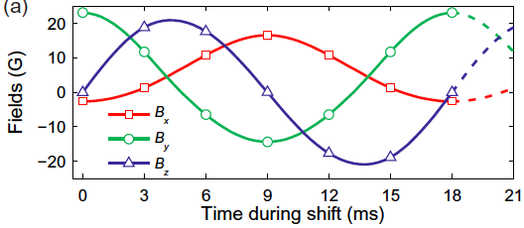
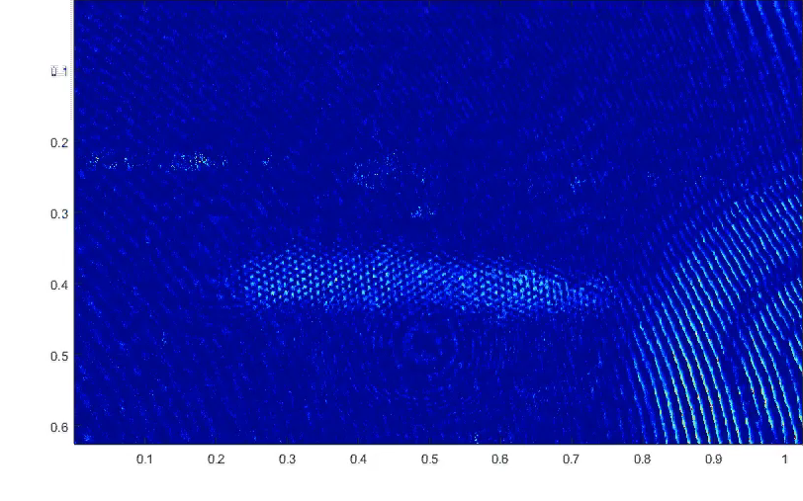
Conveyor belt (crossing the interface)
external field B_{x}(t) , B_{y}(t) , B_{z}(t) makes ‘cycles in B-space’
y (mm)
x (mm)

Slide 4
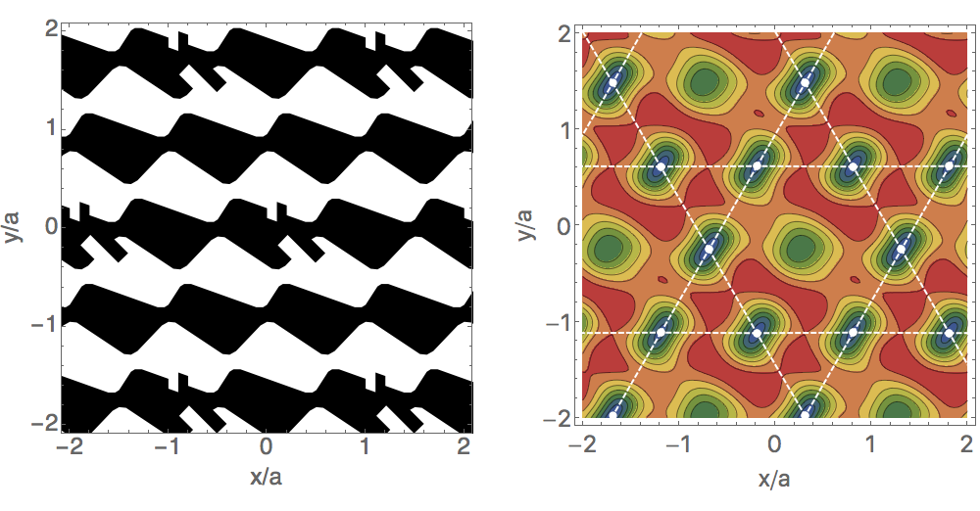
Kagome: triangular + designer defects
Magnetic film
Potential landscape

Slide 5
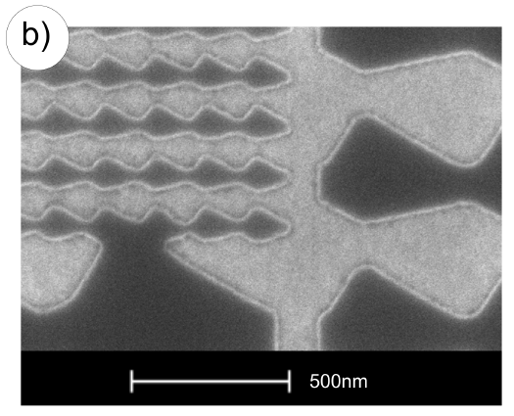
Smaller lattices
e-beam lithography
Plasma etching
Monocrystalline
FePt,
epitaxially grown (KU Leuven)

Slide 6
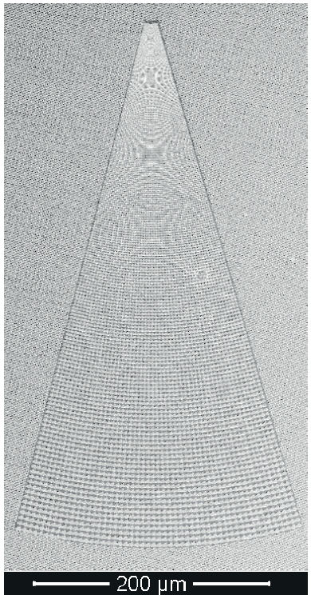
Tapered lattice
250 nm
e-beam lithography,
plasma etching
Combine with conveyor belt:
  Load at 5 μm
  Shift to … nm
  Shift back
  Detect at 5 μm
May solve loading and imaging resolution problems
5 μm

Slide 7


Slide 8
Electric fields from adsorbates
Measured by Rydberg EIT
nl
480 nm
5p
adsorbed Rb
(< 0.01 ML)
780 nm
5s
E
Rydberg Stark shifts
caused by Rb adatoms
Obrecht et al., PRA 2007
A. Tauschinsky et al.,
PRA 81, 063411 (2010)
H. Kubler et al., Nat. Photon. 2010
Abel et al., PRA 2011
Hattermann et al., PRA 2012
Notes:
In response: add layer of quartz, cleanable by LIAD

Slide 9
Tübingen group
Rydberg EIT
Hattermann et al., PRA 2012

Slide 10
Oklahoma group
Sedlacek et al., PRL 2016
Rb adsorbate causes negative electron affinity
Low-E Electrons cancel surface fields
Requires atomically flat surface, <5Å, for uniform adsorbate layer
(here: single Xtal quartz)

Slide 11
ENS group (Paris)
Cryogenic atom chip
Chip covered by metallic layer of Rb
Coherence time as long as Rydberg lifetime
Distance to surface 550μm
Hermann-Avigliano et al., PRA 2014

Slide 12
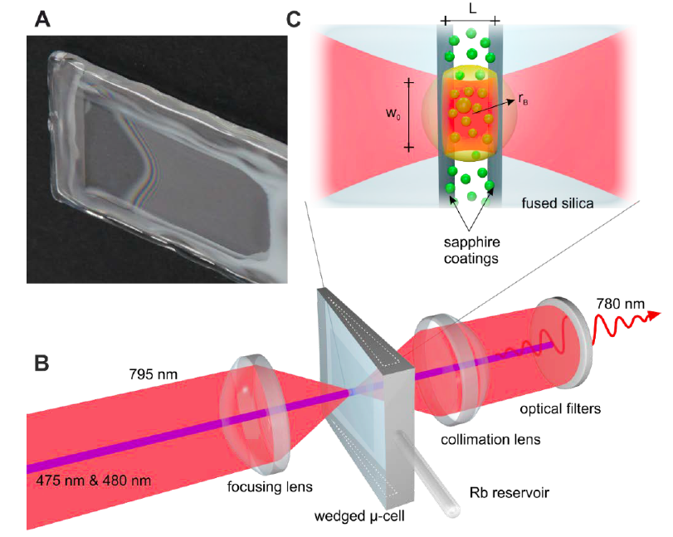
Stuttgart group
Hot, thermal atoms, above room-T
Micron size cavities
Surface uniformly coated with Rb
arXiv:1806.02120

Slide 13
Swinburne (Melbourne)
Wang et al. PRA 2017
Co/Pd multilayer film, 10nm total
Distance to surface ~ few 100 nm
Short lifetime seems due to 1D evaporation (room for improvement)
Loading is nontrivial: ω_{trap} changes by ~3 orders of magnitude
(from 10² – 10³ Hz down to ~ 10⁵ – 10⁶ Hz)

Slide 14
Ultracold atoms near surfaces
Quantum control: challenging, not quite there yet
Is this a rare case where hot atoms are better suited?

